Slide 1
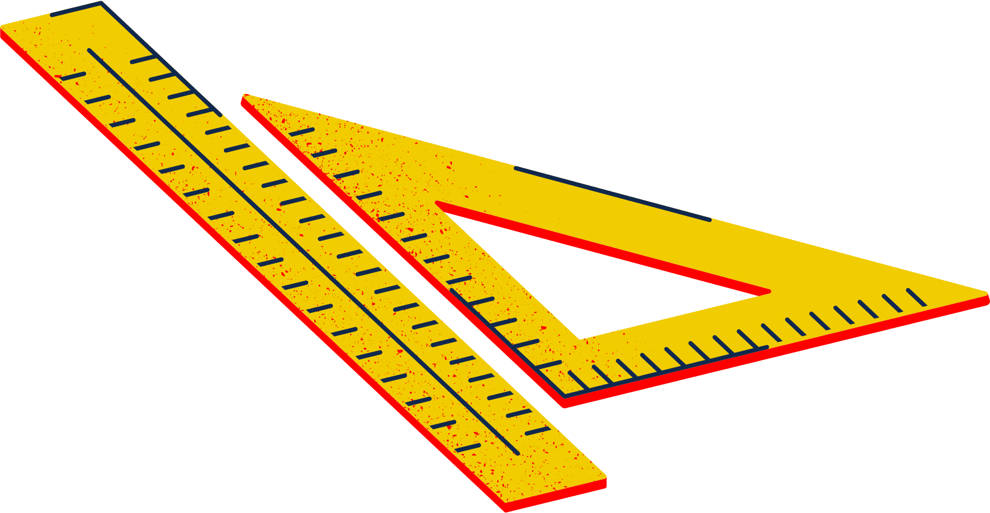
Intro to Arduino Workshop

Slide 2
AGENDA FOR TODAY
About Robogals
Introduction to Coding
Electronics Safety Debrief
Activity Instructions
Testing
Notes:
2. Introduction to Coding
What is coding?
Why do we learn coding?

Slide 3
ABOUT ROBOGALS
OUR MISSION:
INSPIRE, EMPOWER AND ENGAGE!
Non-profit, international and student-run organization
Bring diversity into STEM-related careers, especially in engineering!
More than 30 Chapters across the globe in over 10 different countries.

Slide 4
What is Coding?
Used in almost every electronic device (i.e. computers, cell phones, even in rockets!)
Also known as programming
The written instructions that tell a computer what to do
More than 700 programming languages!
Python, HTML, JavaScript, C++

Slide 5
Why Learn Coding Now?
Many jobs can be done faster using coding
Scientists, engineers, and even business owners can use coding to do tasks easier, faster, and more accurately
It is not easy
The earlier you learn, the more practice you will get
It is fun!
You can make your own games, apps, websites, and code your own devices

Slide 6
Safety First!
We must be safe when working to avoid injuries or damaging the equipment!
Ask a Volunteer to check your circuit BEFORE you plug-in your device
A volunteer will come check your circuit to ensure it work properly
Shock Hazard
Some circuit components can hold electricity even if it’s off (i.e. capacitors)
Tip: Handle electronics as if they are on and dangerous at all times to avoid any injuries

Slide 7
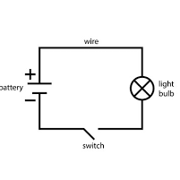
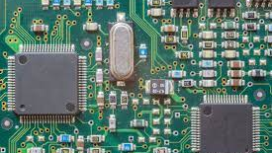
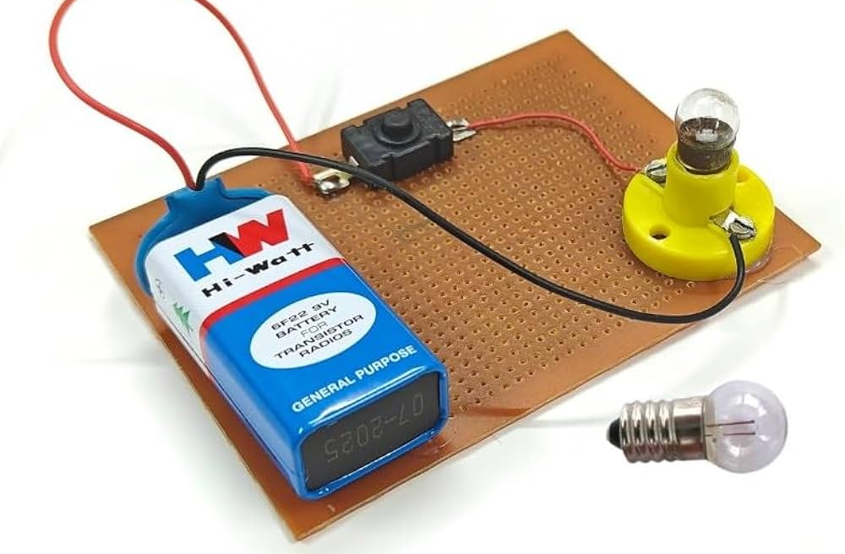
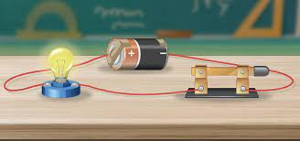
Circuit Basics

Slide 8
Ohm’s Law: Current, Voltage and Resistance
Current I (measured in Amperes or Amps)
The flow of electrons which are tiny particles that move through wires and do work
Think of this as water flowing through a hose. It can flow very fast or very slow
Voltage V (measured in Volts)
The force that pushes electrons through a circuit to produce electricity
Electrical “height” or potential energy between two points
Resistance R (measured in Ohms 𝛀)
Something that resists the flow of electrons in a circuit
Think of someone stepping on a garden hose when you are watering plants

Slide 9
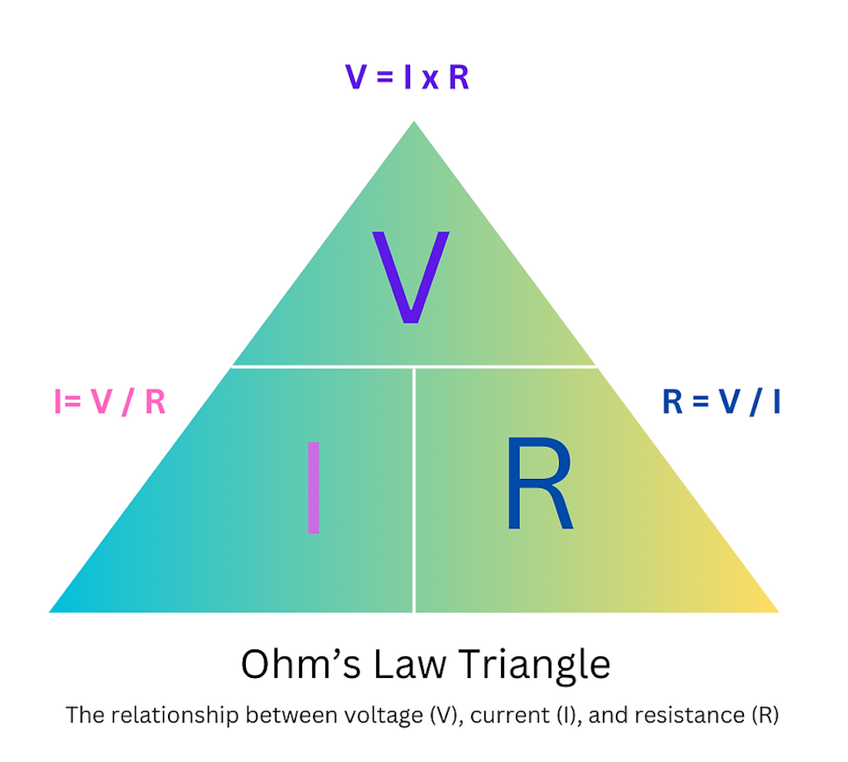
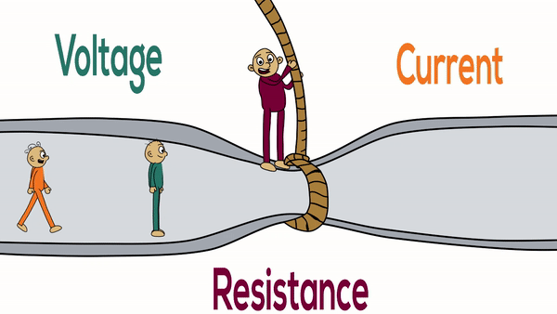
Ohm’s Triangle
Ohm’s Law Analogy

Slide 10
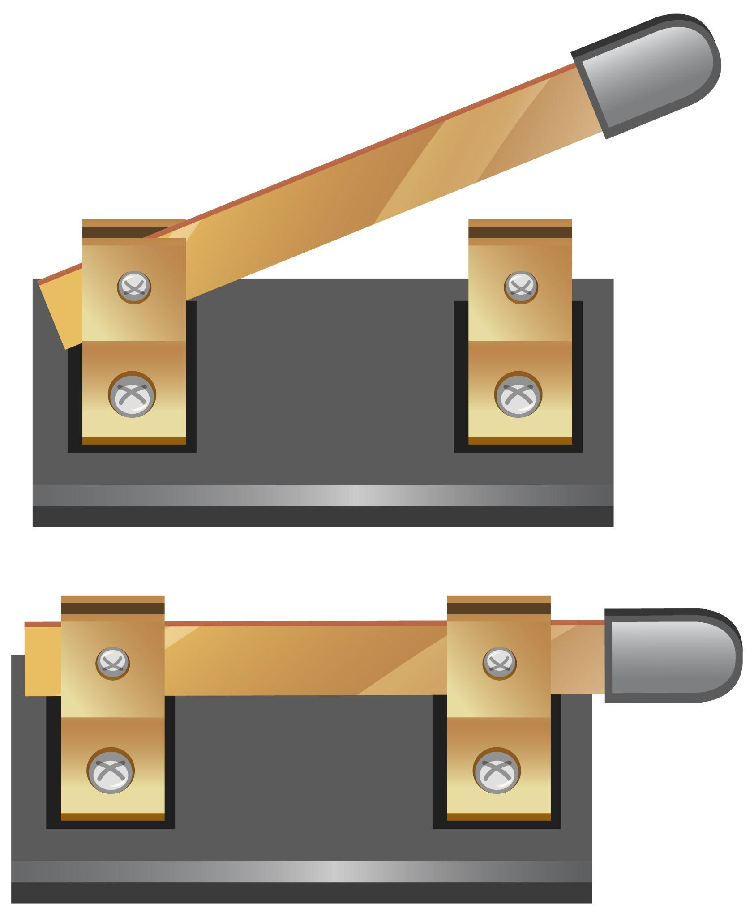
Circuit Components
Resistor
Small device that “steps on the hose” and slows down the flow of electrons
Used to protect devices like LED lights
Produces heat (this is how space heaters work)
Switch
Turns the flow of electrons on or off (just like a lightswitch)
Fun Fact: cell phones use more than 15 BILLION super tiny switches called transistors that turn on and off more than 5 BILLION times per second

Slide 11
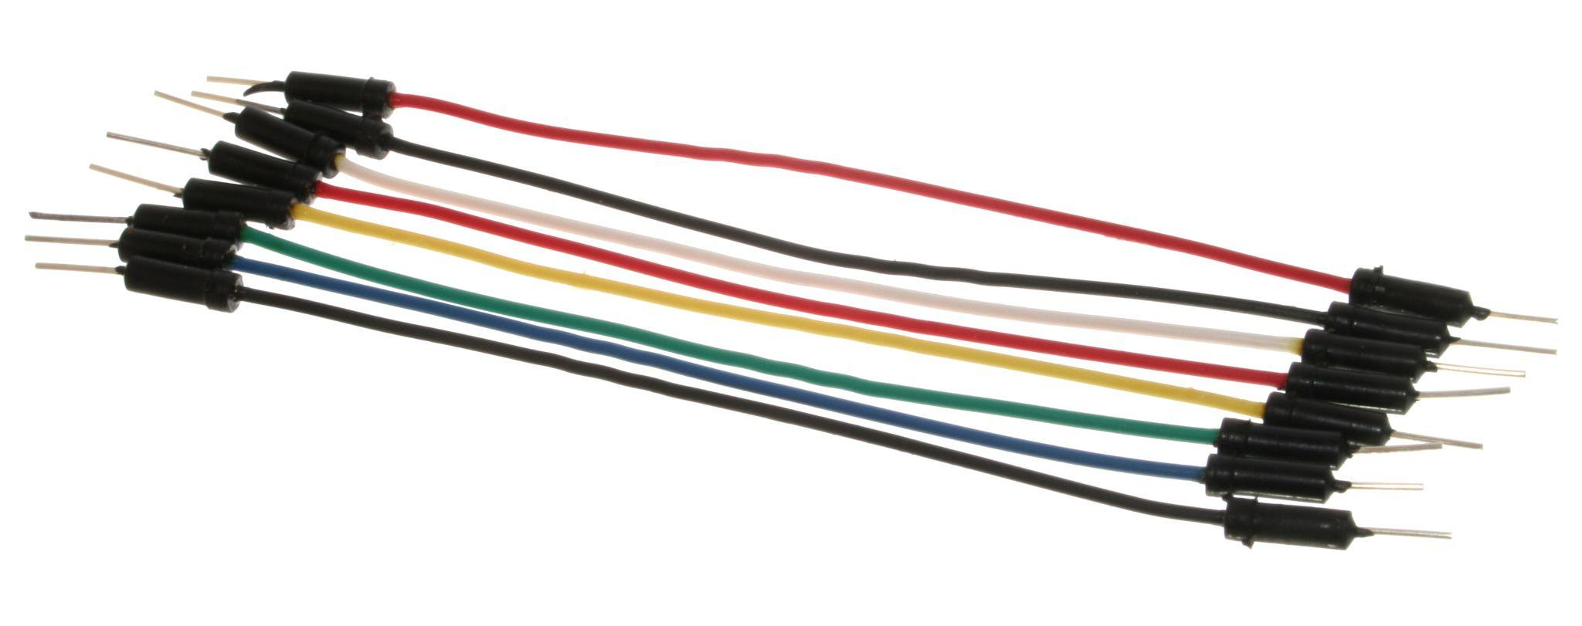
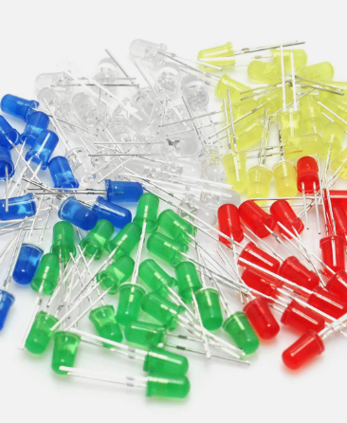
Circuit Components
Wire/Conductor
Wires are made of conductive metal (can carry electricity) that connect different parts of the circuit together
LED Bulb
LEDs (Light Emitting Diodes) produces light when electrons get excited inside the bulb
So many different colours can be made with LEDs and they use very little power

Slide 12
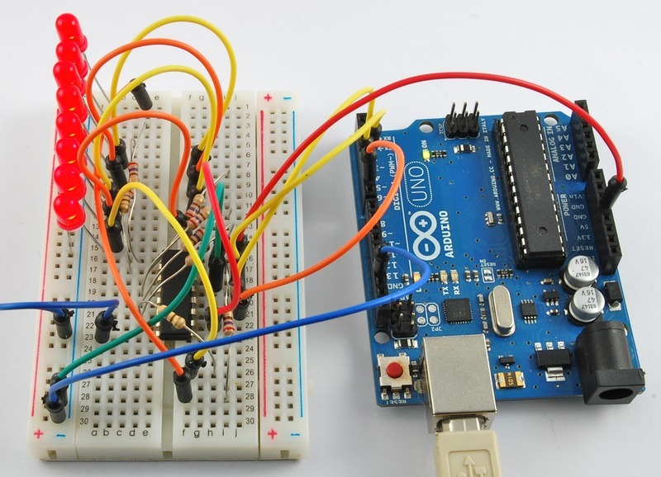
Arduinos
Small computers with inputs and outputs
You can program code onto them
Used to make robots, self watering gardens, and even game consoles

Slide 13
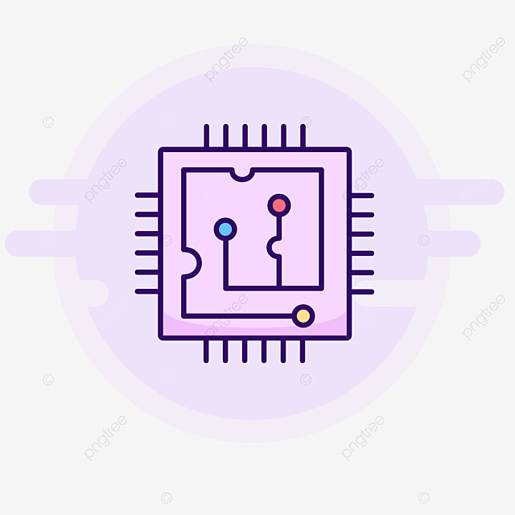
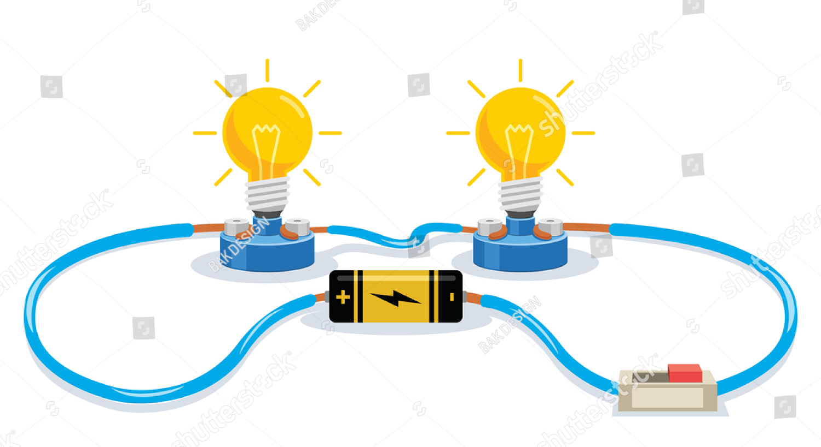
Activity Time

Slide 14
Step-by-step Instructions
1) Connect the 5V pin to the plus and the GND pin to the minus
2) Insert your switch into the breadboard
3) Insert a “10K” resistor near the switch
4) Use the white wire (green in photo) to connect the switch pin across from the resistor to pin 2 on the Arduino
10K

Slide 15
Step-by-step Instructions
5) Connect the bottom left pin of the switch to positive (beside red line)
6) Connect the other end of the resistor to the negative (beside blue line)

Slide 16
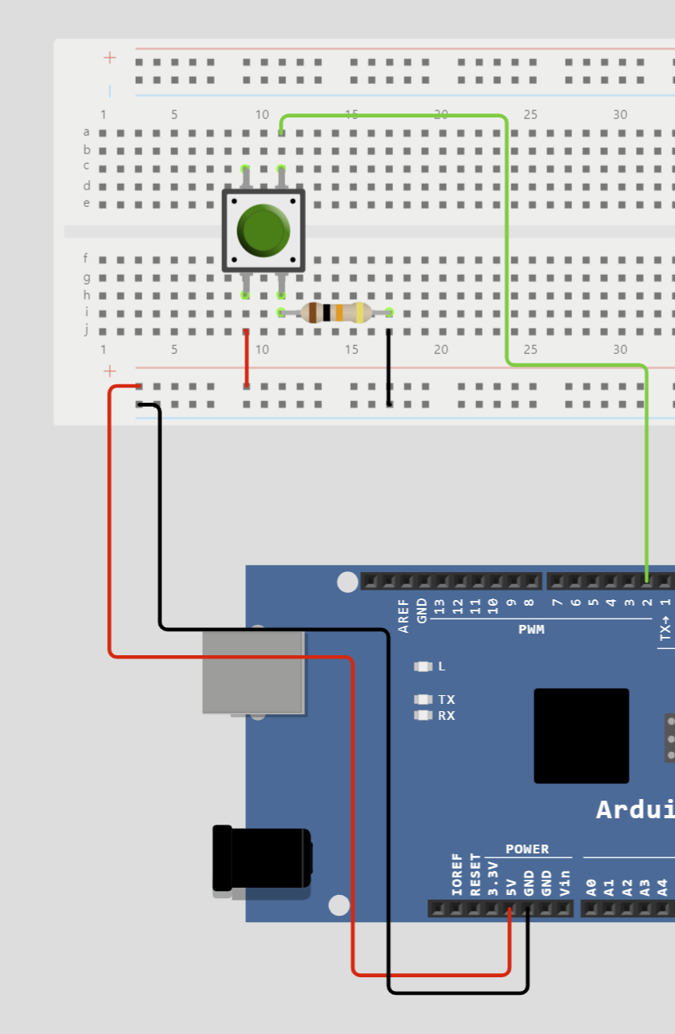
What it Should Look Like So Far

Slide 17
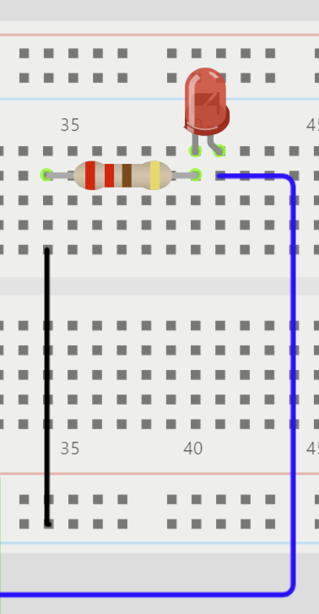
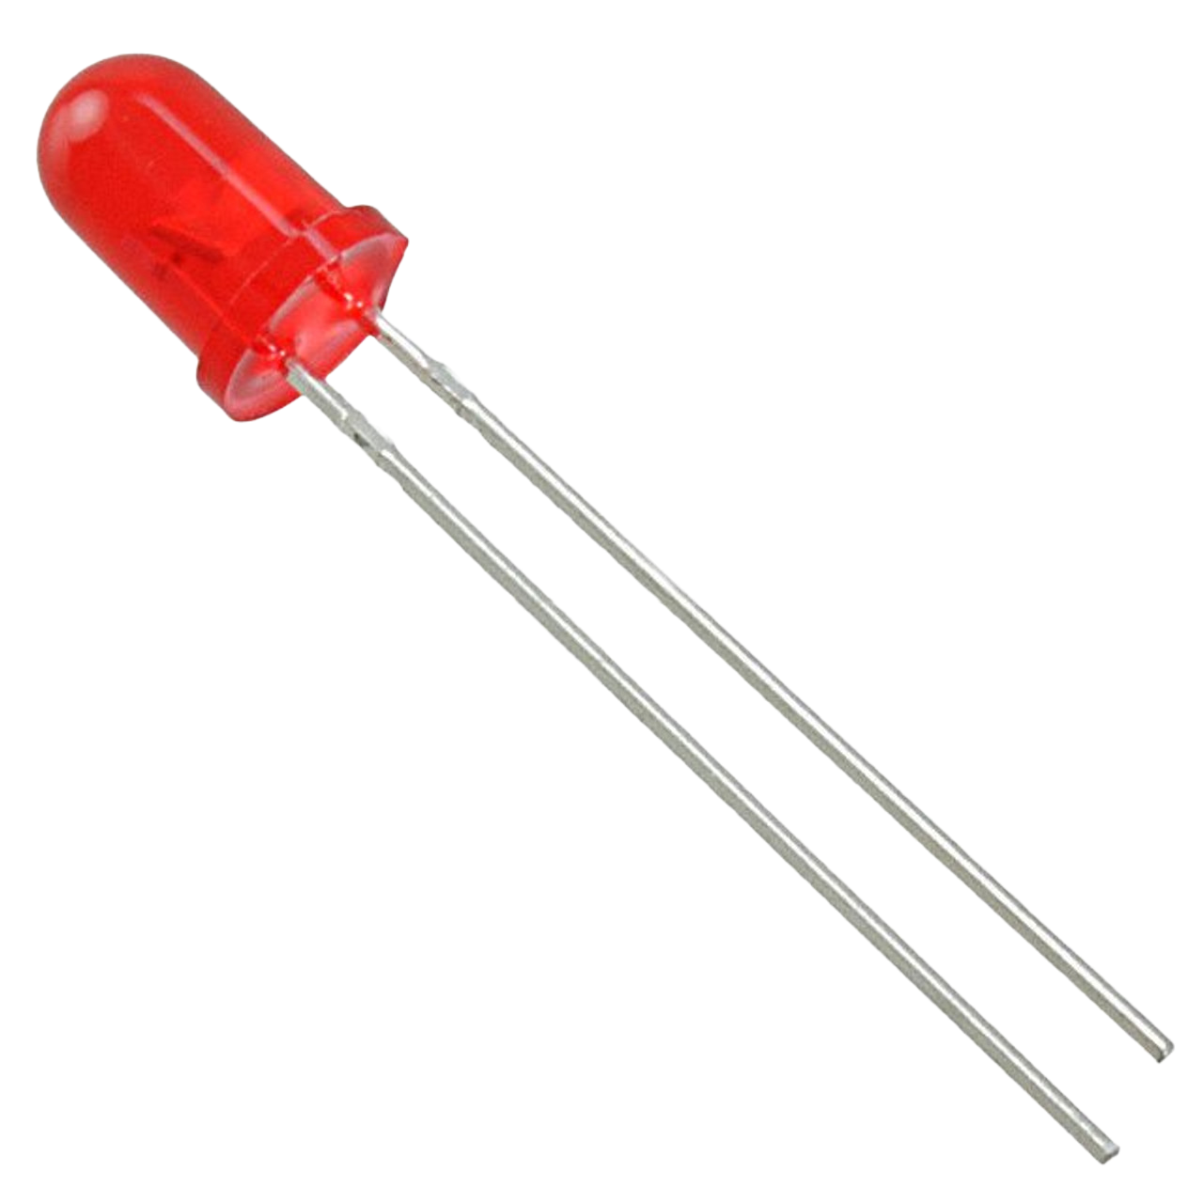
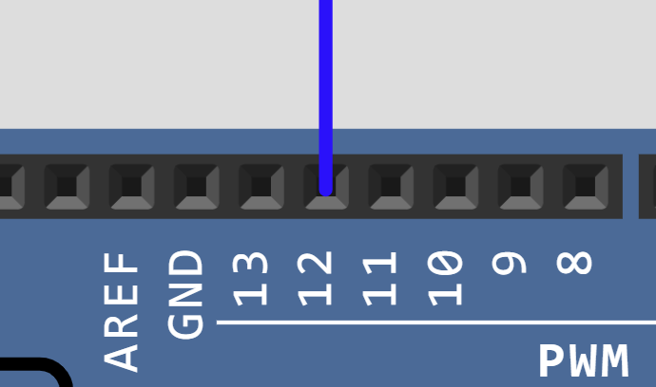
Step-by-step Instructions
7) Insert the LED (any colour) as shown with the LONG leg on the RIGHT side
8) Insert the “220Ω” resistor, with one end connected to the SHORT leg of the LED
9) Connect the other end of the resistor to the negative (beside blue line)
10) Connect pin 13 to the LONG leg (RIGHT side) of the LED
220Ω
LONG

Slide 18
code.makewitharduino.com

Slide 19
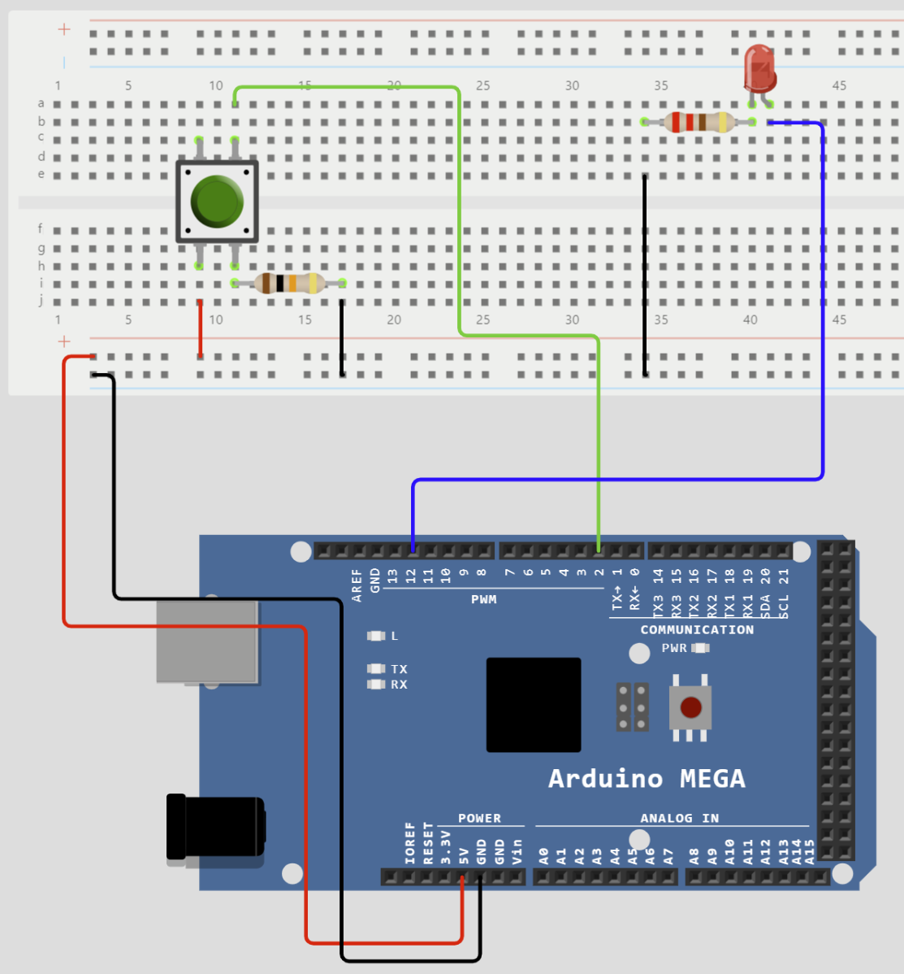
Full Schematic

Slide 20
Today’s Code
void setup() {
pinMode(**input pin number**, INPUT);
pinMode(**output pin number**, OUTPUT);
}
Pick these numbers once you analyze the circuit
Hint: the pin connected to the LED will be the output

Slide 21
Coding Basics

Slide 22
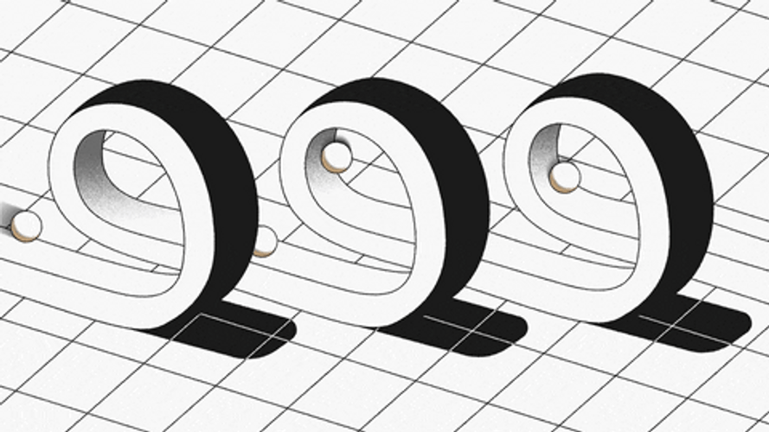
Coding Fundamentals
Loop
Will do something forever, or until you tell the computer to stop
If/Elseif/Else Statements
Will do something IF something happens
Will do something ELSE IF something happens
Will do something ELSE when nothing happens
Void Setup and Void Loop (Arduinos)
Sets your variables (e.g. x = 1 or in our case Pin 2 = An Input Pin)
Read and Set Commands (Arduinos)
Read the input from a digital pin (HIGH or LOW which is ON or OFF)
Set the output to a digital pin (HIGH or LOW)

Slide 23
Today’s Code
The code will read as:
If digital pin #____ detects voltage (high), allow voltage to leave pin #____. Otherwise, set turn digital pin #____ off.
See if you can convert this to block code.

Slide 24
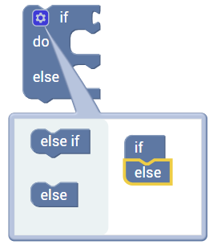
Where to Find The Blocks We Need
Location | Blocks
Logic
Input/Output

Slide 25
THANK YOU!

Slide 26
Done Early?
If you have mastered the button activity, we can move onto a more advanced dimming activity
This activity will use ANALOG (dim, medium, and bright) outputs instead of DIGITAL (ON/OFF) outputs

Slide 27
Analog with Arduino
Since analog can be more than just on and off, it needs two instructions instead of just 1
First Instruction: Output pin
Second Instruction: Fade speed
FUN FACT: Since the Arduino board is digital, it actually simulates the dimming by turning a switch on and off very fast

Slide 28
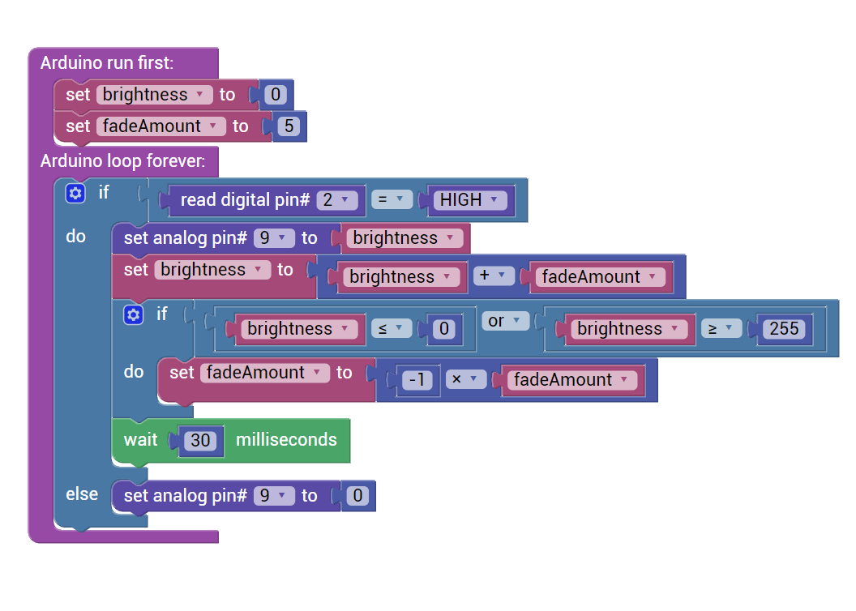
Key Changes
Functions
Variables
(need to make a new variable)
Math
Logic
Inputs/Outputs
Logic
Math
Time
Logic

