Slide 1
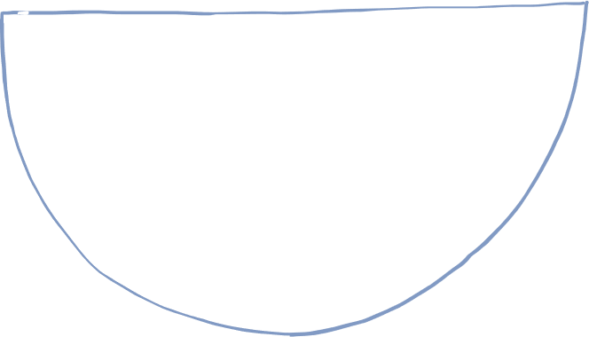
Introduction to Engineering Week 1:
Bridges

Slide 2
AGENDA FOR TODAY
About Robogals and STEM
Sketch Activity and Role Model of the Day
Icebreaker
Introduction to Civil Engineering
Challenge

Slide 3
ABOUT ROBOGALS
OUR MISSION:
INSPIRE, EMPOWER AND ENGAGE!
Non-profit, international and student-run organization
Bring diversity into STEM-related careers, especially in engineering!
More than 30 Chapters across the globe in over 10 different countries.

Slide 4
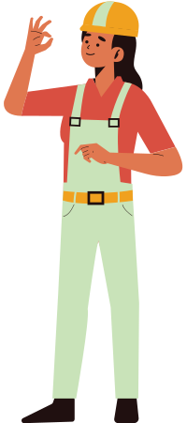
What is STEM?
SCIENCE
TECHNOLOGY
ENGINEERING
MATHEMATICS
Notes:
We have been mentioning the word “STEM” a lot! So, we are going to go over what is STEM and what it stands for.
Science: a system of studying, testing, and experimenting on things in nature. Science is a search for general laws about how the world works.
Give EX. biology, chemistry, physics, astronomy, meterology
Technology: The use of science to invent useful things or solve problems. Anything man-made
EX. chair, computer, shoelaces
Engineering: Designs and builds complex products, machines, systems, or structures. Engineers want to know how and why things work.
Math: Science that explains numbers, quantities, measurements, and the relations between them
You will learn more about each letter in the next two weeks.

Slide 5
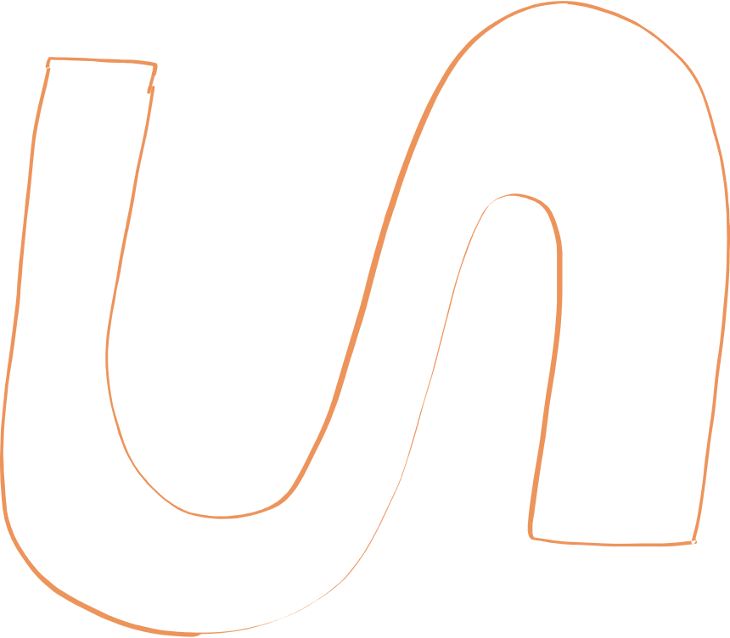
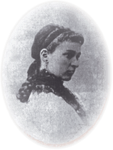
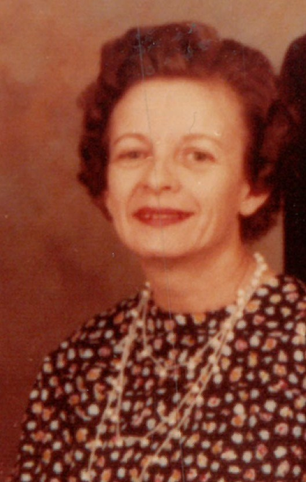
Elizabeth Bragg
Role Model of the Day
First woman to receive a Bachelor’s degree in civil engineering degree from an American University in 1876 (University of California, Berkeley)

Slide 6
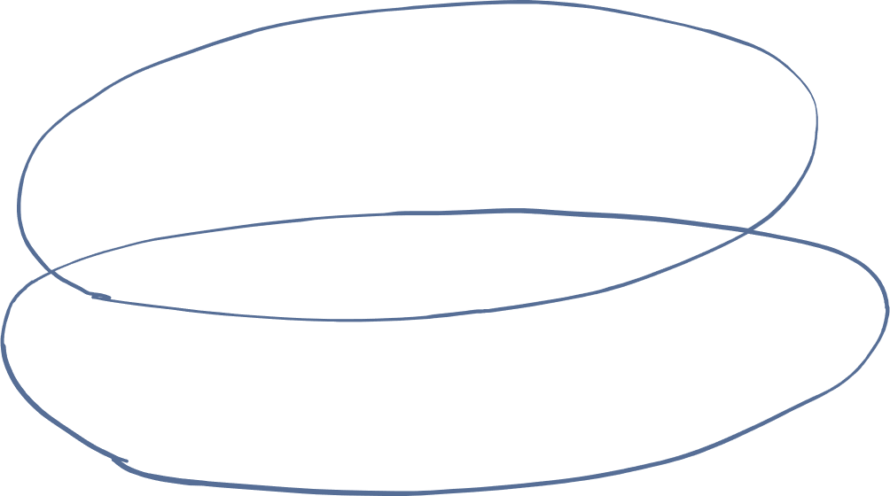
Icebreaker!
Notes:
Let see how organized you are!
We are going to play a game is called Lines and blobs.
I’m going to ask you something and you guys are going to have to either line up or group in a blob depending on what I ask you.
So, for example, if I say “get into blobs depending on your favorite season”, you have to find everyone who likes the same season as you and make a blob (group). So in total, we should have 4 blobs for this example.
1. blob by favorite season→ I like Winter so everybody who likes winter has to blob around me!
2. blob by favorite color
3. line by birthday or by height
I want you to draw what you think people in STEM look like and what they do.
Draw someone who works in Science, Technology, Engineering and Math. What are they doing?

Slide 7
SKETCH ACTIVITY!
Notes:
We are going to do a short 5 minute sketch activity.
I want you to draw what you think people in STEM look like and what they do.
Draw someone who works in Science, Technology, Engineering and Math. What are they doing?

Slide 8
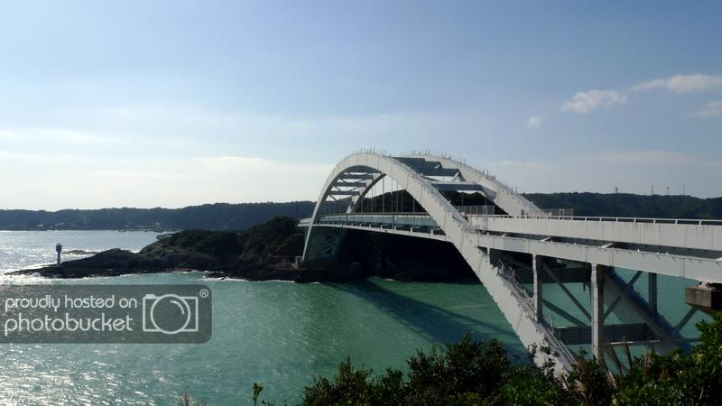
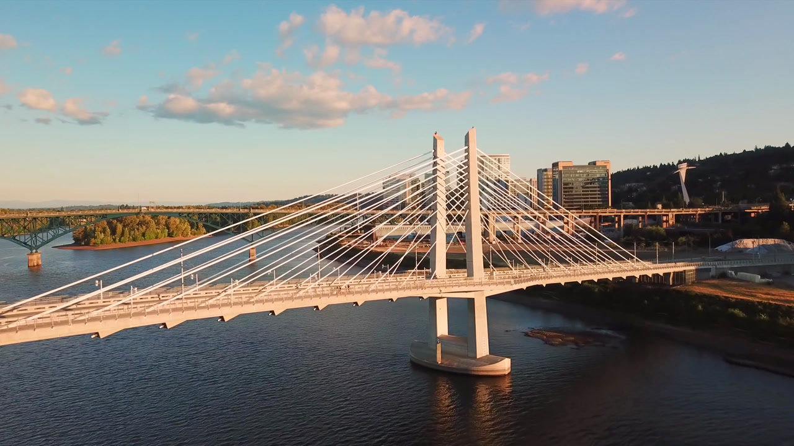
Civil Engineering
Design and construction of:
Roads
Buildings
Train systems
Bridges
Notes:
It is considered the second-oldest engineering discipline after military engineering. Way back in the day when you would study engineering it was because you wanted to join the military or army, so military engineering. But after the wars ended there were many engineers who didn’t have jobs. That is where civil engineering started. These engineers decided to build and design complex system, products that would make our lives easier so they were interested in making their area of living better.

Slide 9
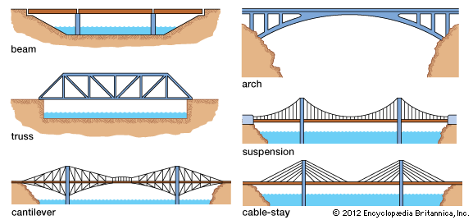
Types of Bridges
Notes:
Beam - Most simple and common type of bridge, most highway bridges are beam types and their span is quite short since their have no supports throughout the bridge only at the two ends
Arch - Most popular types of bridges. They of course have a curved arch and fun fact they become stronger over time. (built to compress)
Truss - Have triangle units that allow it carry very heavy loads, like industrial trucks and trains. These triangle units can be placed differently depending on the strength of the bridge that you want.
Suspension - It can span over long distances and inexpensive to build compares to the others we talked about. They have cables attached to each end of the poles

Slide 10
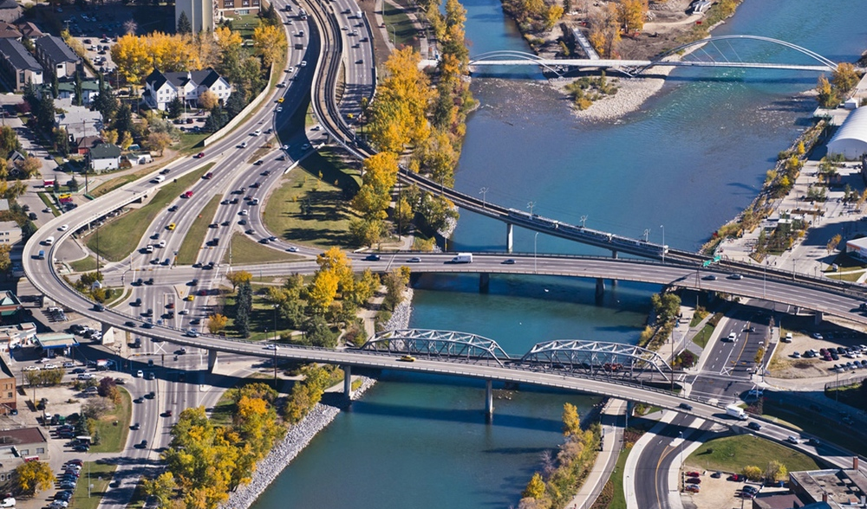
Take a look at bridges in Calgary!

Slide 11
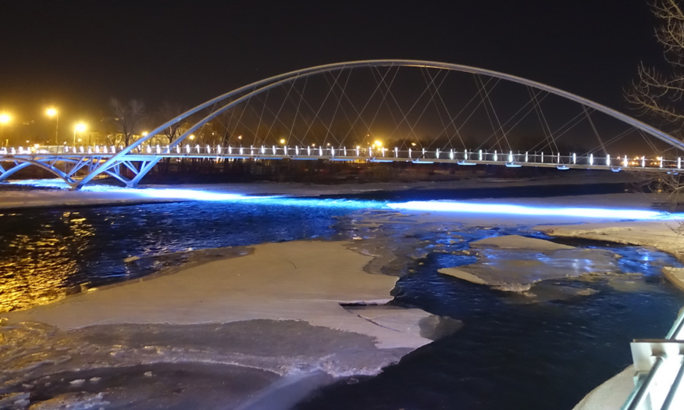
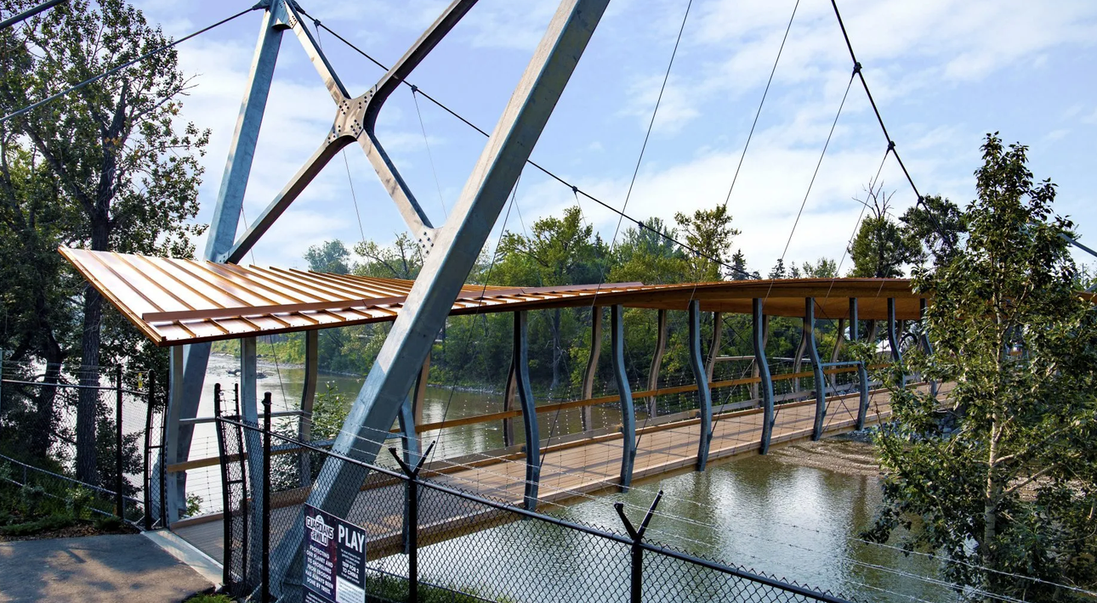
Suspension Bridges
St. Patrick’s Bridge
Calgary Zoo Pedestrian Bridge

Slide 12
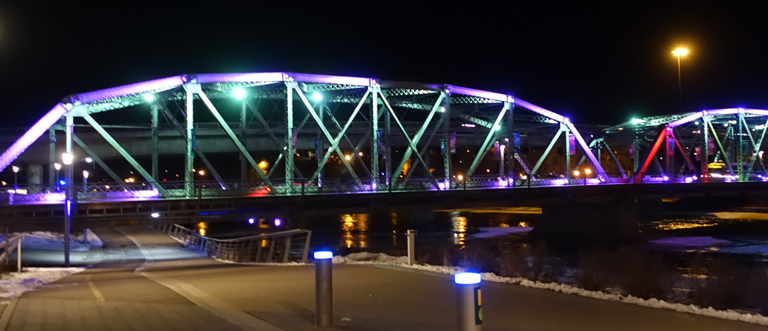
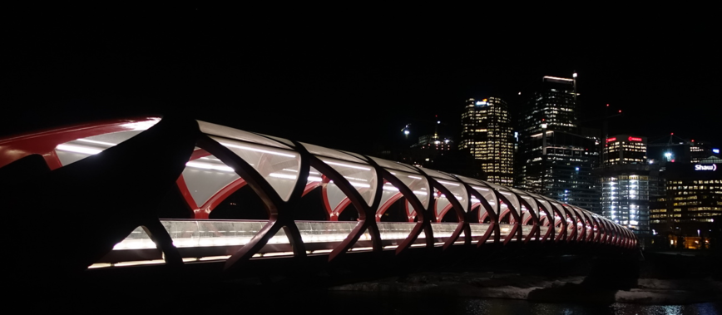
Truss Bridges
Reconciliation Bridge
Peace Bridge

Slide 13
CHALLENGE TIME!
Notes:
We are going to do a short 5 minute sketch activity.
I want you to draw what you think people in STEM look like and what they do.
Draw someone who works in Science, Technology, Engineering and Math. What are they doing?

Slide 14
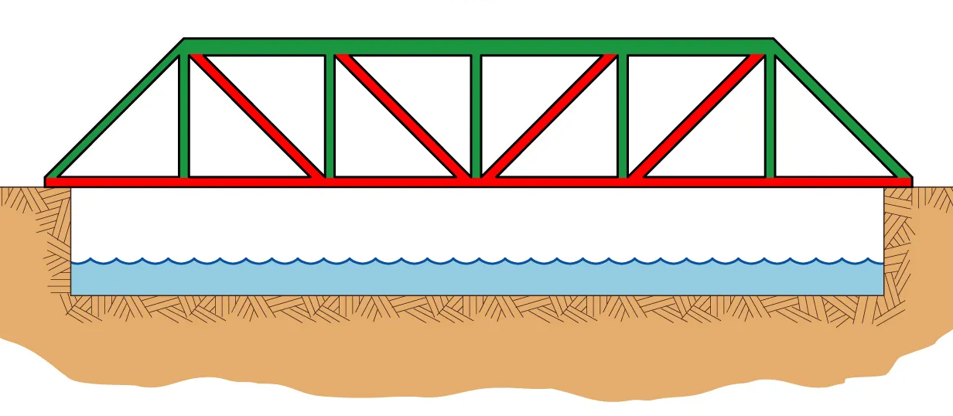
Challenge: Build a truss bridge that can hold as many weights as possible
Rules:
Bridge must be limited to 30 cm in length
Bridge must be able to hold 2 weights minimum
You can break popsicles sticks if needed
Only materials given:
2 metres of tape
30 popsicle sticks
Notes:
We are going to do a short 5 minute sketch activity.
I want you to draw what you think people in STEM look like and what they do.
Draw someone who works in Science, Technology, Engineering and Math. What are they doing?

Slide 15
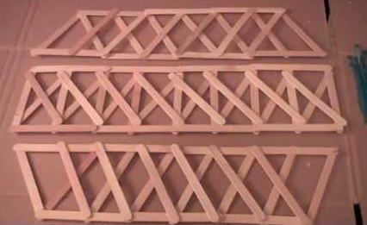
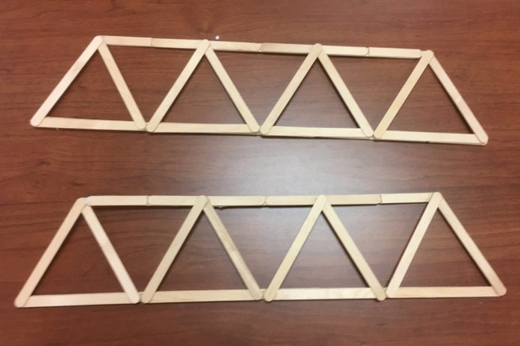
Tips!

Slide 16
SEE YOU NEXT WEEK!

