Slide 2
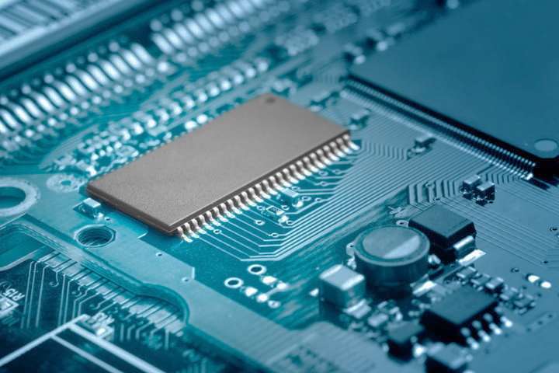
Plan for the Day

Slide 3
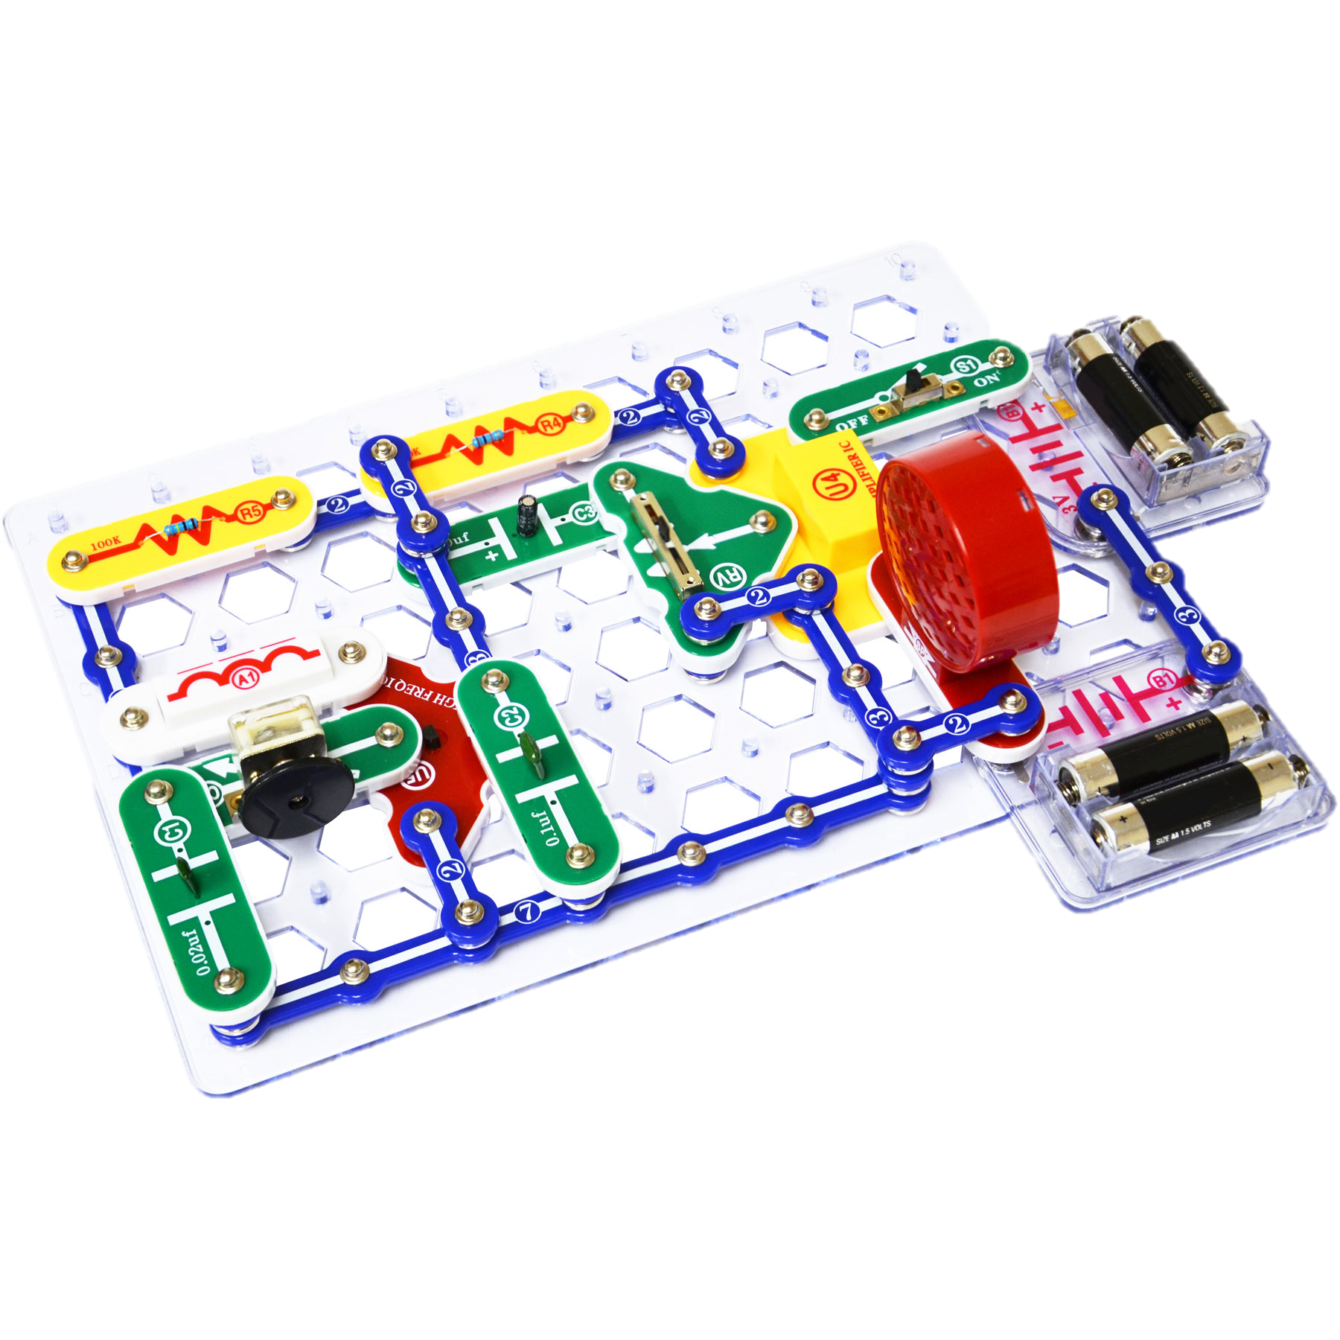
Plan for the day
What is Electrical Engineering?
Role Model of the Day
Electricity and Circuits
Activity of the Day
Snap Circuits
Morse Code

Slide 4
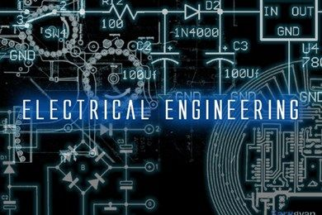
Notes:
What is Electrical Engineering?
Give definition of electrical engineering
Jobs in Electrical Engineering?
Many different industries, generally they work with other engineers in their projects
For ex. To make electronics they also work with mechanical, chemical, software, material, and manufacturing engineers

Slide 5
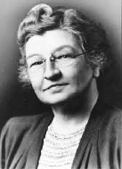
Role model of the day
Edith Clarke
First female electrical engineer and first female professor of electrical engineering in the US.
Invented the “Clarke Calculator”, which was a graphing calculator that simplified equations that electrical engineers used at the time.
Inducted into the Inventors Hall of Fame in 2015
Notes:
She was
the first professionally employed female engineer
The first full time female professor of electrical engineering
The inventor of the Clarke Calculator
Inducted into the Inventors hall of fame in 2015
She lived from 1883-1959

Slide 6
Electricity
Notes:
Who knows what electricity is? (does anyone? LOL)
So electricity is something that has always existed, even in nature.
- Can you think of any examples of electricity in nature? [Static electricity, lightning]
But what actually is electricity?
Have you guys heard of things called electrons?
- yes! -> Can someone explain what they are?
- no … -> How about Atoms?
So electrons are teeny tiny negative “charges” that are a part of atoms. And since atoms make up everything in the world … electrons are in everything!
Electricity is the movement of electrons, and since electrons are in everything … that’s why electricity has always existed!

Slide 7
Circuits
Notes:
So what is a circuit?
Defn: a path in which electrons flow.
You can think of it like cars driving on a road (this analogy will continue throughout)
Circuits use the energy created by this movement of electrons to do other things.
Can you think of some things we use circuits for?
Lights, electronics …. Pretty much everything
So what are some of the parts of a circuit?
Wires: “transport” electricity (the road)
Power Source (batteries): this “pushes” electrons in the circuit
Switches: Control the flow of electricity. (Like stop lights on a road)
Other things such as lights which use electricity to operate (usually the desired effect of your circuit)

Slide 8
Notes:
We are going to be using snap circuits today to make our circuits. Don’t worry I’ll explain all the pieces.
So … from the name … Can anyone guess how our circuits are put together?
*Presentation should be very hands on from now on*
Who can remember the basic parts of a circuits that we just discussed?
- Have them list out: Power Source, Wires, Switches, EXTRAS (don’t tell them about the lights yet)
Alrighty, So our first piece from the snap circuits is ….

Slide 9
The WIRE
Notes:
*Pick up the “wires” so you can show students up close”
These are called “Snap Wires” and they come in different sizes. And like the name suggests, they are the wires for your circuit. They connect all the other pieces. They are always blue.

Slide 10
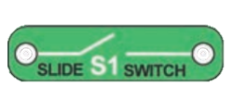
SWITCHES
Notes:
*Pick up the different switches to show the difference”
The switches are always green and labeled with an S
There are different kinds of switches and a circuits can have more than one!
The different types of circuits are press switches and slide switches (Show the differences)

Slide 11
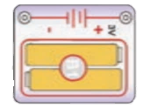
Battery
Holder
Notes:
*Pick up the battery holder”
So this is your power source. It’s where we put the batteries in. Without batteries … your circuit won’t do anything.

Slide 12
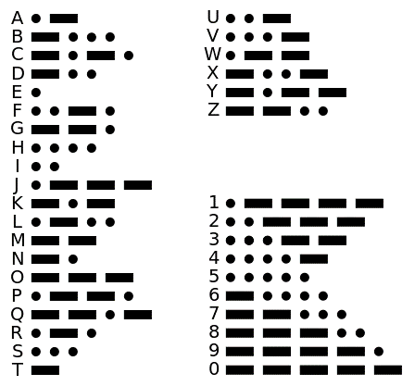
MORSE
CODE
Notes:
So this is the morse code “alphabet”
Morse code is a way of communicating using light or sound.
The way that it works is each bar = the length of three dots (give example by taping on something)
In between the dots/bars in a letter there is a space (so when I lift my finger that’s a space, when I tap down that’s a dot, and when I hold down that’s a bar)
In between letters there are 3 spaces (give example … Hi S [or any other letter])
In between words there are 7 spaces
Makes sense right?

Slide 13
Here’s The Situation
Notes:
Rules:
Plan your circuits first -> do a little sketch of the layout of the circuit
Build your circuit
(for morse code, make sure the room isn’t too big)
(sailor on a ship – do an SOS call)

Slide 14
What did you learn today?

