Slide 1
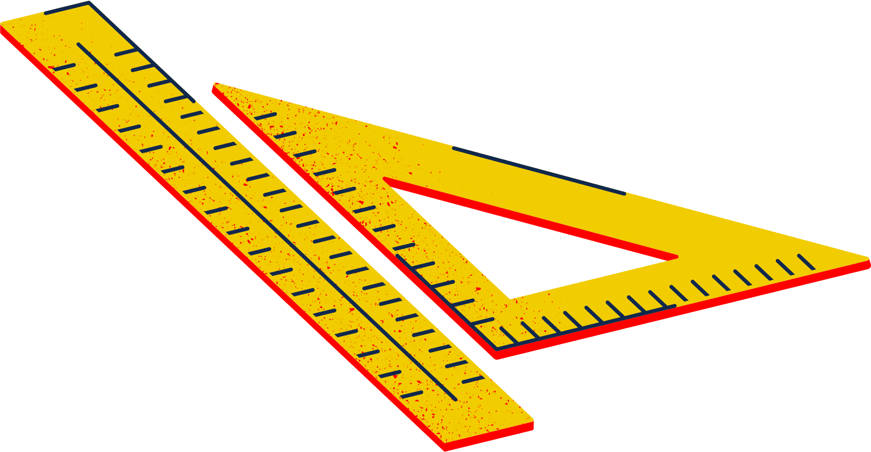
Robotics Workshop

Slide 2
AGENDA FOR TODAY
About Robogals
Role Model of The Day
Robots in Real Life
Materials and Software
Activity

Slide 3
ABOUT ROBOGALS
OUR MISSION:
INSPIRE, EMPOWER AND ENGAGE!
Non-profit, international and student-run organization
Bring diversity into STEM-related careers, especially in engineering!
More than 30 Chapters across the globe in over 10 different countries.

Slide 4
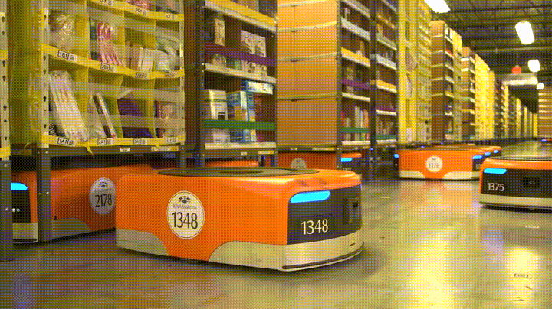
Amazon Warehouse Robots
Carry heavy shelves filled with items
Bring items to the workers
Makes finding things in the warehouse very quick

Slide 5
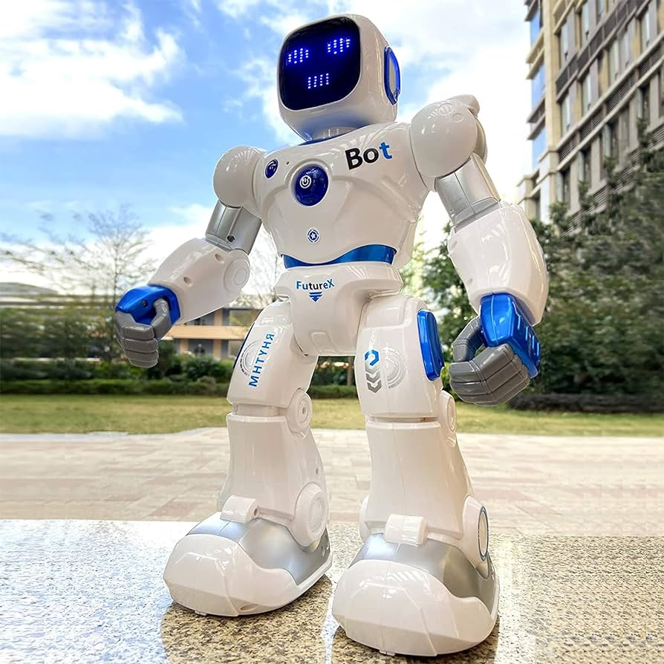
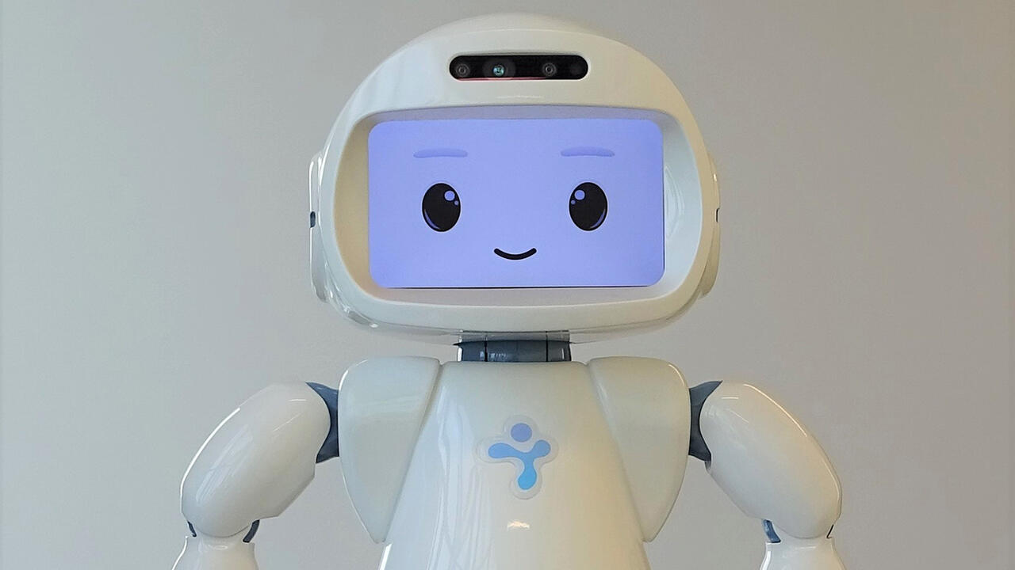
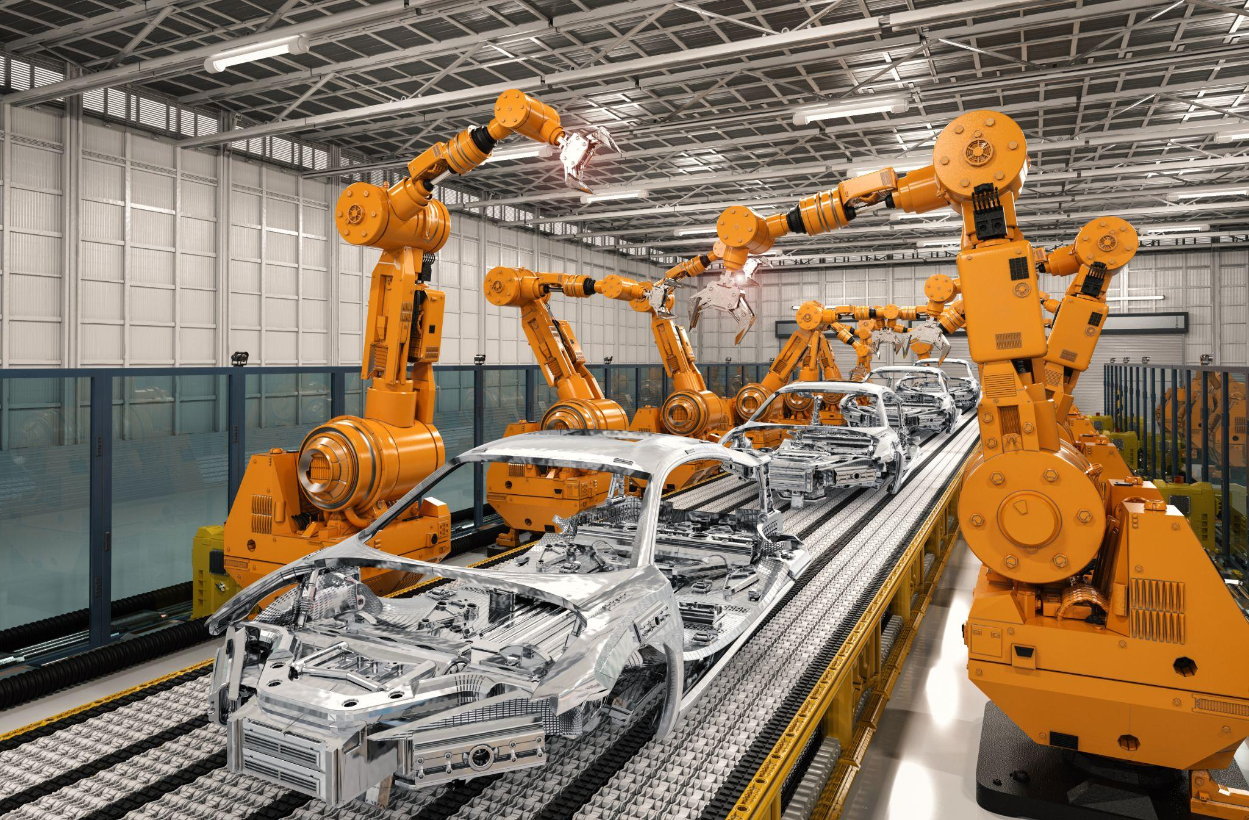
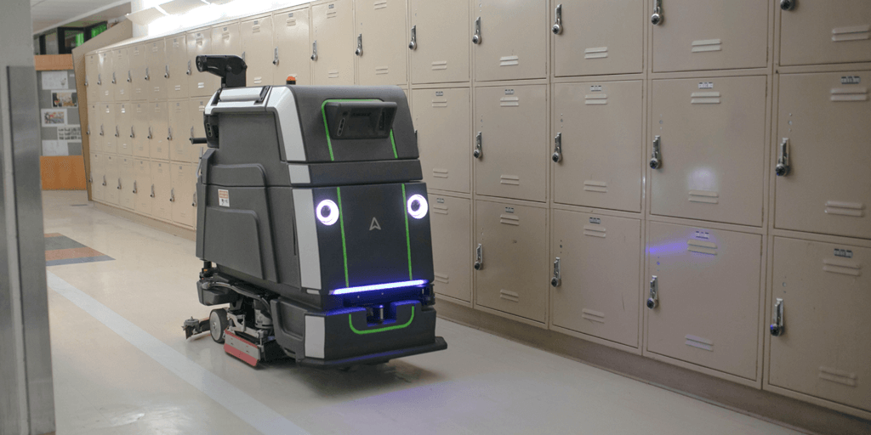
What other robots can you think of?

Slide 6
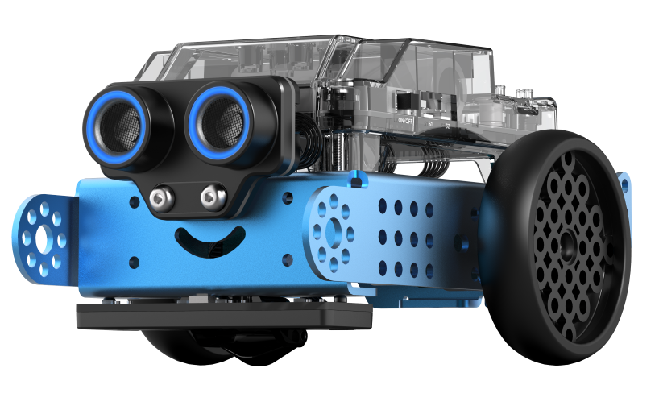
For today’s activity we will be using mBot 2’s

Slide 7
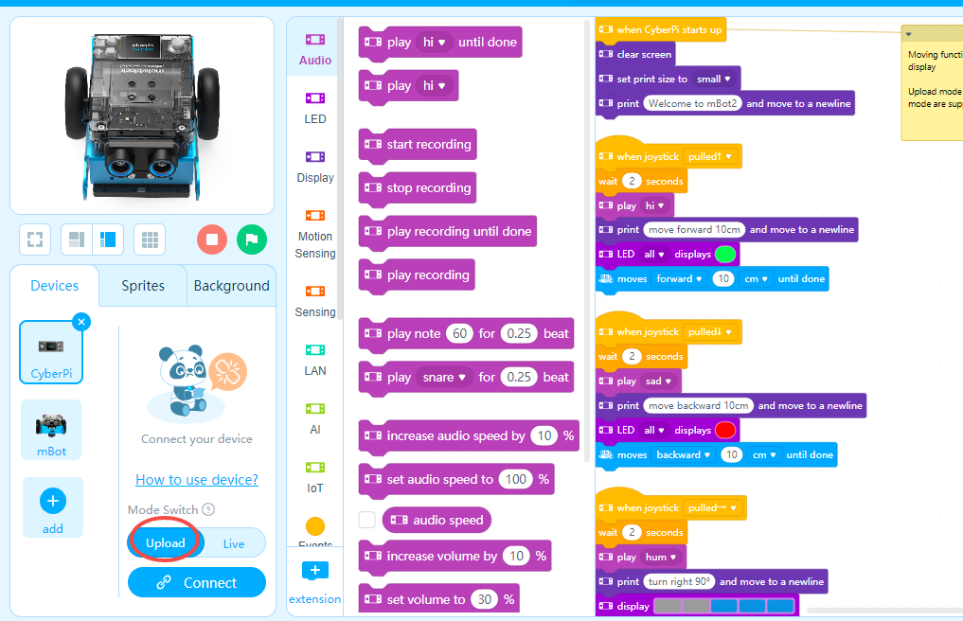
mBlock
using the software you will create programs that run your robot
there are many different 'blocks' to choose from, we will use CONTROL, OPERATORS, CHASSIS, and ULTRASONIC

Slide 8
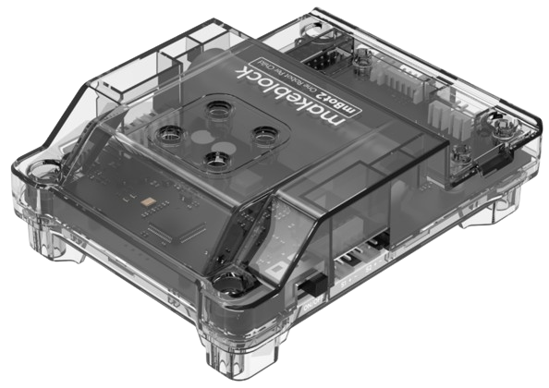
Computer
The “brain” of the robot
We tell the brain what we want the robot to do
The brain tells the rest of the robot what to do

Slide 9
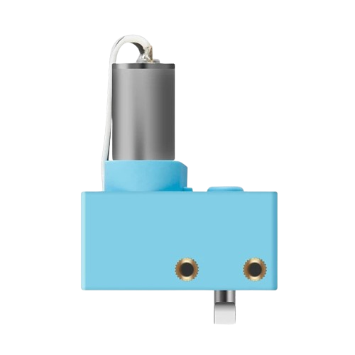
Motors
Move the robot exact distances and at exact speeds
Small cameras inside the motor tell it how much to rotate

Slide 10
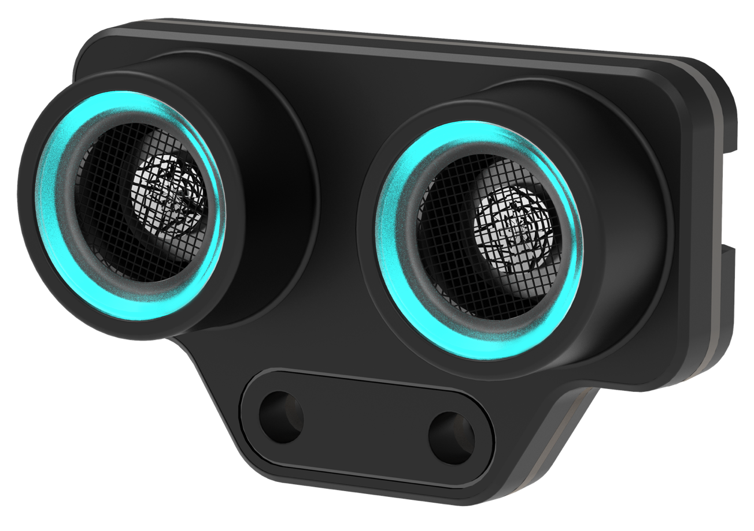
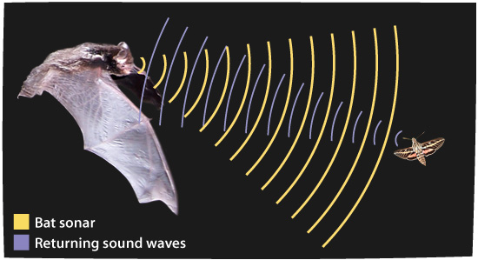
Ultrasonic Sensor
The speaker plays a sound no humans can hear and the microphone listens to the sound
A computer inside measures the time the sound takes to echo and calculates the distance away from a wall
Speaker
Microphone

Slide 11
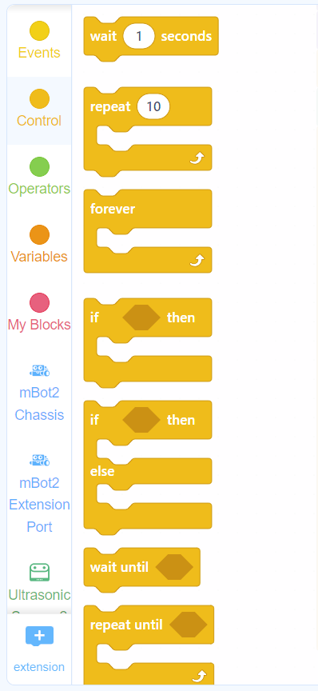
Control Blocks
Used to control the robot under certain conditions
Examples of conditional statements:
do something UNTIL something happens
REPEAT something 10 TIMES

Slide 12
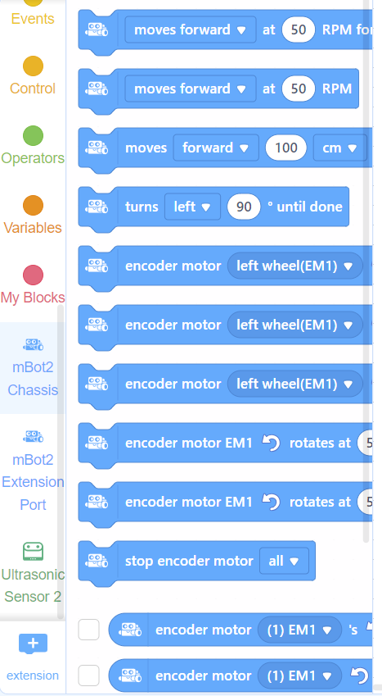
Chassis Blocks
Used to control both motors on the robot, which are connected to the wheels
Controls BOTH motors at the same time
Example:
Move FORWARD at 50 rotations of the wheel per minute (RPM)

Slide 13
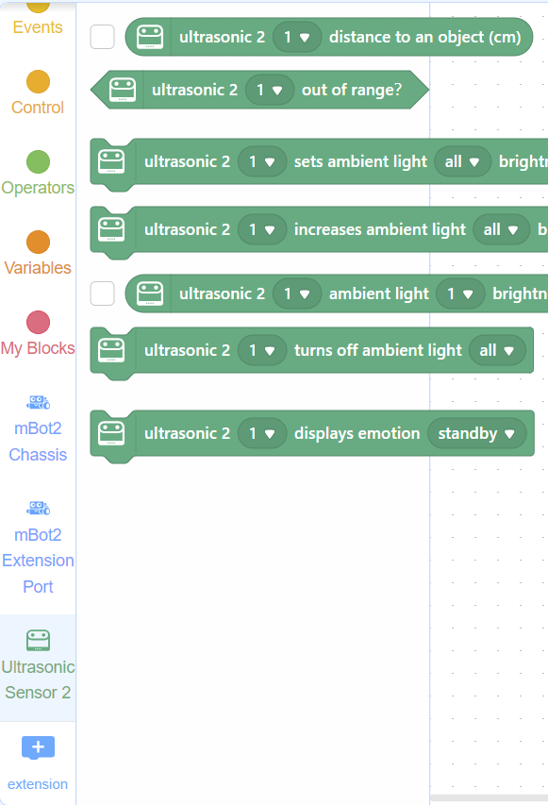
Ultrasonic Blocks
Used to tell the robot to read data from the ultrasonic sensor and control the blue lights
Example:
Is the distance to a wall 8 centimeters?

Slide 14
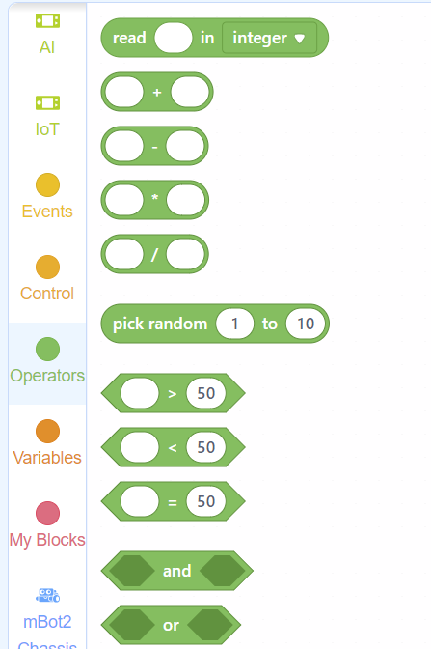
Operator Blocks
Tells the robot to make math calculations
Example:
Pick a random number from 1 to 10

Slide 15
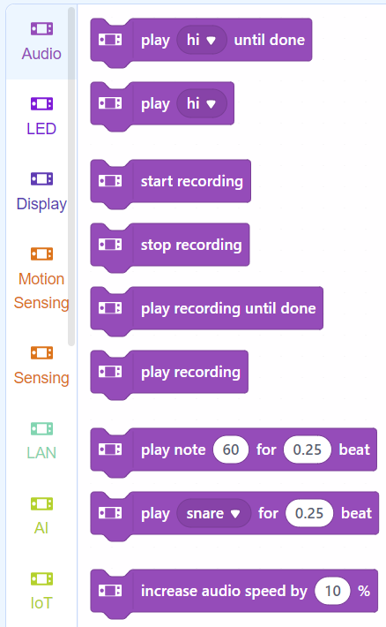
Audio Blocks
Used to make the robot play sounds
Example:
Make the robot say "Hi" then "Bye"

Slide 16
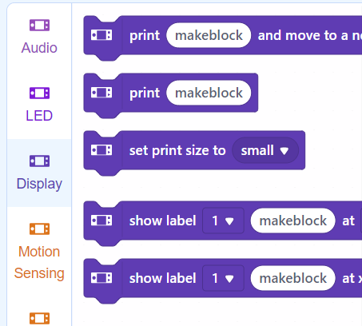
Display Blocks
Used to control the display on the Intelligent Brick
Example:
Write "Hello" on the display

Slide 17
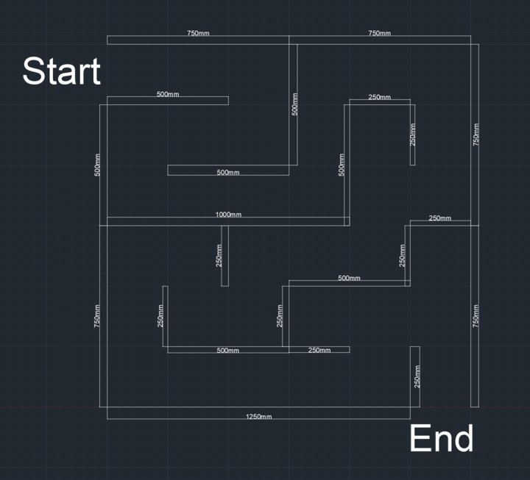
CHALLENGE
Use the Ultrasonic Sensor
To get through the maze as fast as possible

Slide 18
Let’s Work Together

Slide 19
What We Need
A Group
A Chromebook
An mBot
Thinking Caps
Patience

Slide 20
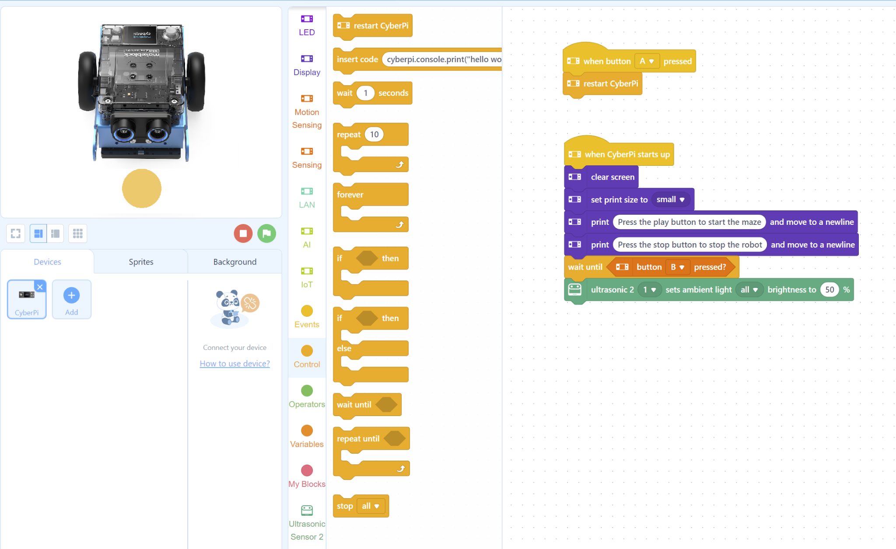
Step 1
Open your Chromebook and make sure mBlock is open
Your screen should look like this

Slide 21
Step 2
Choose if you want your robot to:
Automatically solve the maze
OR
Solve the maze with distances
We will start with automatic

Slide 22
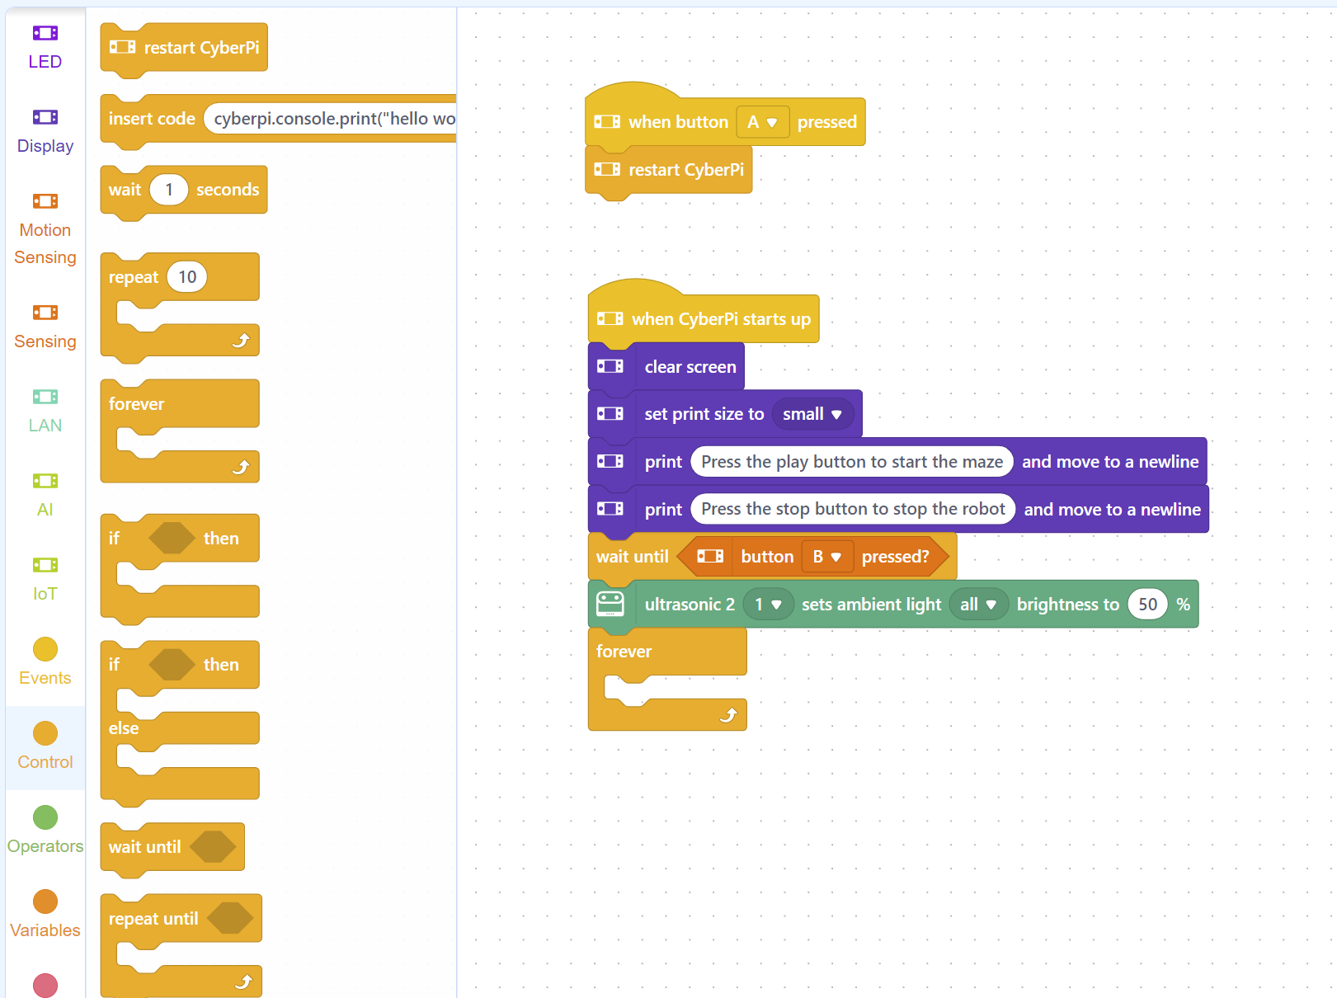
Control
Step 3
Drag a “forever loop” and connect the top to the bottom of the green block
This will tell the robot to do whatever we do next forever! (or until we tell it to stop)

Slide 23
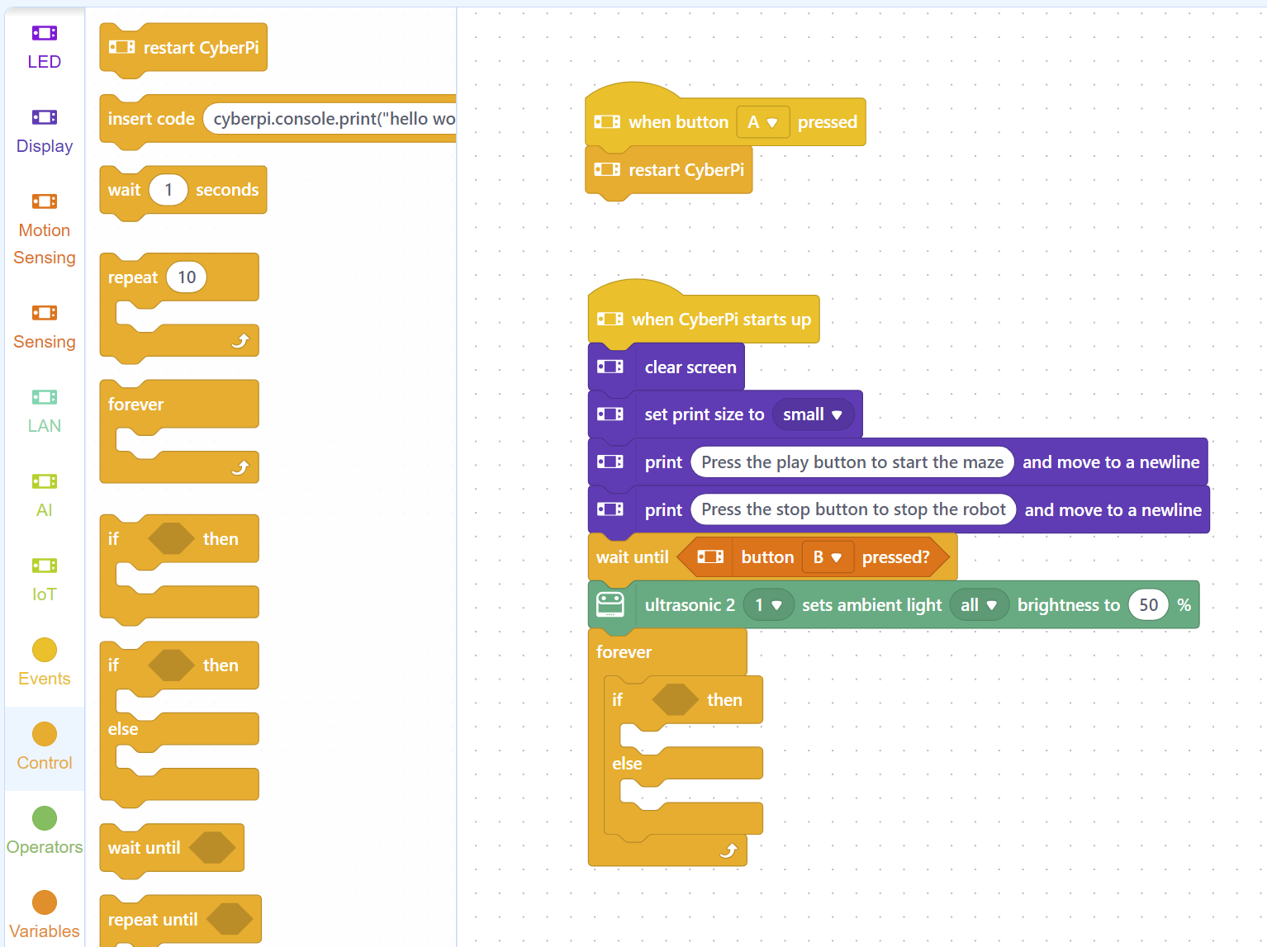
Control
Step 4
Drag an “if-else” block in and put it inside of the forever loop
This will tell the robot that if something happens, do an action, or else, do another action

Slide 24
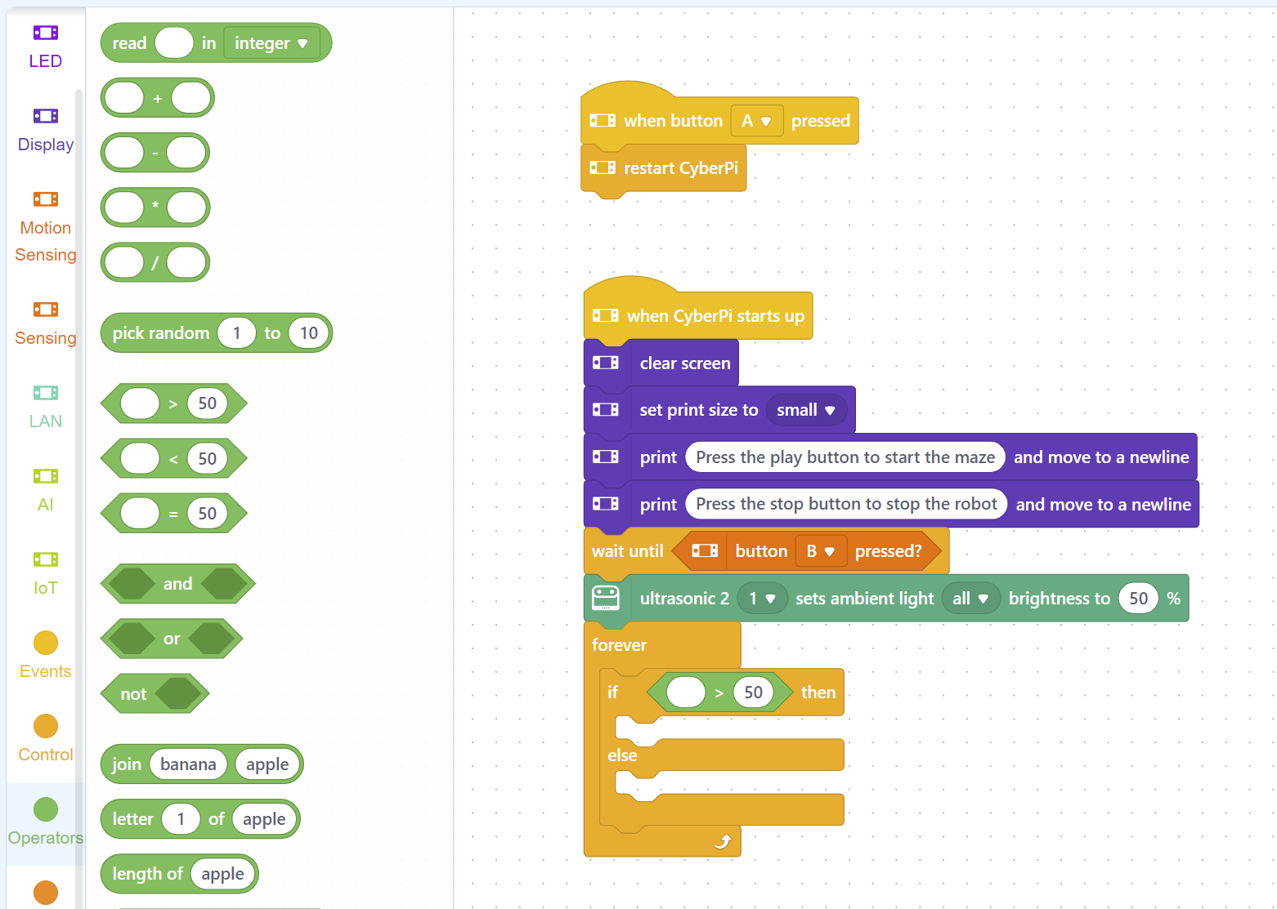
Operators
Step 5
Go to the Operators section
Drag the shape with the > symbol into the empty space between “if” and “then”
This symbol will compare 2 numbers and choose which one is bigger

Slide 25
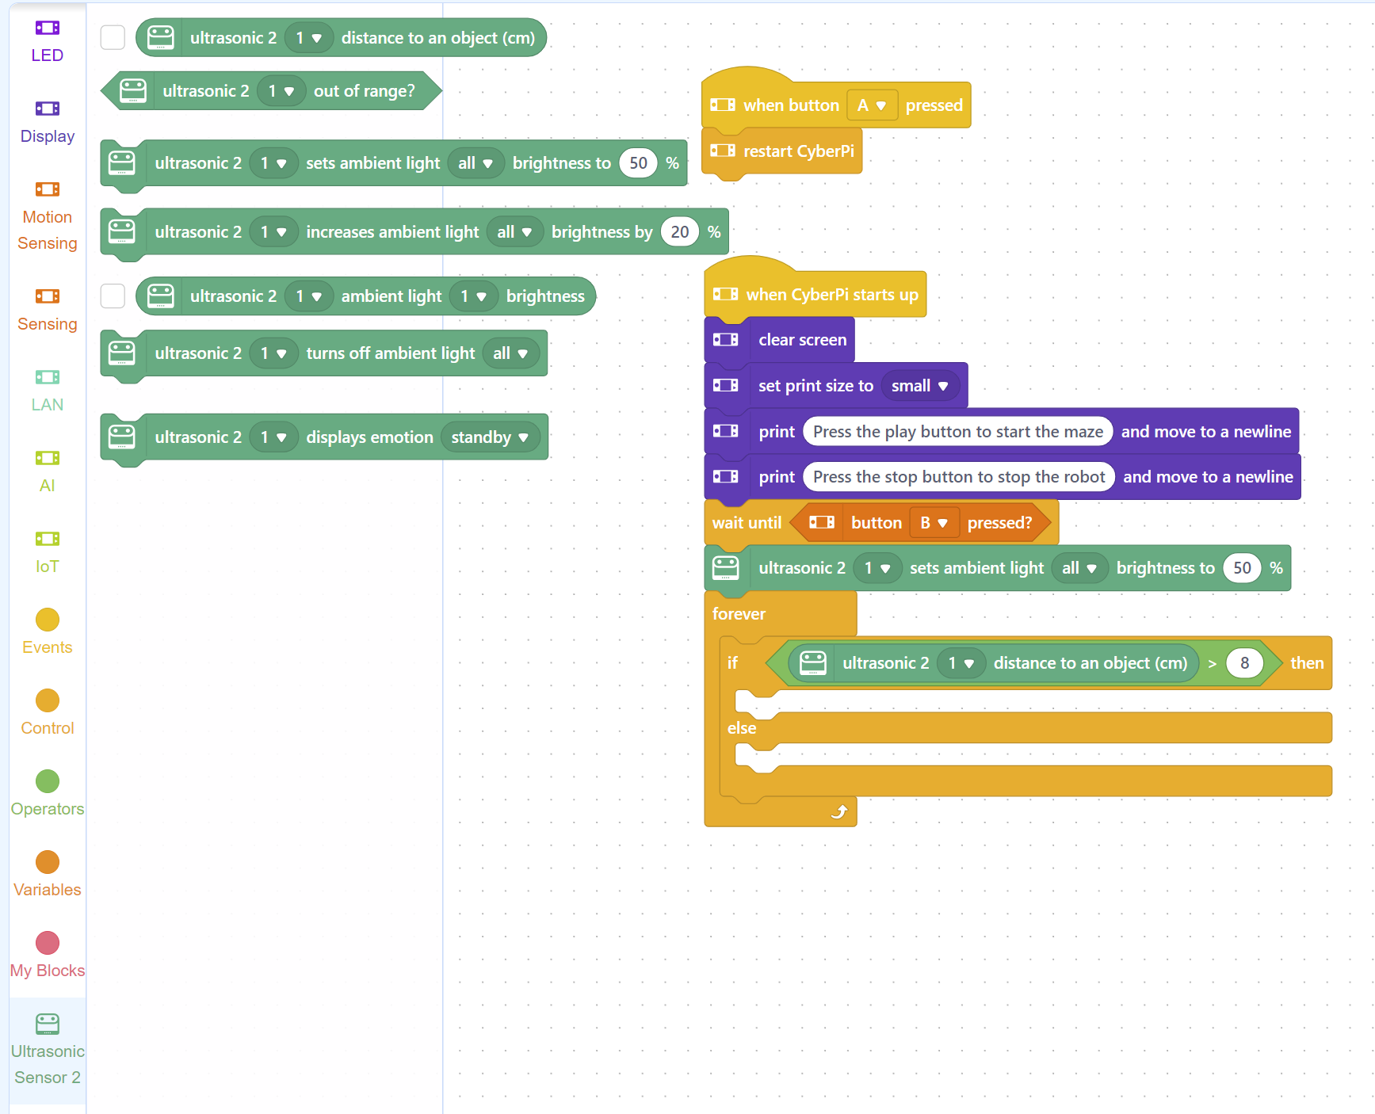
Ultrasonic
Step 6
Go to the Ultrasonic Sensor 2 section
Drag the top shape into the the empty space to the left of the > symbol
Change the number 50 to 8
This will be the number of centimeters away from the wall that the robot will stop

Slide 26
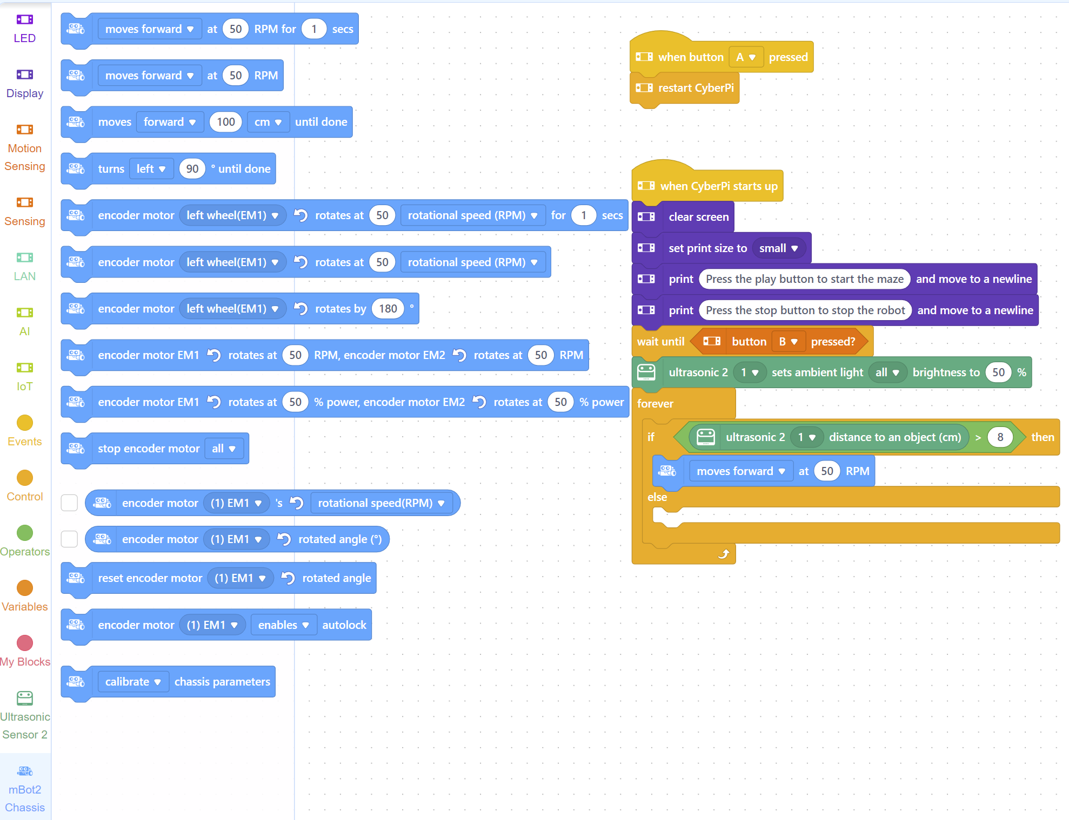
Chassis
Step 7
Go to the mBot2 Chassis section
Drag the second block to underneath the “if”
This will tells the robot to turn the wheels 50 times per minute (medium speed)

Slide 27
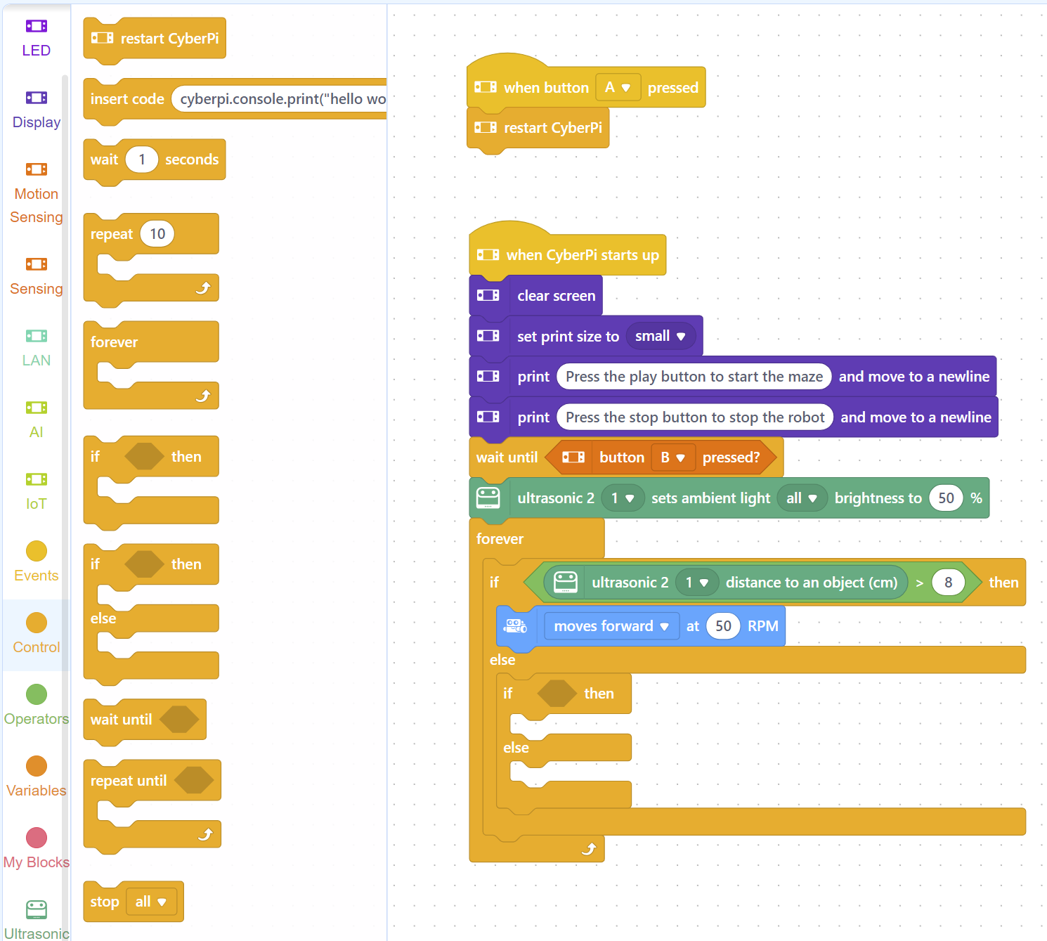
Control
Step 8
Go to the Control section
Drag another if-then-else block underneath the word “else”
This will let us tell the robot what to do when it gets close to a wall

Slide 28
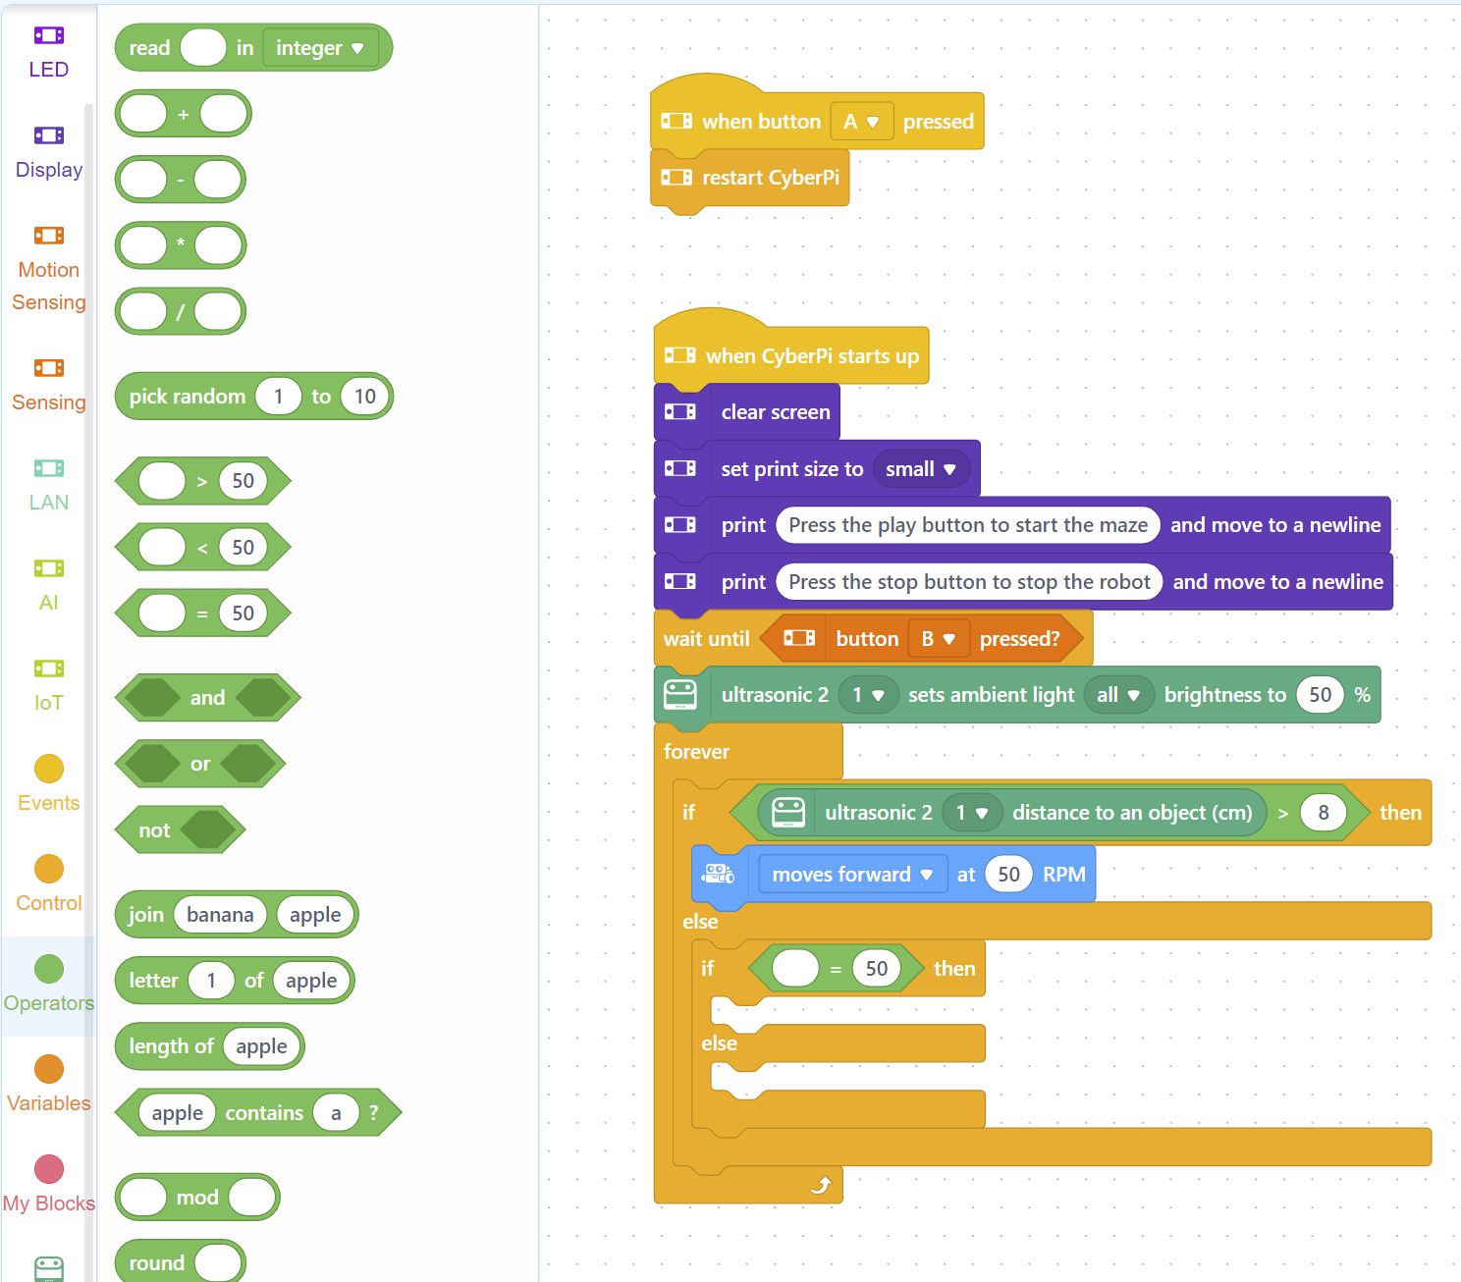
Operators
Step 9
Go to the Operators section
Drag the shape with the = sign into the empty space between “if” and “then”
This symbol will compare 2 numbers see if they are equal

Slide 29
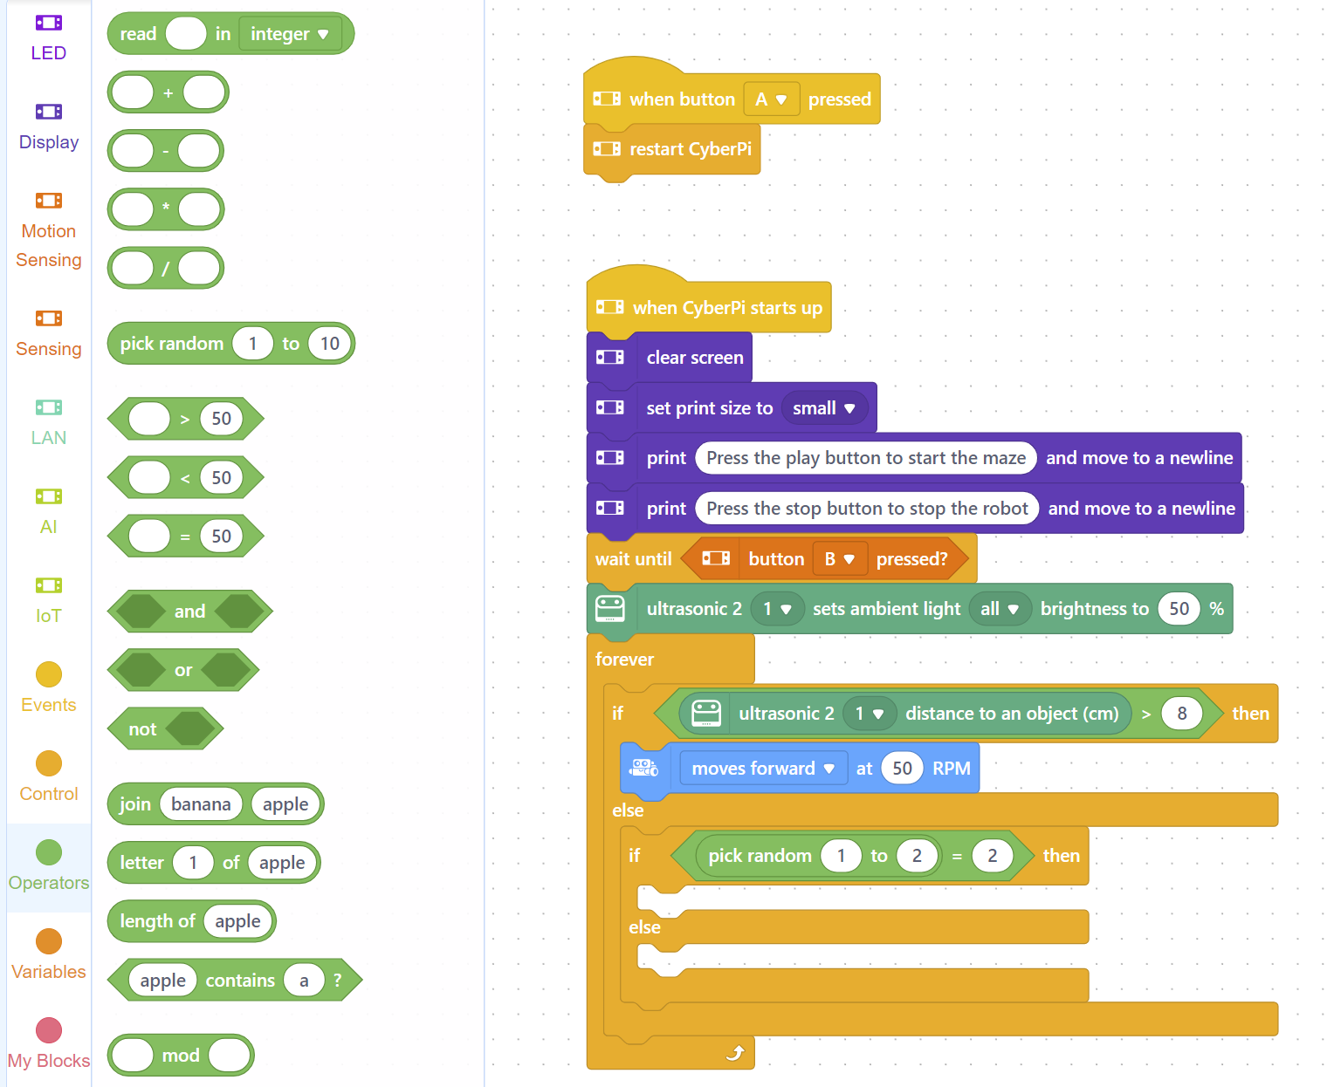
Operators
Step 10
Go to the Operators section
Drag the pick random block before the = sign
This block will pick 1 or 2 randomly, which will tell the robot to turn left or right randomly

Slide 30
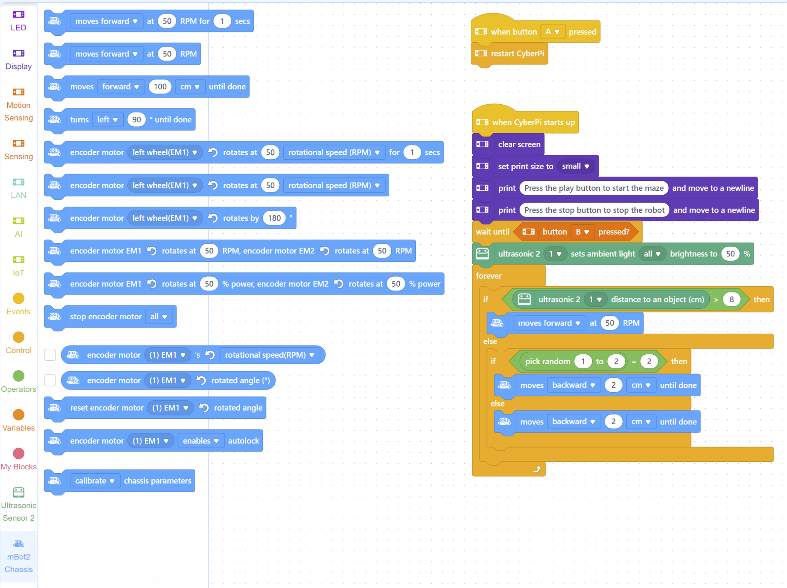
Chassis
Step 11
Go to the mBot2 Chassis section
Drag the third block to underneath the “if”
Drag the third block again to underneath the “else”
Change the directions of both to “backward” and change the distance to 2 centimeters
This will tell the robot to move back 2 centimeters before turning so it doesn’t get stuck

Slide 31
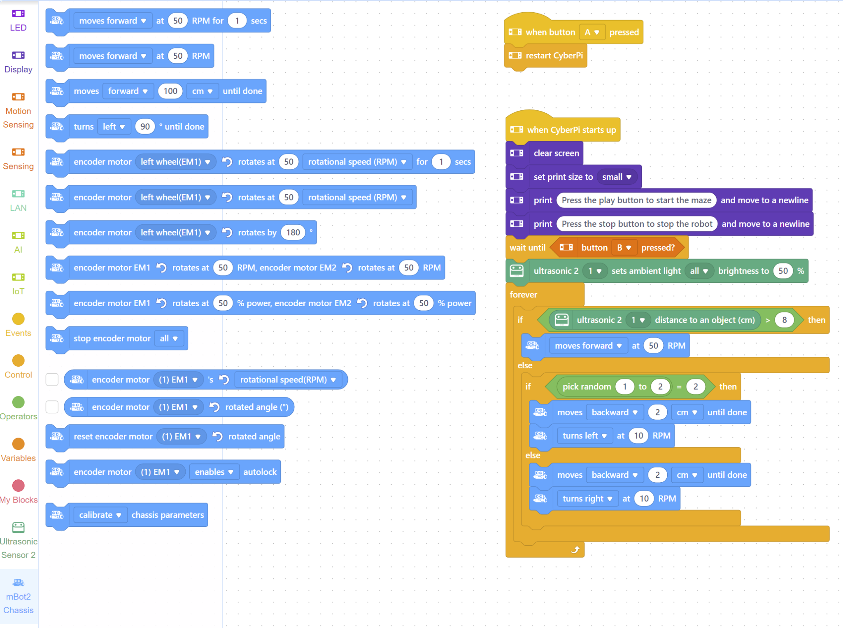
Chassis
Step 12
Drag the second block to underneath both of the “move backward” blocks
Change the speed to 10 RPM for both (slow speed)
Change one block to “turn left” and the other to “turn right”

Slide 32
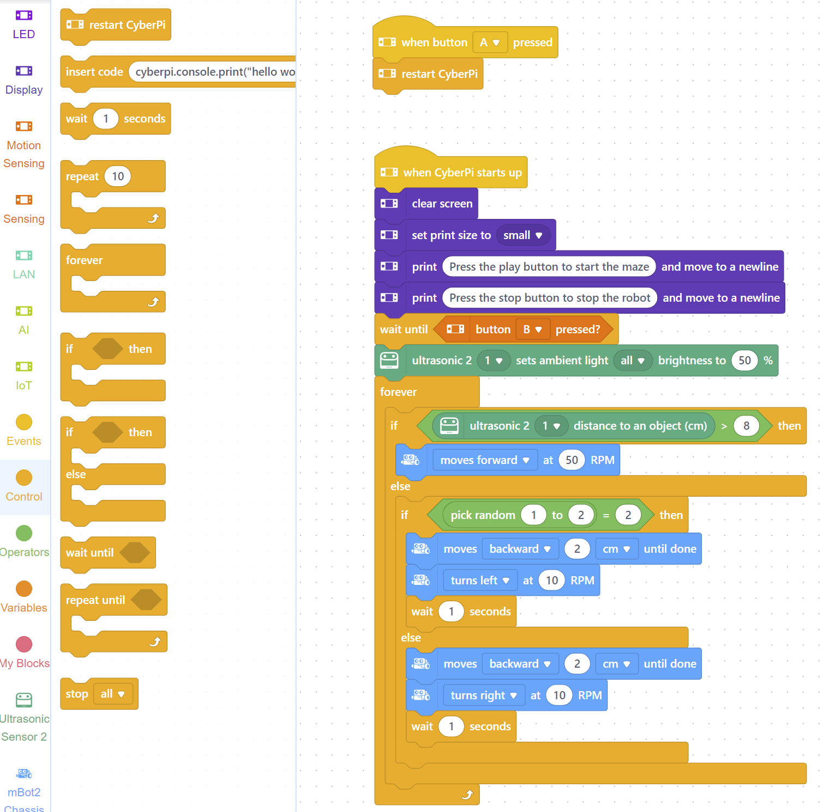
Control
Step 13
Drag the “wait 1 seconds” block to underneath both turn blocks
This tells the robot to wait 1 second before restarting the forever loop

Slide 33
Upload Code
Step 14
Plug the robot into the Chromebook and a volunteer will upload your code

Slide 34
Let’s Go Test It

Slide 35
THANK YOU!

