Slide 1
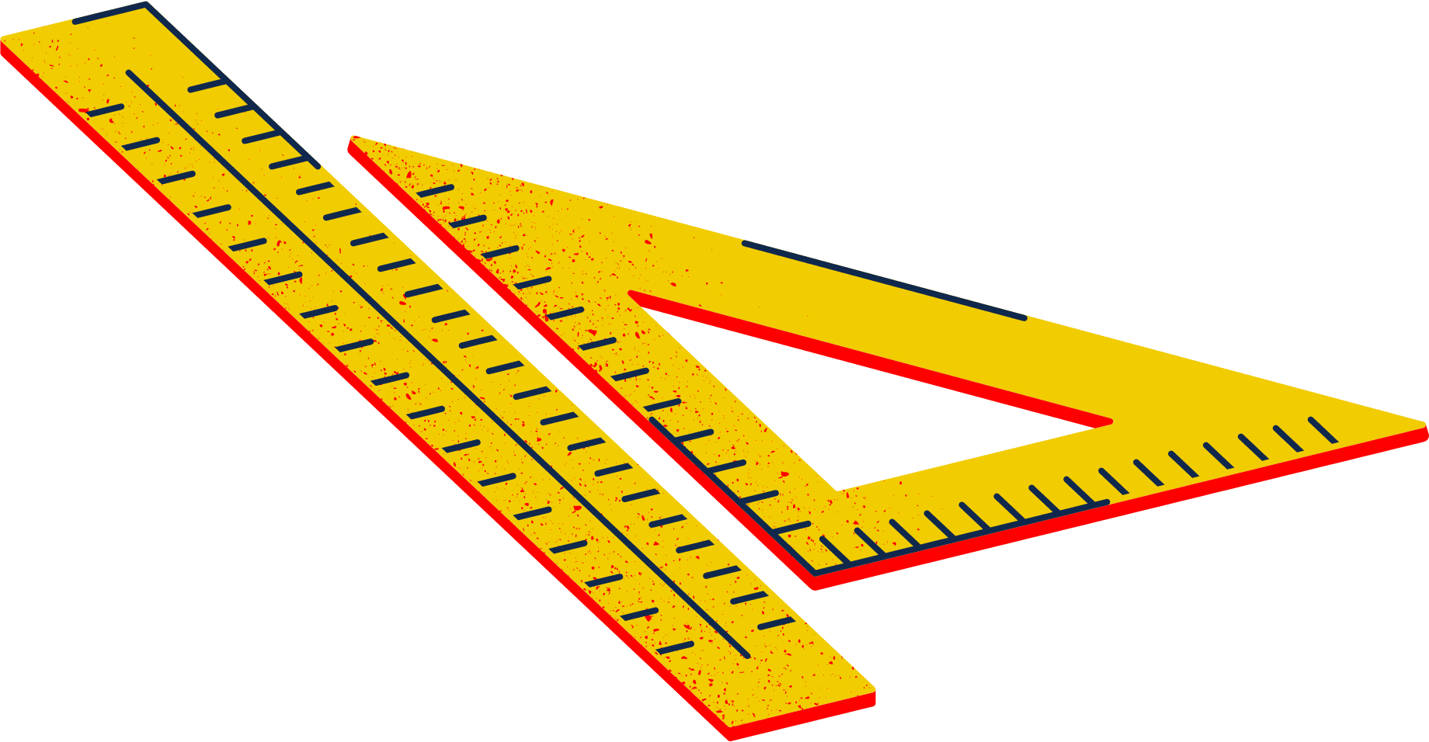
Robotics Workshop

Slide 2
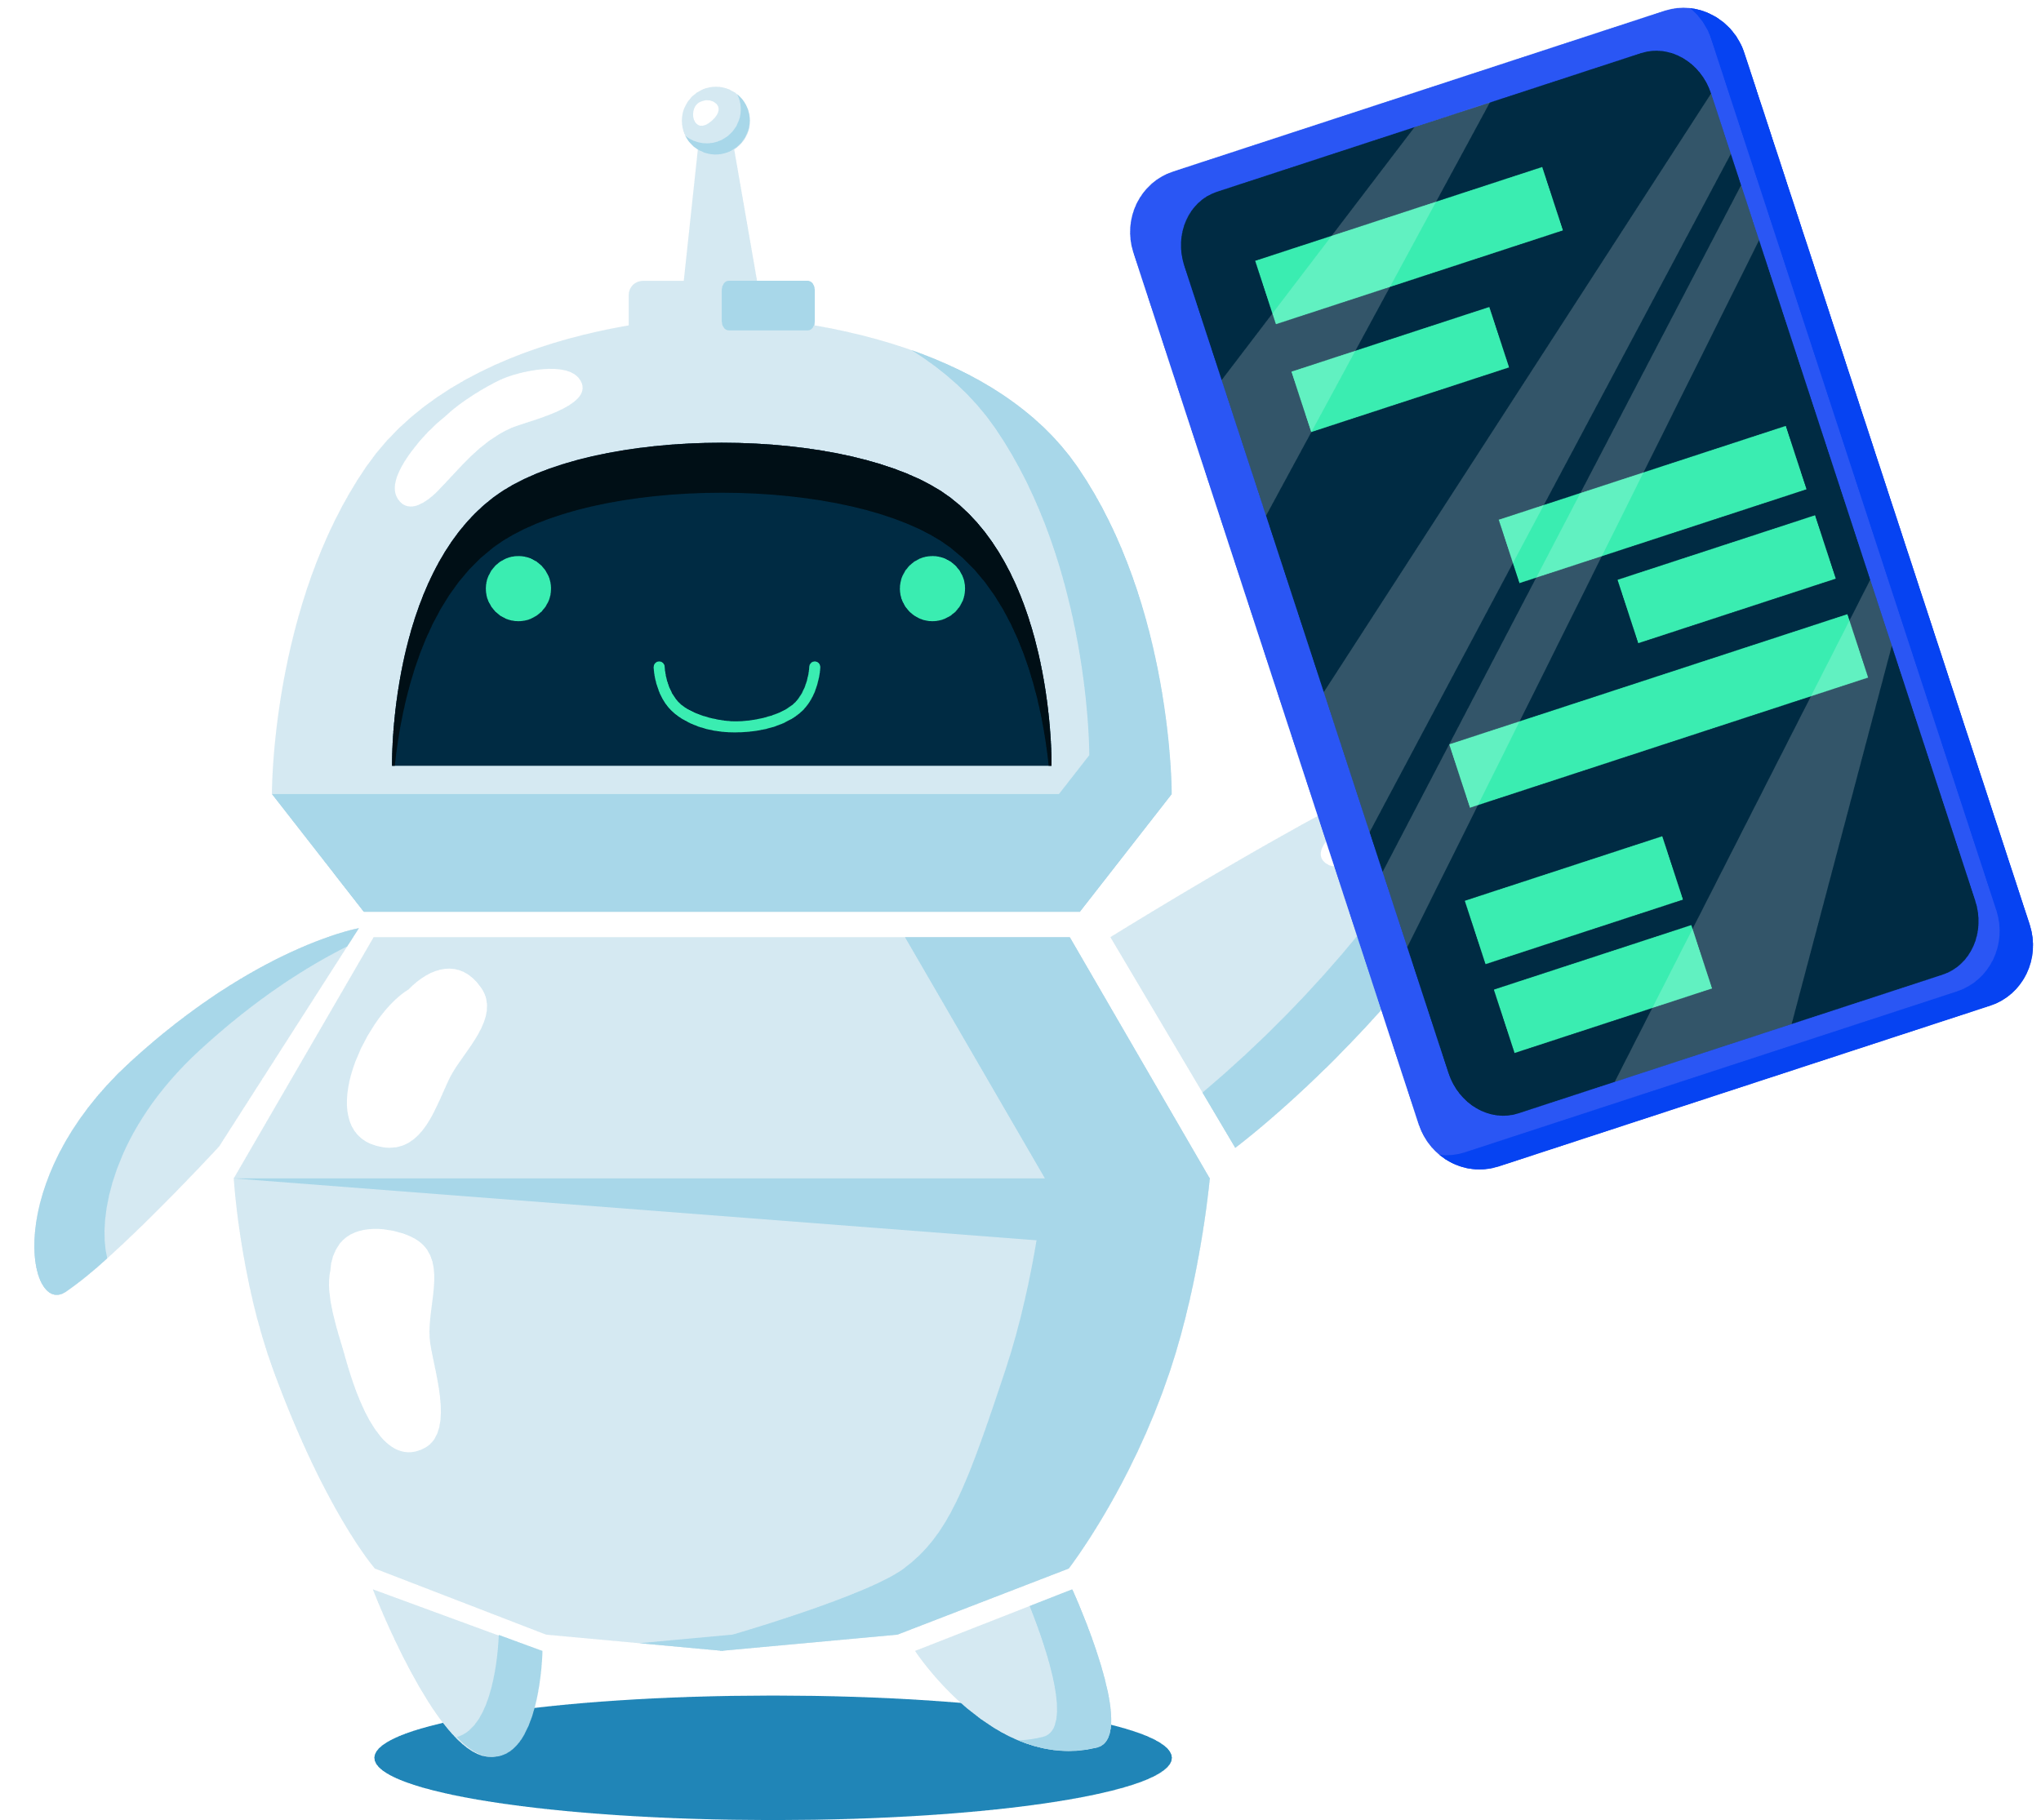
AGENDA FOR TODAY
About Robogals
Role Model of The Day
Robots in Real Life
Materials and Software
Activity

Slide 3
ABOUT ROBOGALS
OUR MISSION:
INSPIRE, EMPOWER AND ENGAGE!
Non-profit, international and student-run organization
Bring diversity into STEM-related careers, especially in engineering!
More than 30 Chapters across the globe in over 10 different countries.

Slide 4
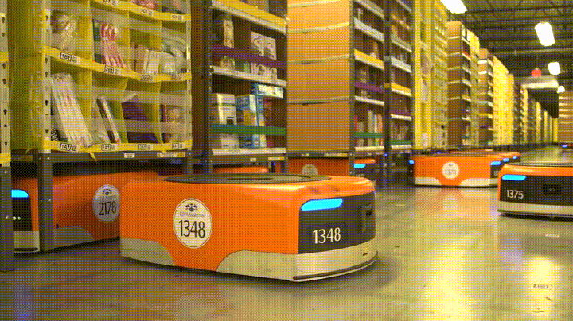
Amazon Warehouse Robots
Carry heavy shelves filled with items
Bring items to the workers
Makes finding things in the warehouse very quick

Slide 5
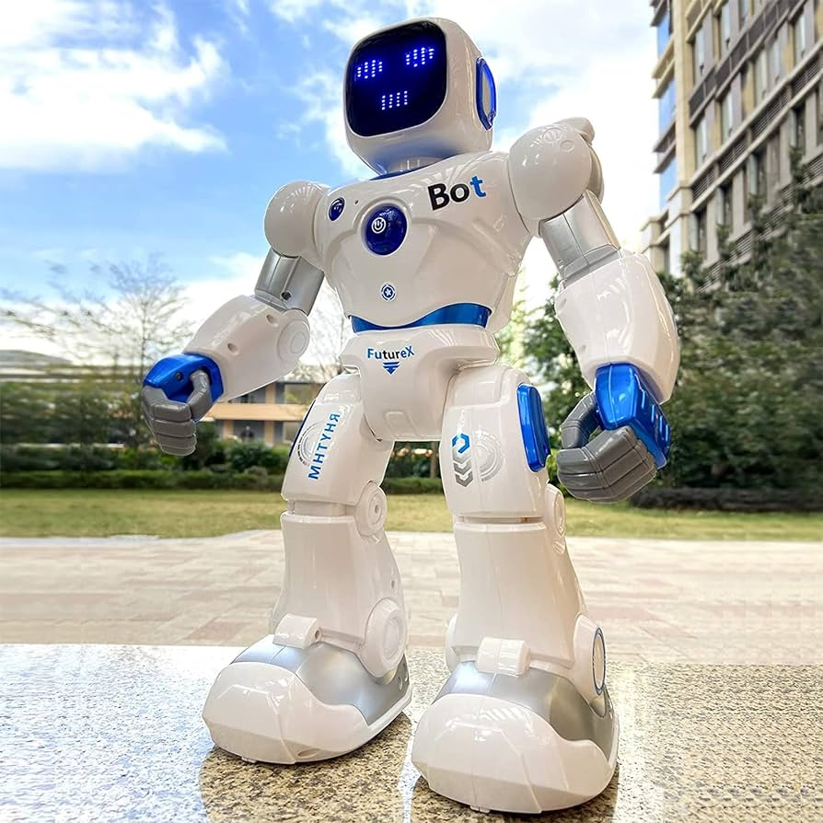
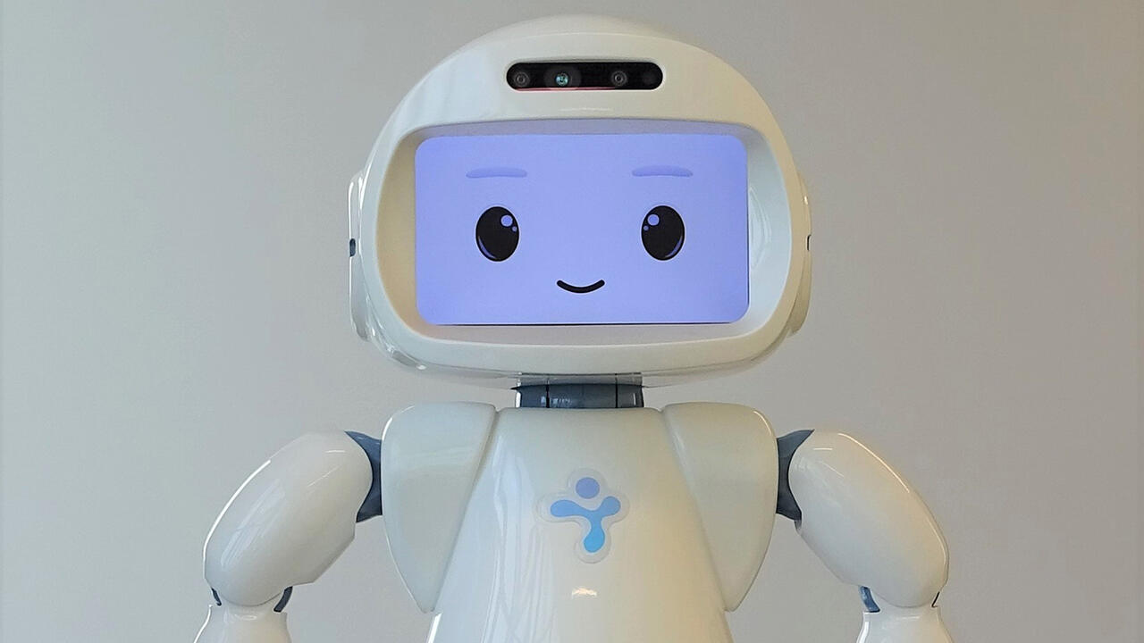
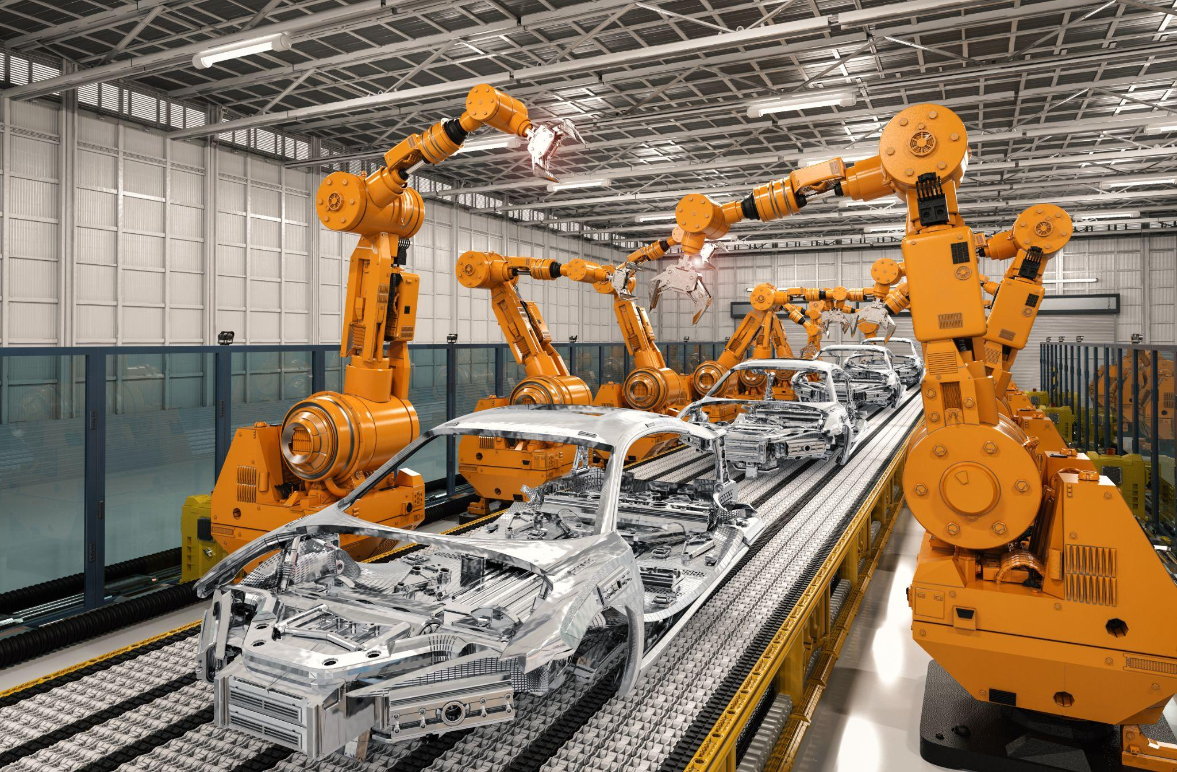
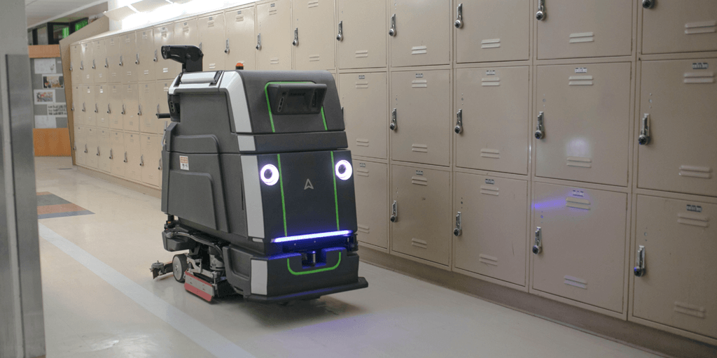
What other robots can you think of?

Slide 6
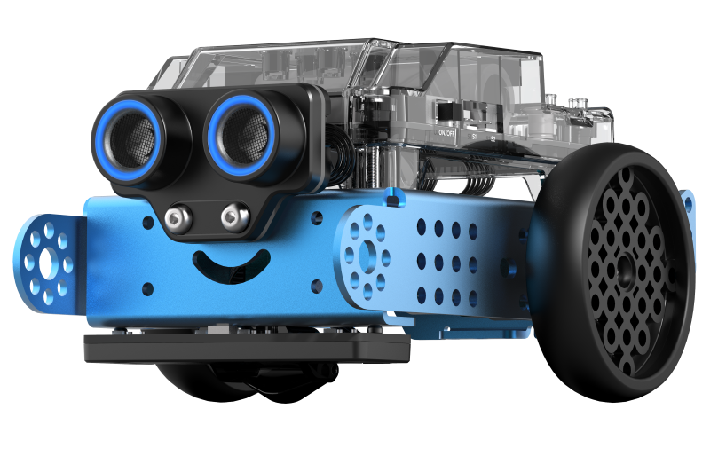
For today’s activity we will be using mBot 2’s

Slide 7
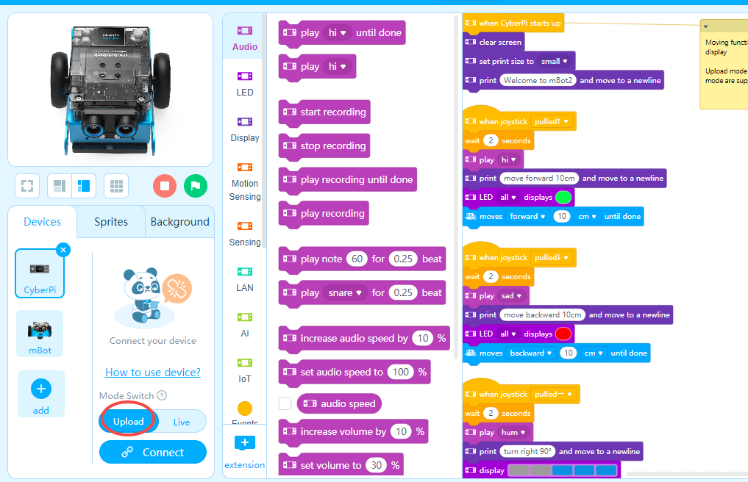
mBlock
using the software you will create programs that run your robot
there are many different 'blocks' to choose from, we will use the CHASSIS blocks

Slide 8
Parts of the mBot

Slide 9
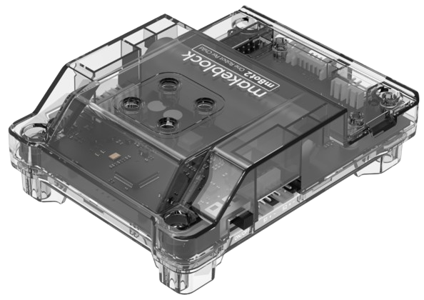
Computer
The “brain” of the robot
We tell the brain what we want the robot to do
The brain tells the rest of the robot what to do

Slide 10
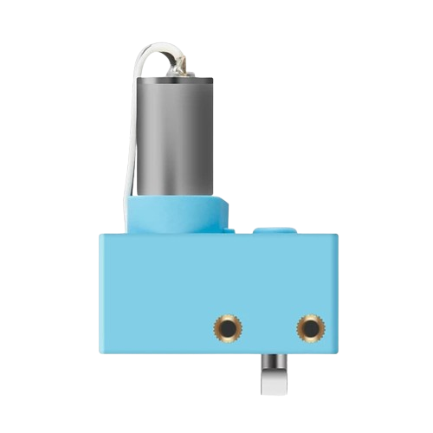
Motors
Move the robot exact distances and at exact speeds
Small cameras inside the motor tell it how much to rotate

Slide 11
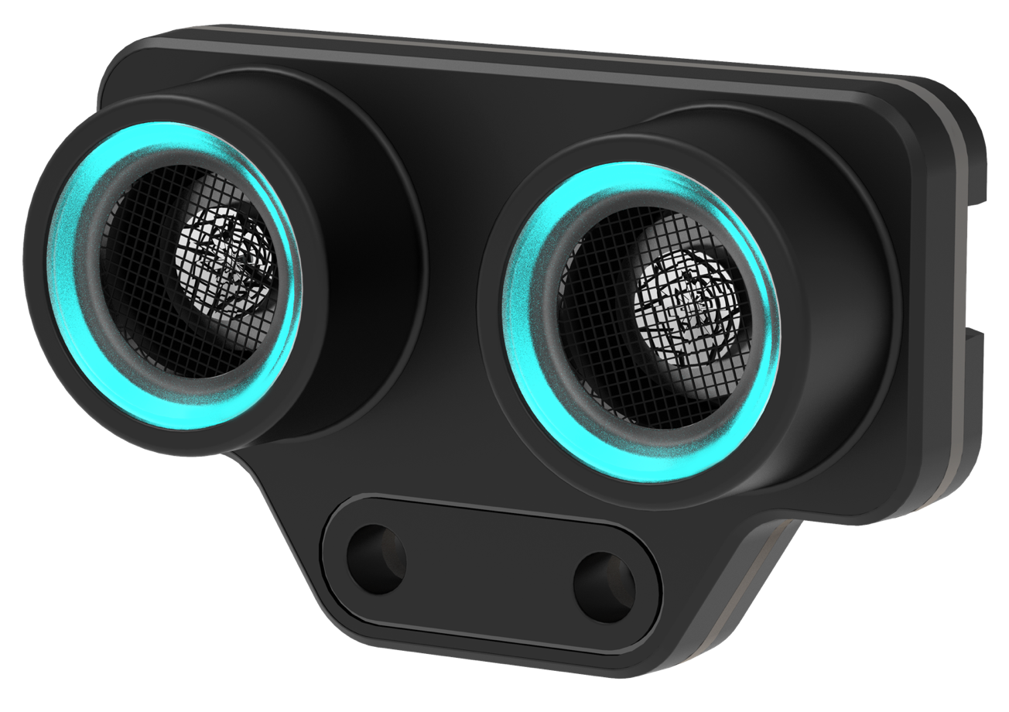
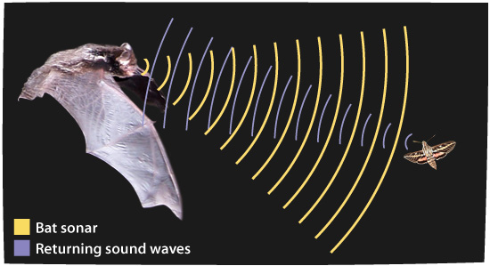
Ultrasonic Sensor
The speaker plays a sound no humans can hear and the microphone listens to the sound
A computer inside measures the time the sound takes to echo and calculates the distance away from a wall
Speaker
Microphone

Slide 12
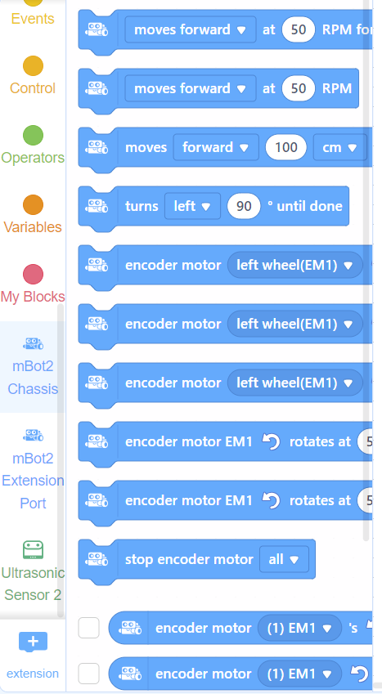
Chassis Blocks
Used to control both motors on the robot, which are connected to the wheels
Controls BOTH motors at the same time
Examples:
Move FORWARD 100 centimeters
TURN Left

Slide 13
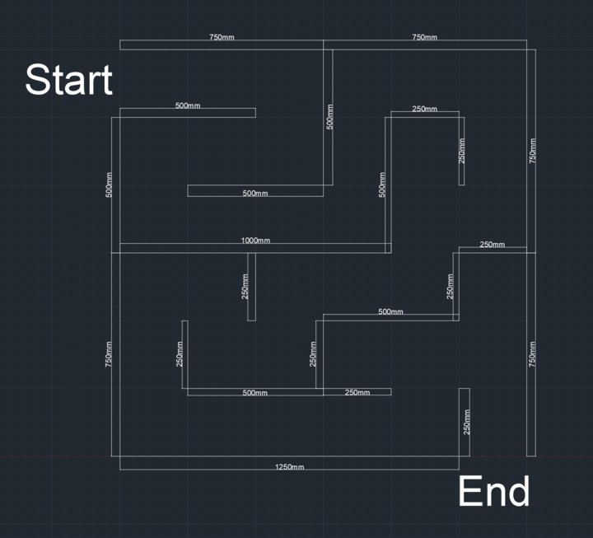
CHALLENGE
Get through the maze without crashing into a wall

Slide 14
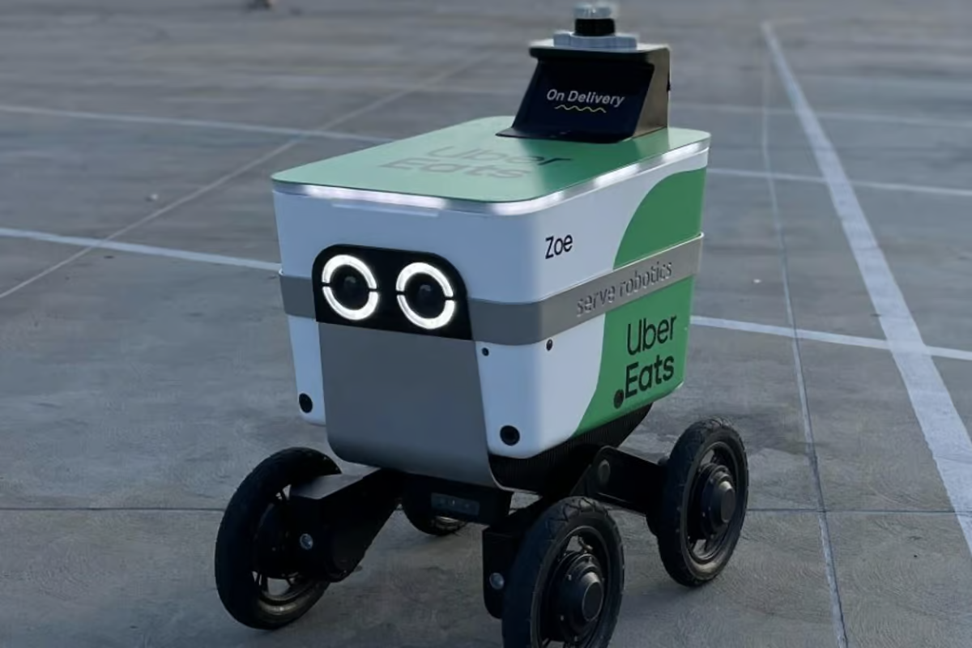
How Robots Work
Since robots are not as smart as humans, they need to be told exactly what you want them to do, or else they won’t do it
We can’t just tell the robot to solve the maze, they need instructions

Slide 15
What We Need
A Group
A Chromebook
An mBot
Thinking Caps
Patience

Slide 16
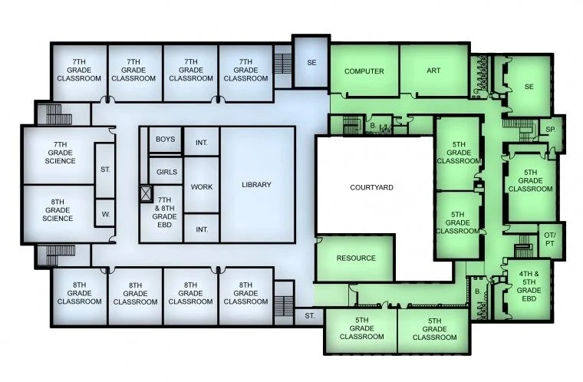
Brainstorming
What information can we tell the robot to get through the maze?
Hint: What instructions would you give a friend in Grade 5 so they can walk to this school's library and won’t get lost?

Slide 17
DIRECTIONS!
We will need to tell the robot directions on how to get to the end
To give directions, we need:
Distances in centimetres
Turn directions (left or right)

Slide 18
Let’s Code Together

Slide 19
Distances and Turns
62cm
R
R
50cm
R
25cm
We will need to tell the robot directions on how to get to the end
To give directions, we need:
Distances in centimetres
Turn directions (left or right)
L
50cm
50cm
50cm
R
25cm
L
L
L
R
75cm
25cm
25cm
25cm
L
L
L
R
25cm
50cm
25cm
25cm
50cm
R
R
R
R
25cm
25cm
38cm
L
123cm
L

Slide 20
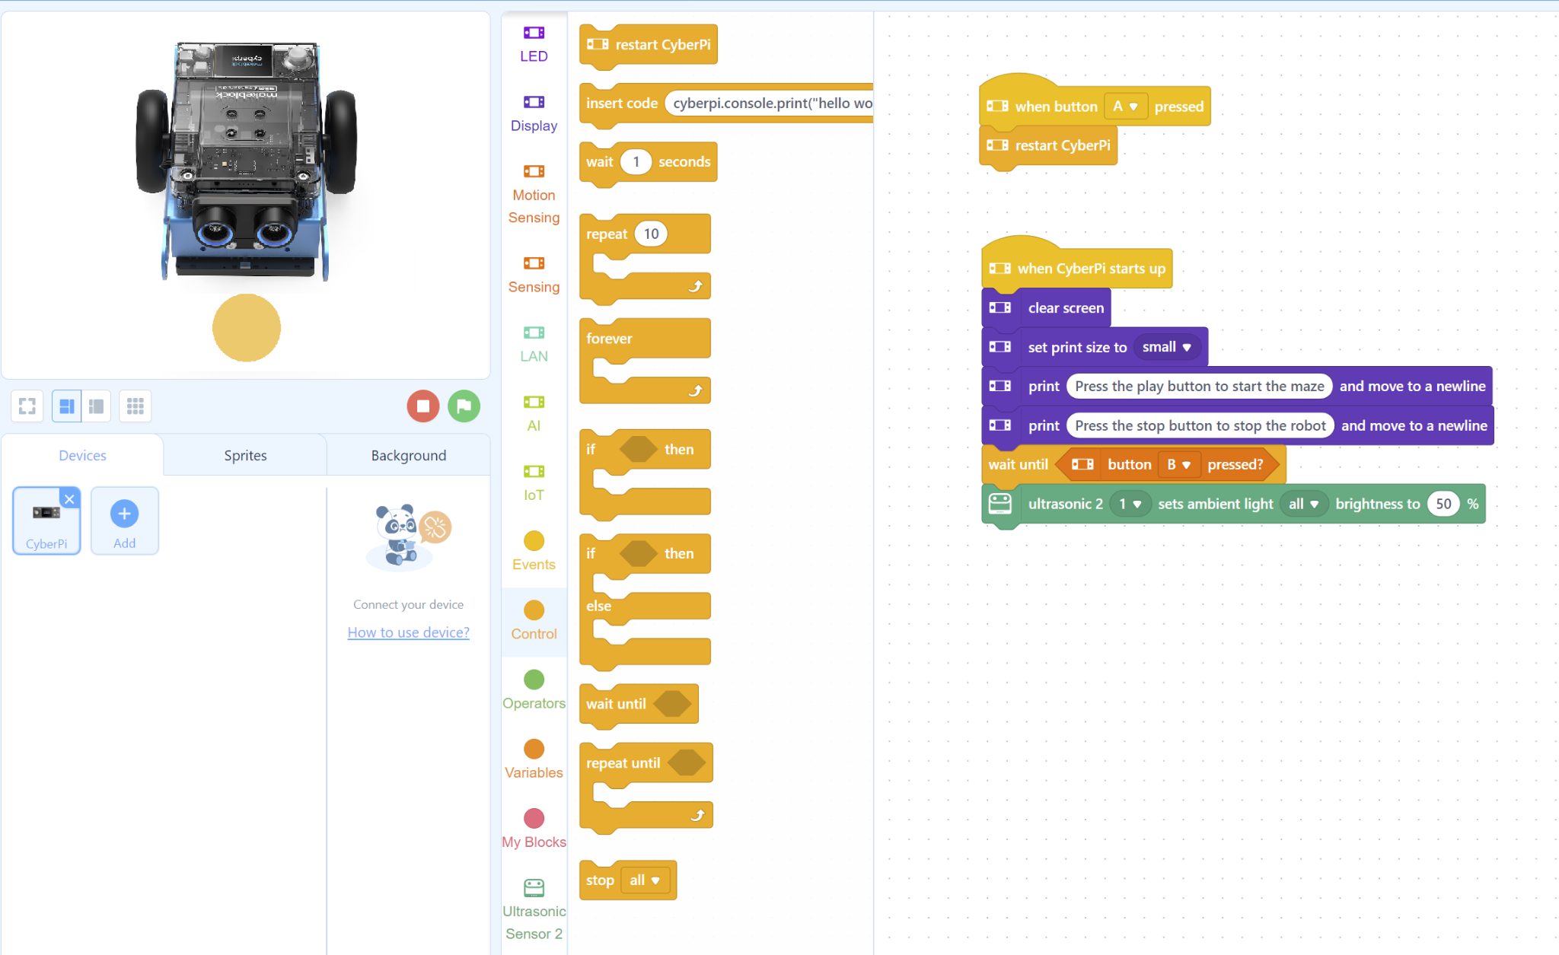
Step 1
Open your Chromebook and make sure mBlock is open
Your screen should look like this

Slide 21
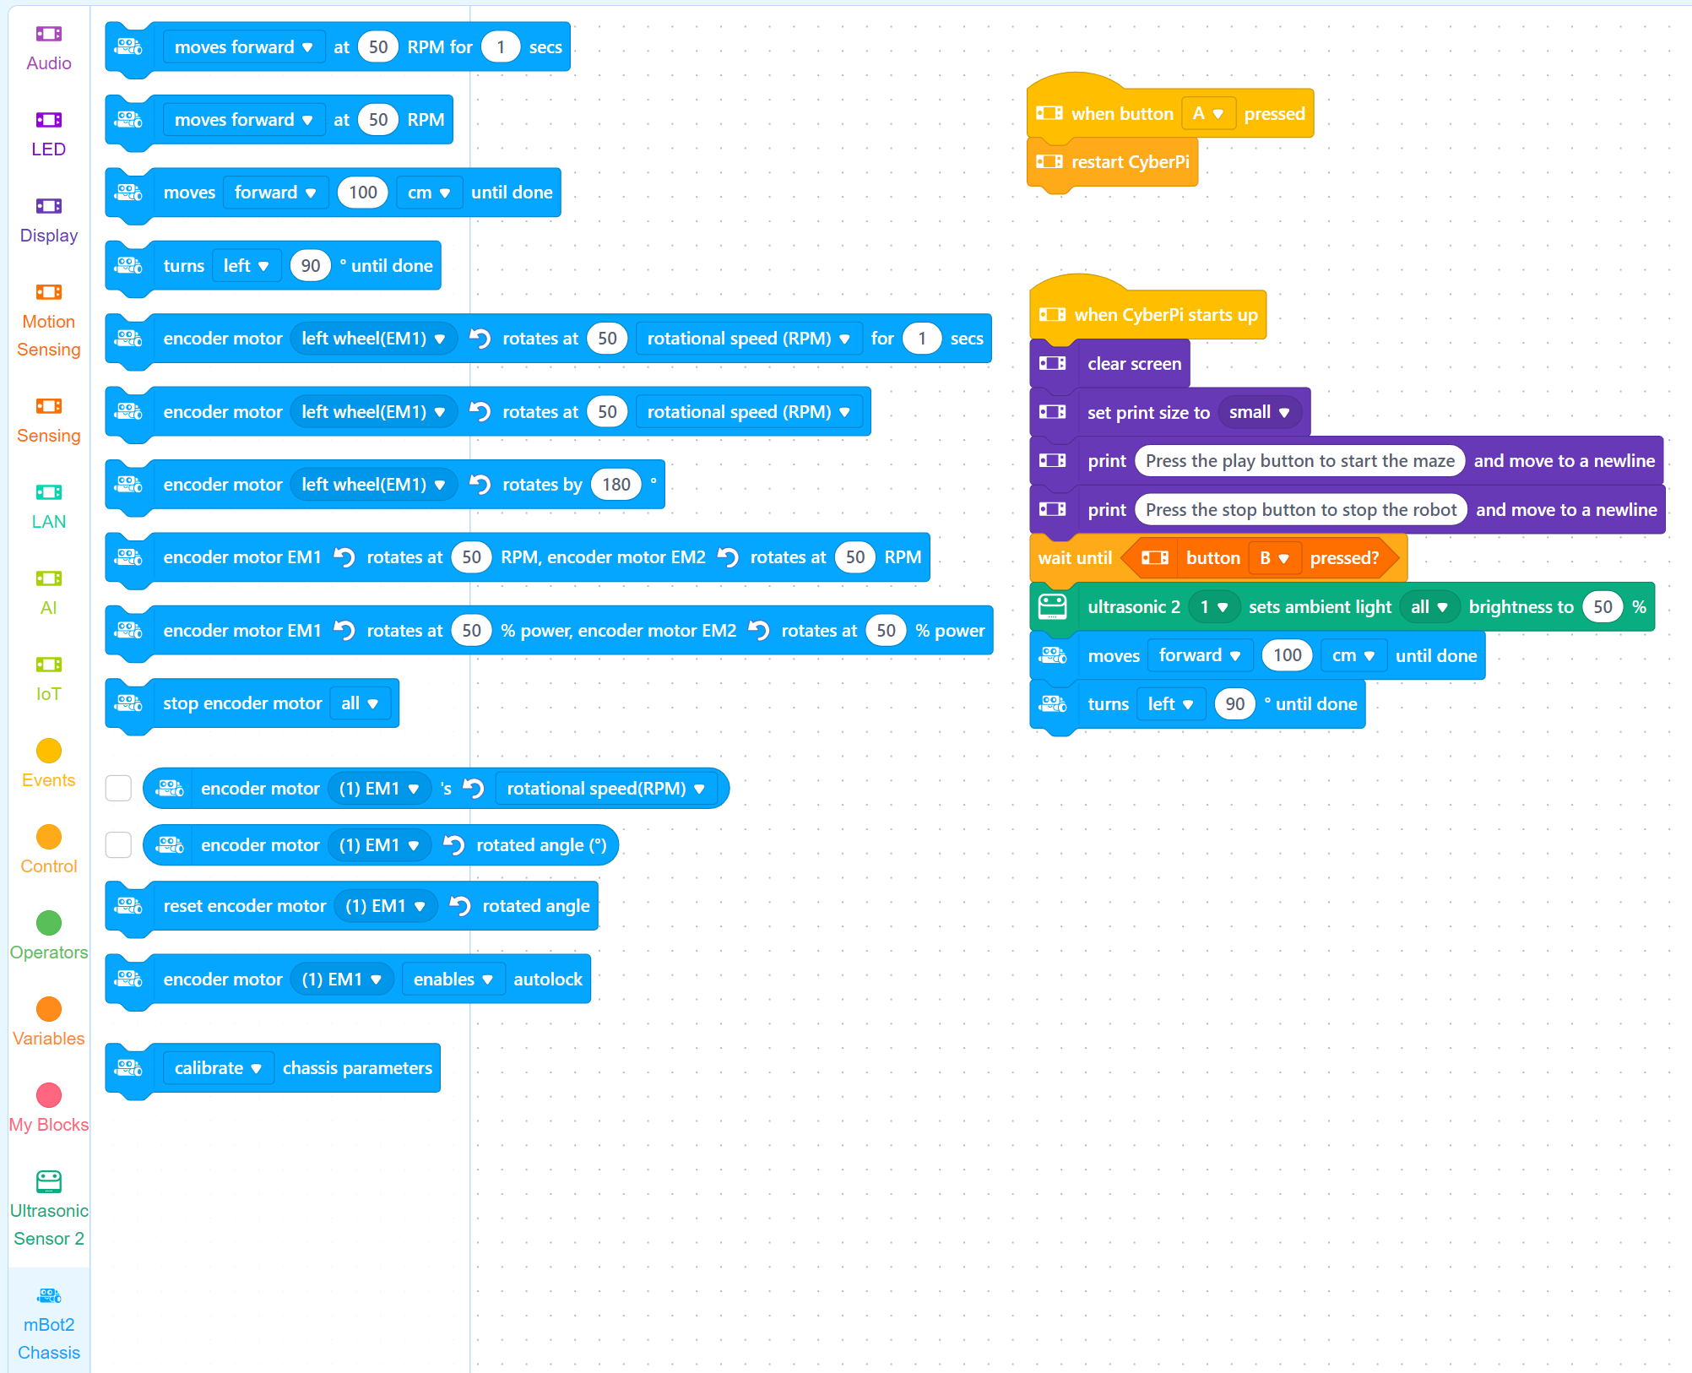
Chassis
Step 2
Go to the mBot2 Chassis section
Drag the third block underneath the green block
Drag the fourth block to underneath underneath the “moves forward” block

Slide 22
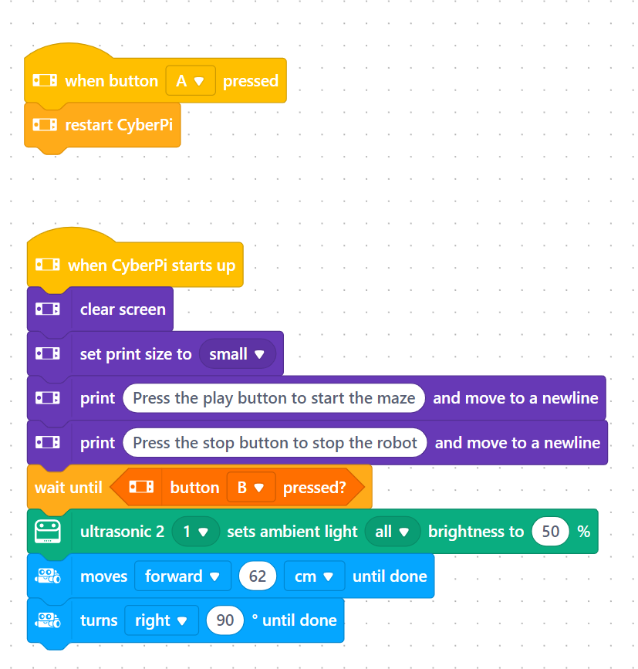
Chassis
Step 3
Change the distance in the first block to 62
Change the direction in the second block to “Right”
This tells the robot to go forwards 62cm and then turn right
We will be repeating this 19 more times

Slide 23
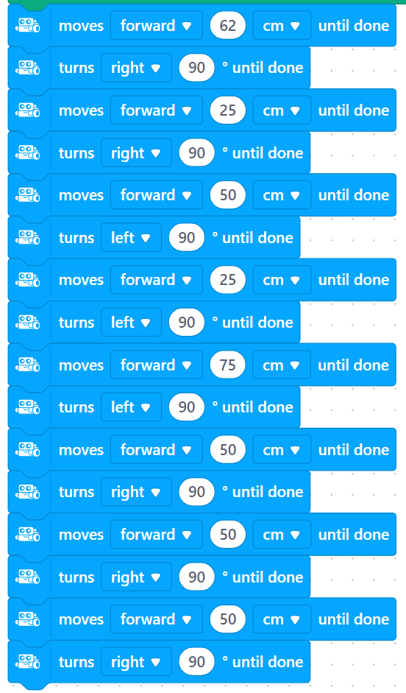
Chassis
Forward 25cm
Turn Right
Forward 50cm
Turn Left
Forward 25cm
Turn Left
Forward 75cm
Turn Left
Forward 50cm
Turn Right
Forward 50cm
Turn Right
Forward 50cm
Turn Right
Step 4
We will pass the Chromebook to our neighbours so everyone gets a chance to code
We will do this 7 more times, volunteers will check to make sure each group hasn’t forgotten a step, and then we can continue
Follow the directions on the right

Slide 24
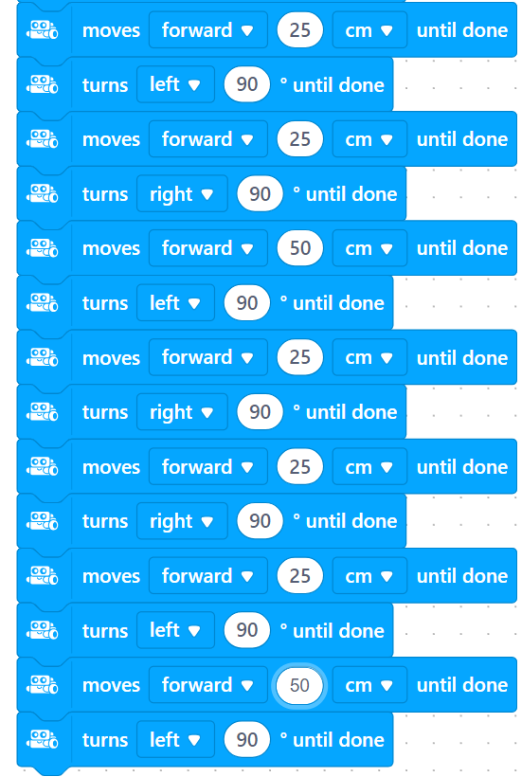
Chassis
Forward 25cm
Turn Left
Forward 25cm
Turn Right
Forward 50cm
Turn Left
Forward 25cm
Turn Right
Forward 25cm
Turn Right
Forward 25cm
Turn Left
Forward 25cm
Turn Left
Step 5
We will pass the Chromebook to our neighbours so everyone gets a chance to code
We will do this 7 more times, volunteers will check to make sure each group hasn’t forgotten a step, and then we can continue
Follow the directions on the right

Slide 25
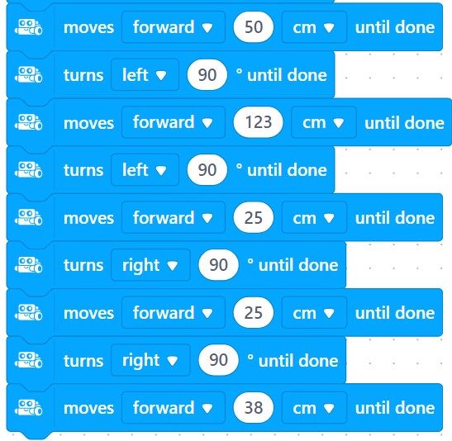
Chassis
Forward 50cm
Turn Left
Forward 123cm
Turn Left
Forward 25cm
Turn Right
Forward 25cm
Turn Right
Forward 38cm
Step 6
We will pass the Chromebook to our neighbours so everyone gets a chance to code
We will do this 5 more times, volunteers will check to make sure each group hasn’t forgotten a step, and then we can continue
Follow the directions on the right

Slide 26
Upload Code
Step 7
Plug the robot into the Chromebook and a volunteer will upload your code

Slide 27
Let’s Go Test It

Slide 28
WHAT DID WE LEARN
Parts of the Robot
Robots and computers need exact instructions
How to code

Slide 29
THANK YOU!

