Slide 2
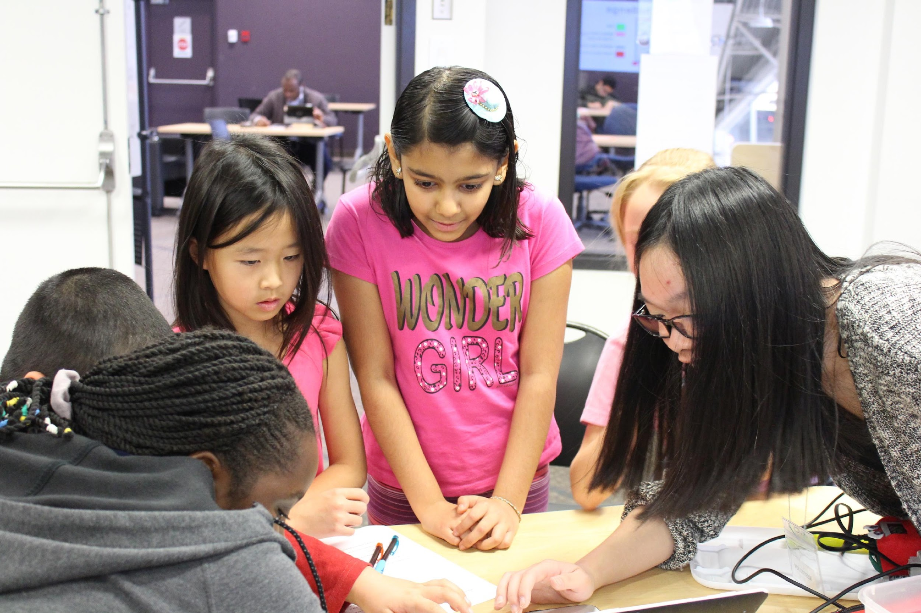
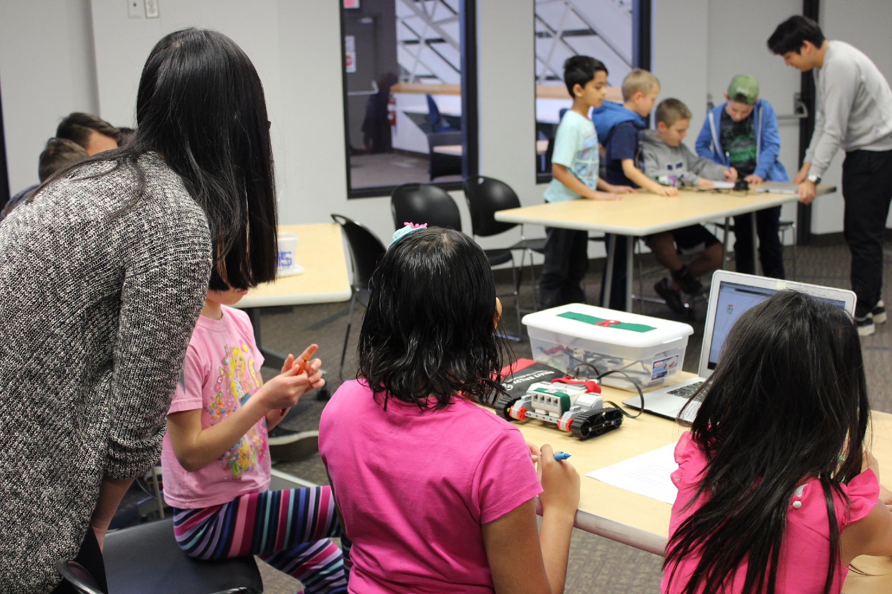
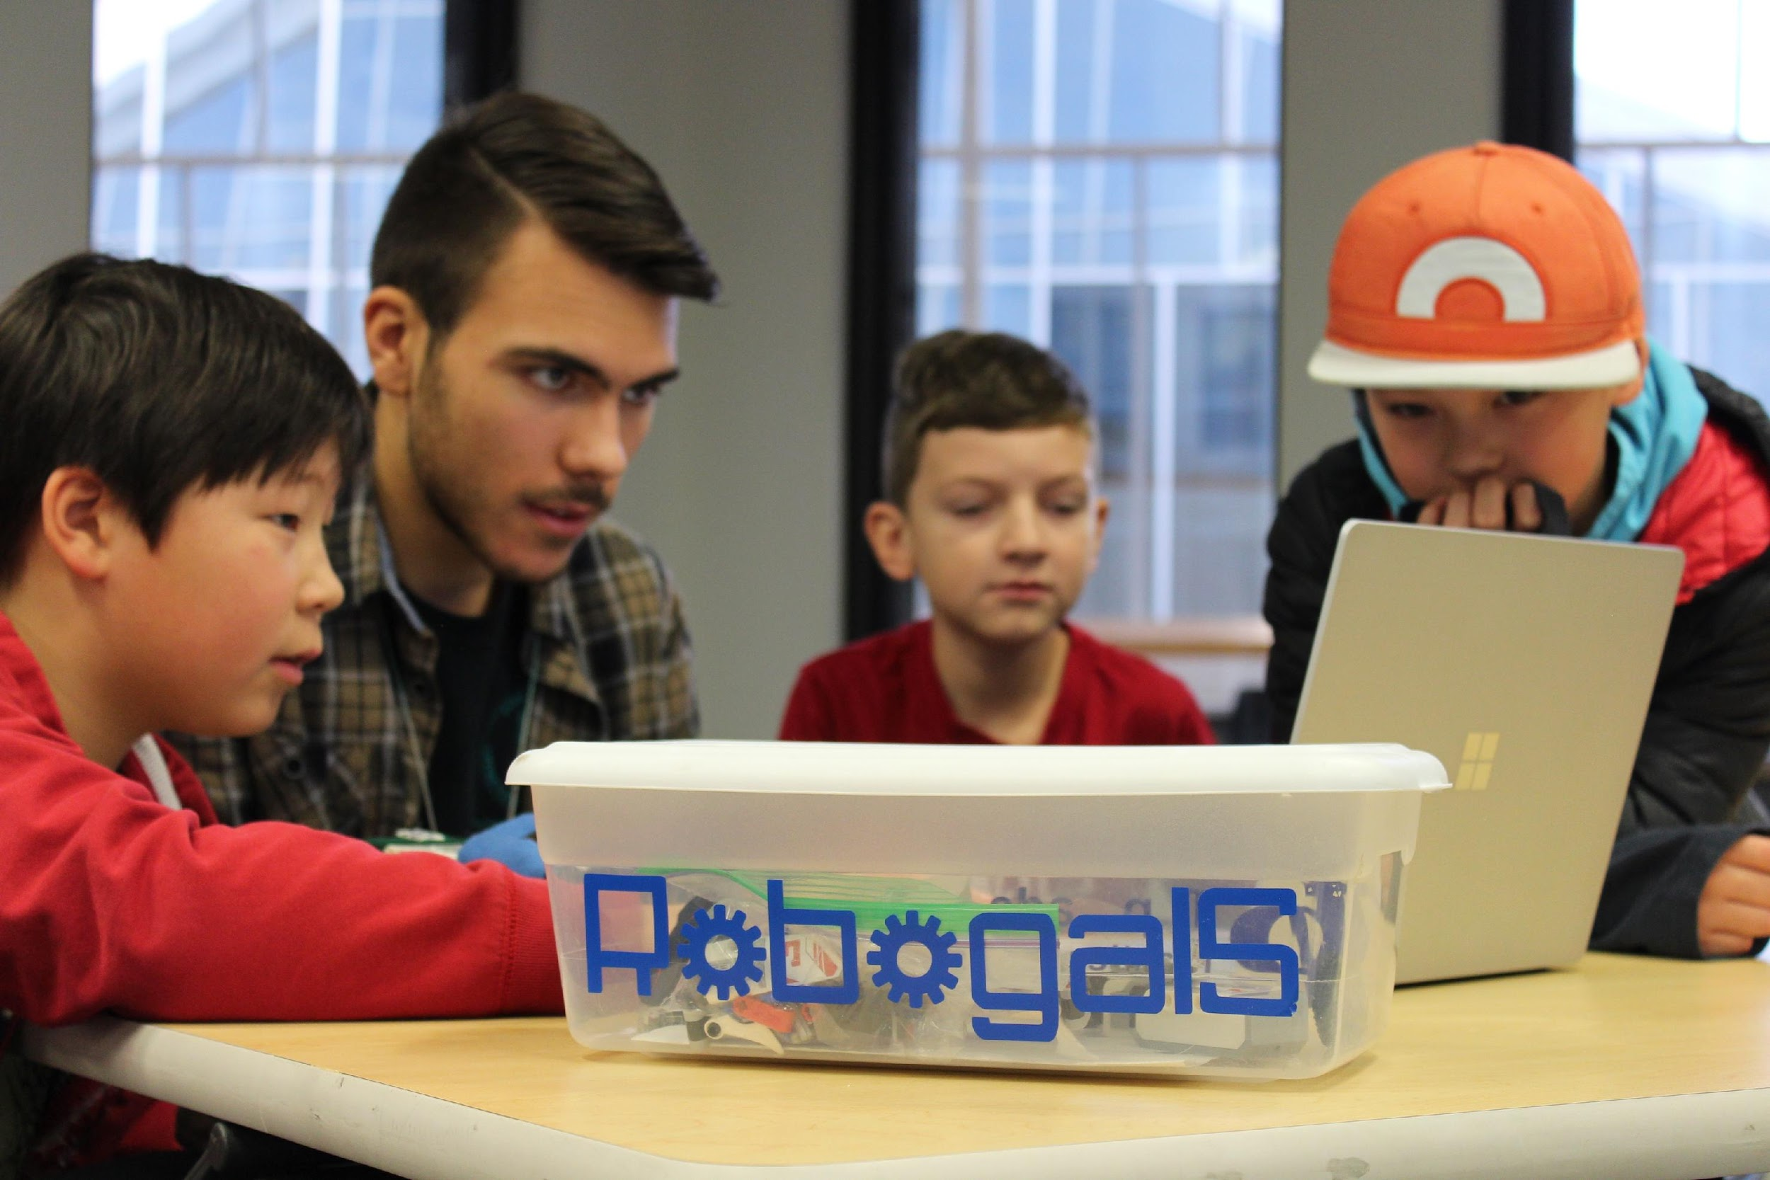
About Us
Robogals is an international, student-run organization, and we hold workshops to try to encourage you guys to be interested in STEM.
OUR MISSION:
To Inspire!
To Empower!
To Engage!
Notes:
Have any of you guys heard of Robogals before?
Robogals is an international, student-run organization. Our mission is to INSPIRE, EMPOWER, AND ENGAGE you by showing you how interesting and fun these topics can be!
We hold workshops in school like this one and in libraries to try to encourage you guys to be interested in STEM (or Science, Technology, Engineering and Math) and overall to promote diversity in these areas!
We are all University of Calgary students, here to volunteer with you guys! Many of us are in engineering but we have volunteers studying biology, chemistry or computer science!

Slide 3
STEM
What Does STEM Stand For?
Notes:
STEM stands for…
Science: a system of studying, testing, and experimenting on things in nature. Science is a search for general laws about how the world works.
Give EX. biology, chemistry (how things are composed), physics, astronomy, meteorology, zoology
Astrology: The study of the movements and relative positions of celestial bodies.
Biology: The study of living organisms. Many specialized fields within biology including: morphology, physiology, anatomy, behaviour, etc.
Botany: The science of plants, one of the branches of biology.
Chemistry: Deals with identifying the substances of which matter is composed; the investigation of their properties and the ways in which they interact, combine, and change; and the use of these processes to form new substances.
Geology: Deals with the earth’s physical structure and substance, its history and the processes that act on it.
Meteorology: Concerned with processes and phenomena of the atmosphere; Think of weather forecasters.
Oceanography: Deals with the physical and biological properties and phenomena of the sea.
Physics: Concerned with the nature and properties of matter and energy.
Zoology: The study of the behaviour, structure, physiology, classification, and distribution of animals.
Technology: the use of science invent useful things or solve problems. Anything man-made
EX. chair, computer yo-yo, wheel --. Doesn’t have to be electrical
JOBS: Software developers, Computer Analysts, Web Developers, Inventors
Engineering: Designs and builds complex products, machines, systems, or structures. Engineers want to know how and why things work.
EX: Types of engineering: oil and gas, chemical, civil, mechanical,
Math: Science that explains numbers, quantities, measurements, and the relations between them
Science, technology, engineering all use math

Slide 4
STEM
What are some jobs in STEM?
Chemist
Software Developer
Astronaut
Mechanical Engineer
Try and brainstorm some jobs in STEM that YOU think you would like!

Slide 5
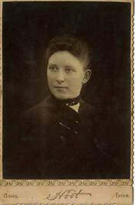
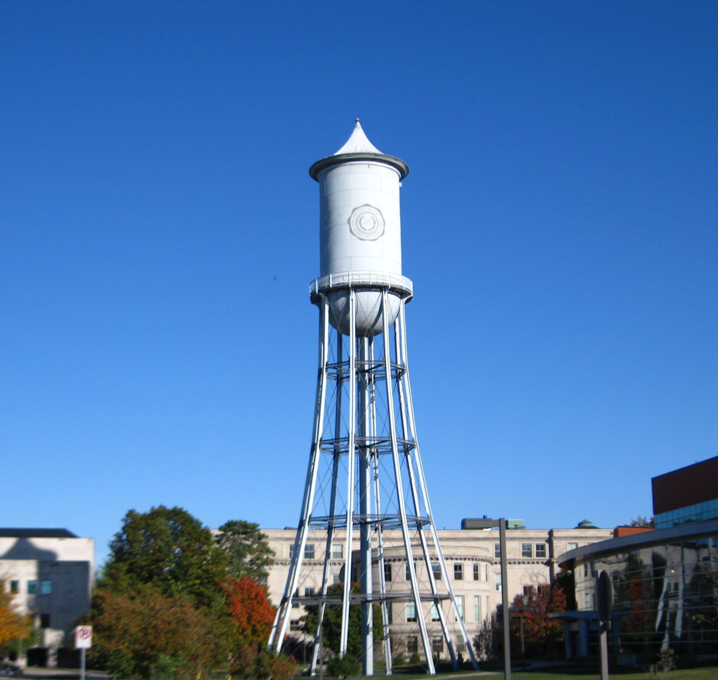
Role Model of the Day: Elmina Wilson
First woman to graduate as a civil engineer
Helped designing a HUGE water tower that was crucial during the 1985 drought in the USA

Slide 6
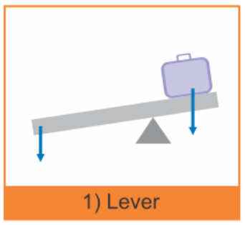
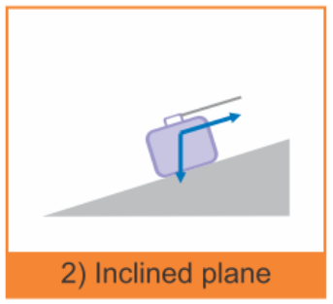
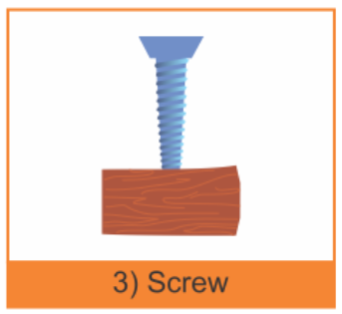
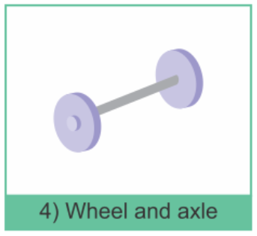
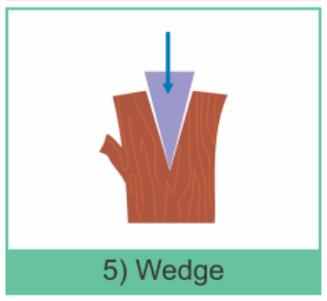
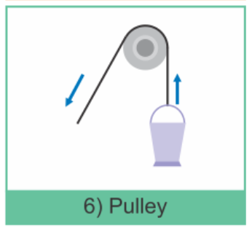
Simple Machines Challenge
This challenge is all about using simple machines, but what are they?

Slide 7
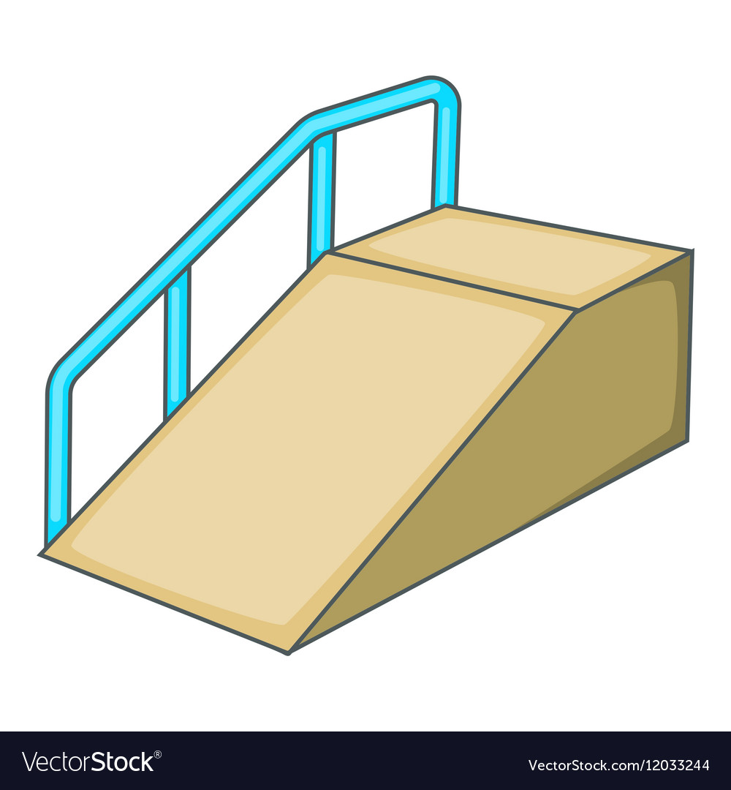
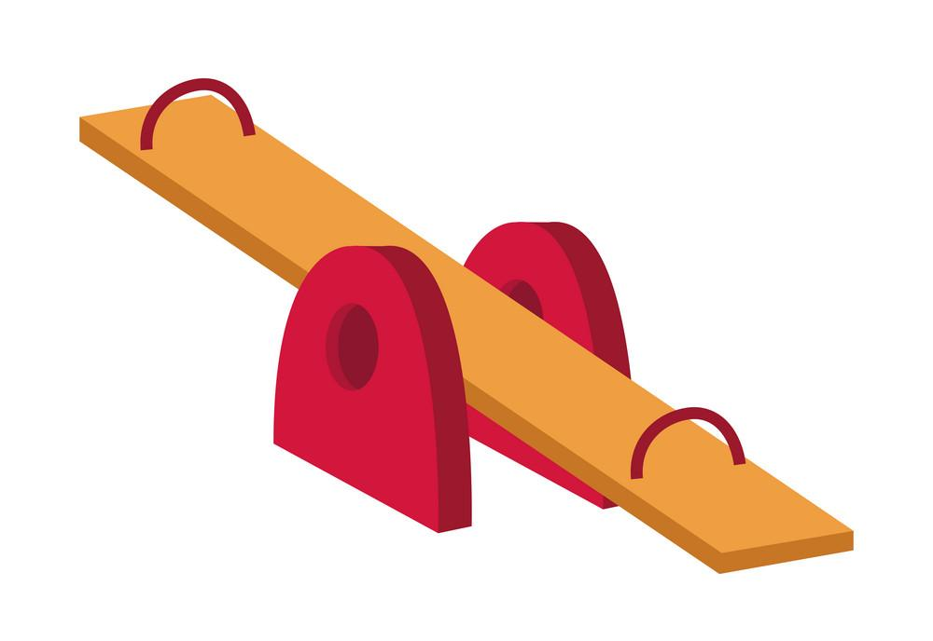
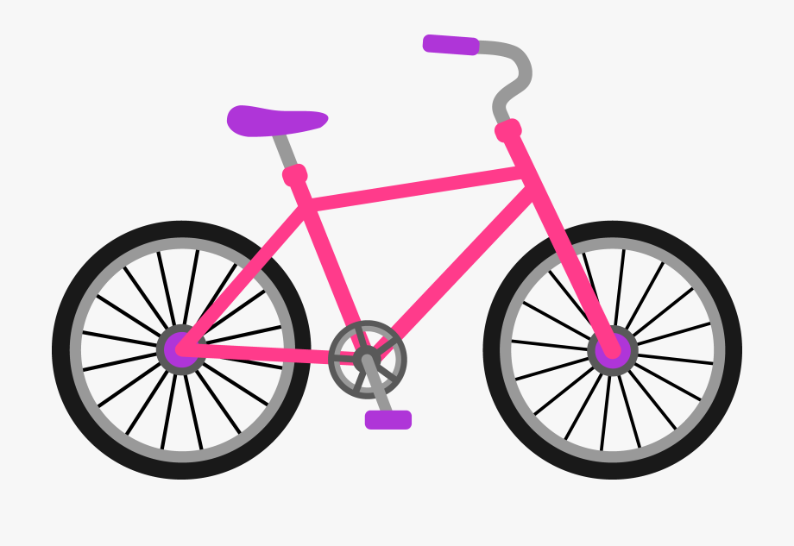
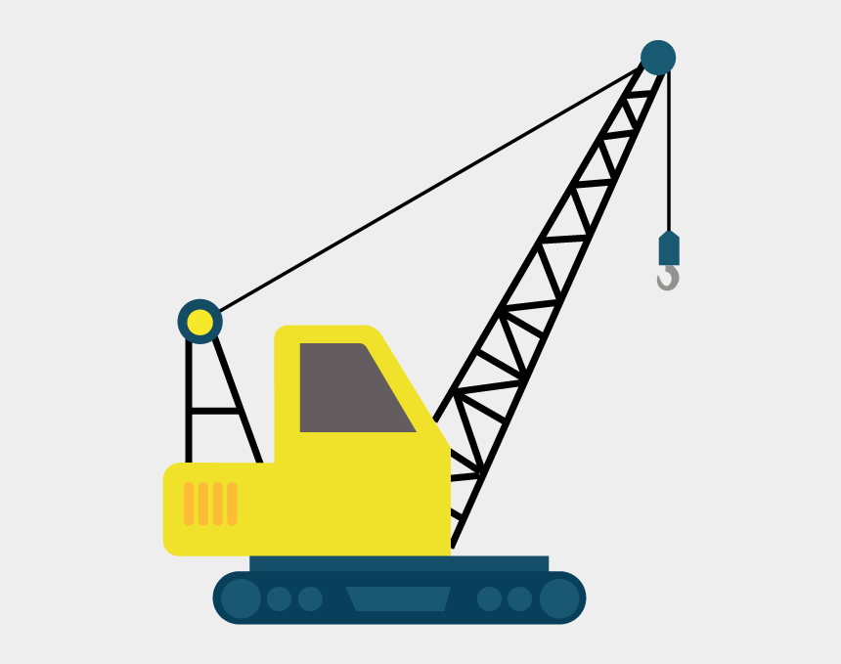
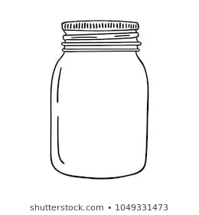
Some Examples
Here are some examples of objects that use each of the simple machines:
Inclined plane: Ramp
Lever: Seesaw
Wedge: Ax
Wheel & Axel: Bike
Pulley: Crane
Screw: Jar Lid

Slide 8
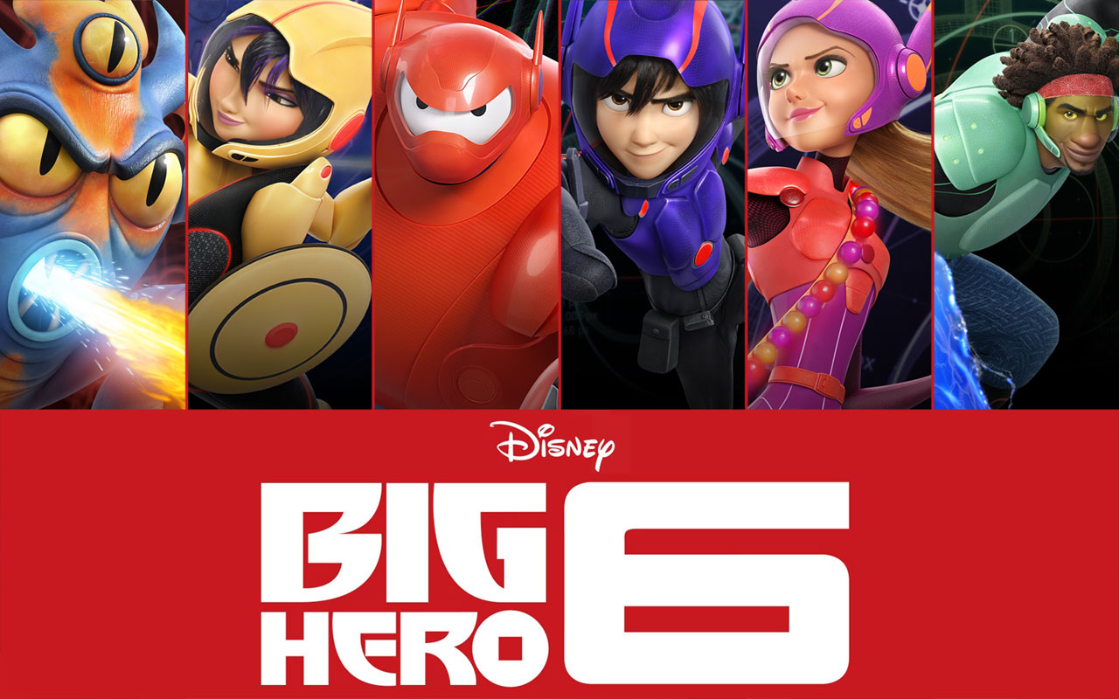
Simple Machines Challenge
Now let's introduce the challenge!
Notes:
So now for the main event: our simple machine challenge!
ask if they’ve heard of Big Hero 6
ask if they’ve learned the simple machines unit
before we get into the challenge, what are simple machines?

Slide 9
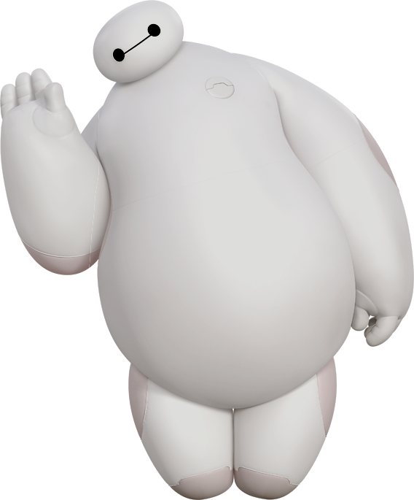
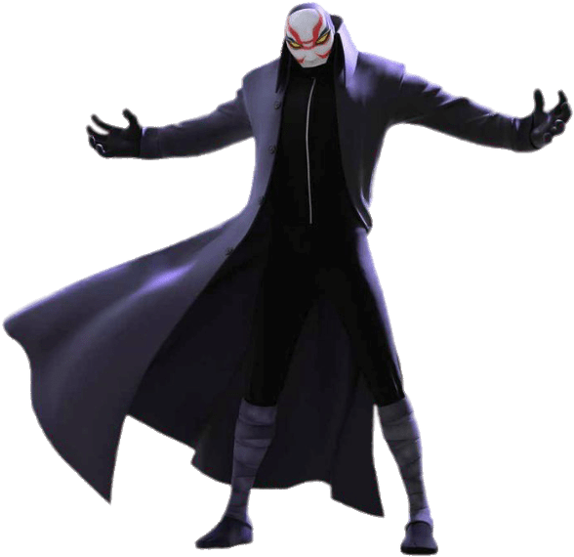
Simple Machines Challenge
Baymax needs your help saving his friend from the villain Yokai!
Baymax cannot transport himself, so YOU have been recruited to build a system of machines that will safely transport Baymax to his friends.
Challenge: build 3 simple machines from household items to transport Baymax.
Notes:
So now for the main event: our simple machine challenge!
ask if they’ve heard of Big Hero 6
ask if they’ve learned the simple machines unit
before we get into the challenge, what are simple machines?

Slide 10
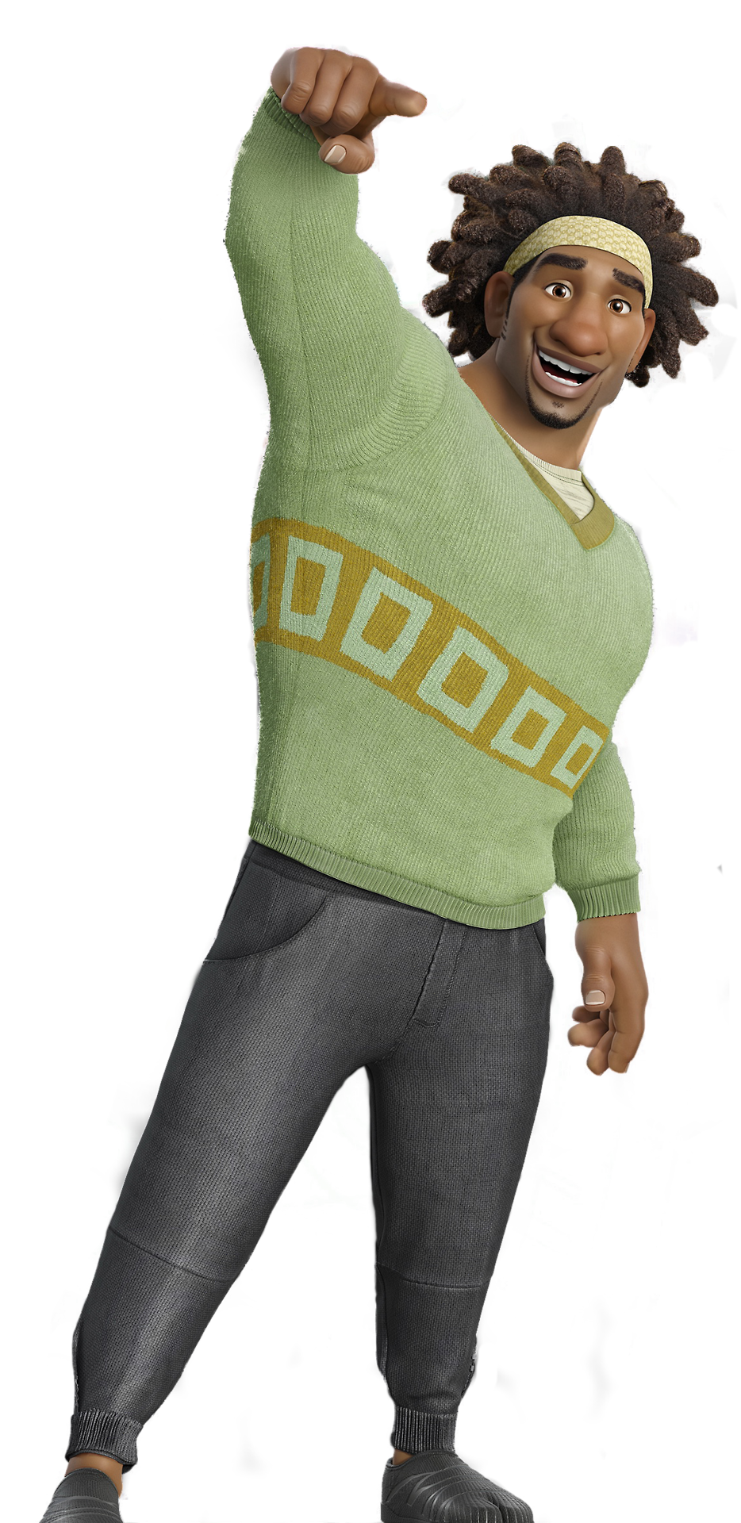
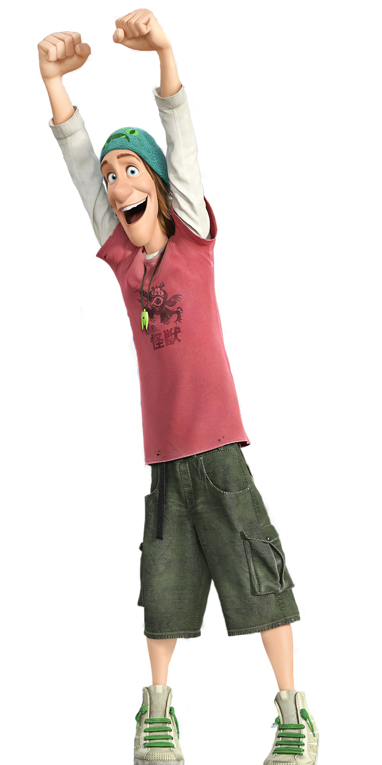
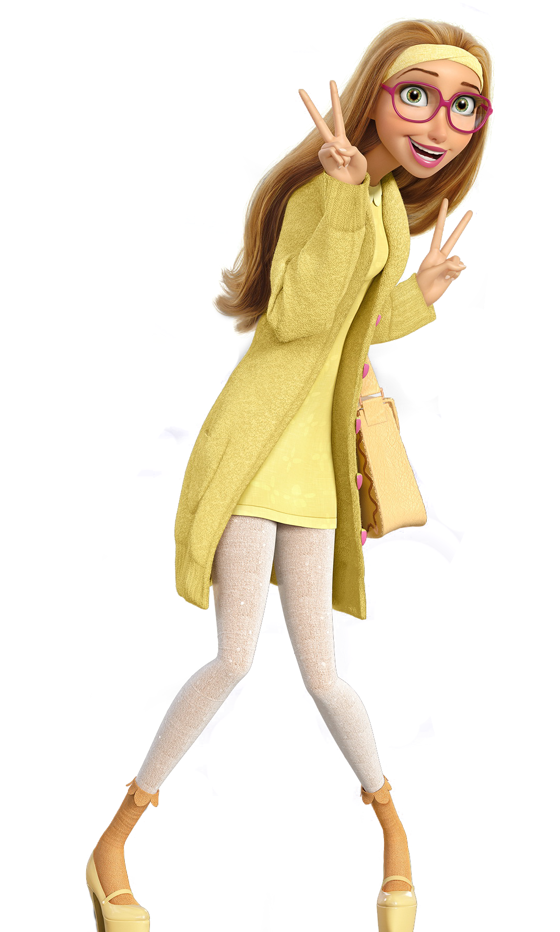
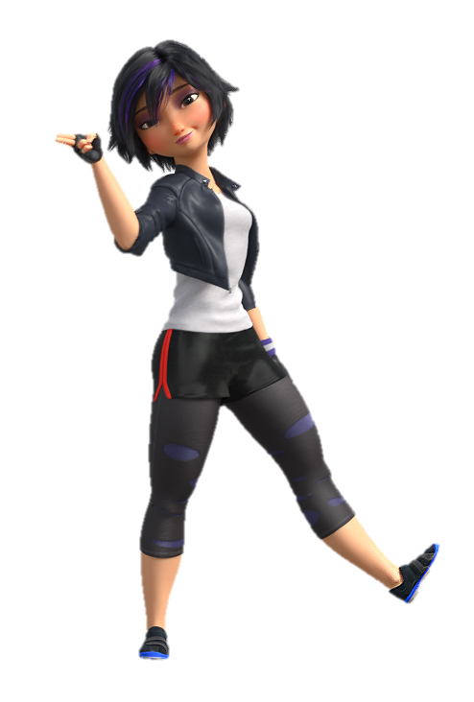
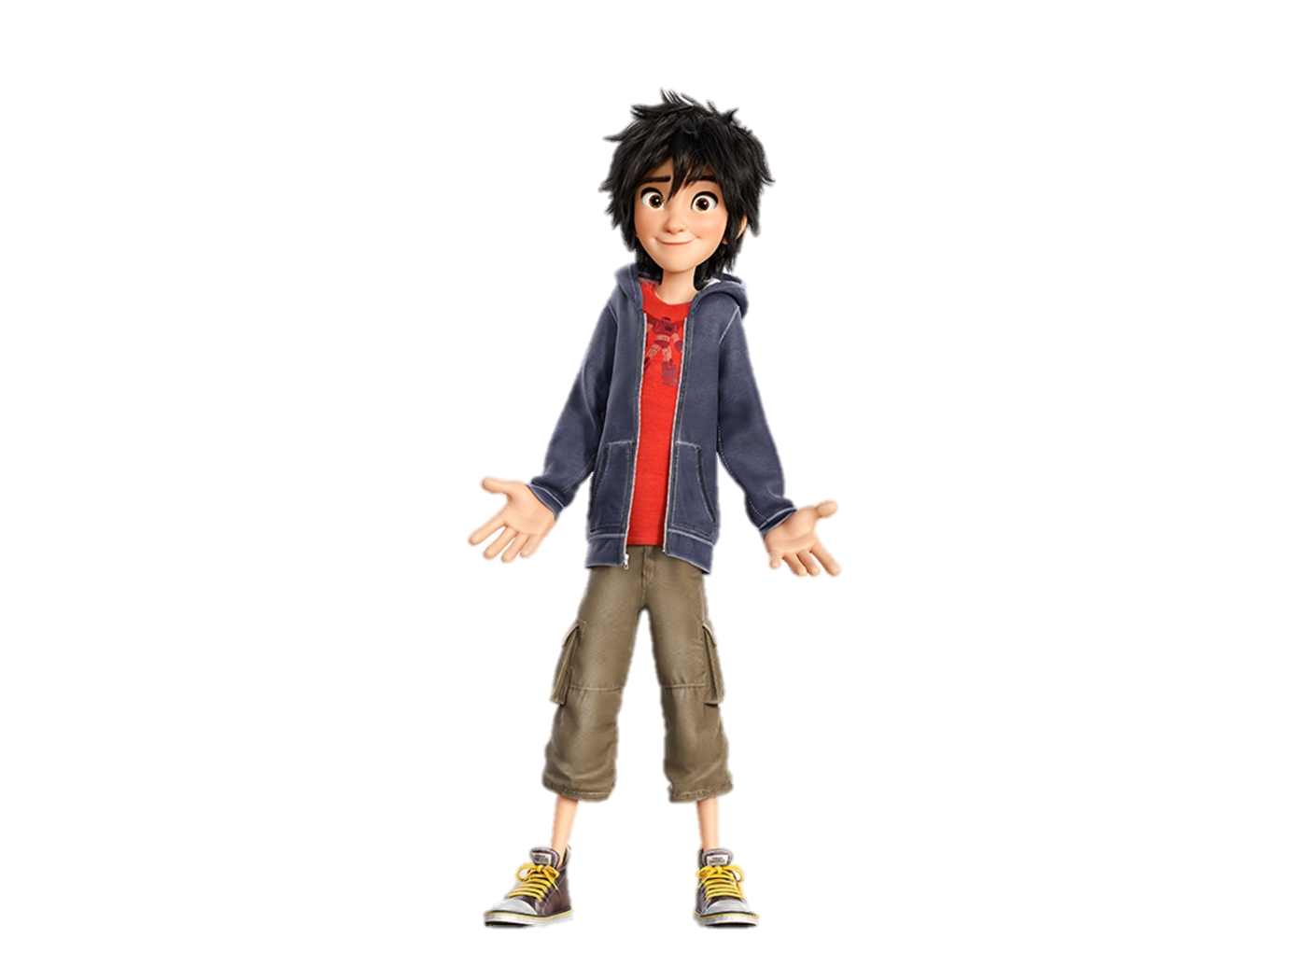
Here’s The Situation
Below are given the locations of Baymax’s friends:
Wasabi & Honey Lemon
Go Go Tomago
& Fred
Baymax
Hiro
50 cm
20 cm
30 cm
On a long table you will need to use tape, a marker, and a ruler to mark off these distances.
Notes:
HELP BAYMAX SAVE HIRO and his friends! Built 3 Simple Machines, placed at the checkpoints. Each simple machine will transport baymax to his friends. (explain Wasabi/Honey Lemon and Go go and Fred, to move Baymax to Hiro)
-All three simple machines should be different for example you can’t have all inclined planes
- Once materials are used, you cannot reuse them for the next checkpoint. For example, if you use popsicle sticks for one simple machine, you can’t take them and use them for another simple machine in your demonstration.
- You may have only one human interaction at the start of every checkpoint (you can push, tap to start the machine)
- You can reposition baymax at every checkpoint.
- Please do not poke or eat or harm baymax in the process.
-IMPORTANT RULE: Okay right now with your team think and choose 3 simple machines you want to build.
We are only giving you a limited amount of supplies, and a limited amount of time, so, 50 minutes, to build your simple machine because, in the real world, engineers have these types of constraints for projects.
Have fun and YOU HAVE 50 MINS

Slide 11
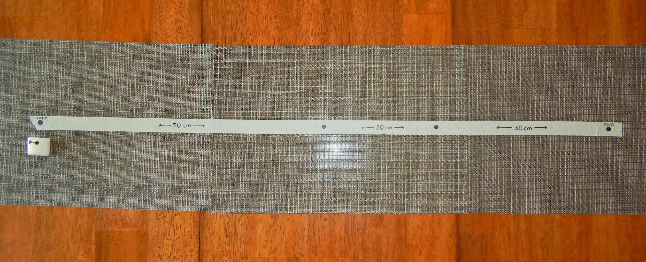
The Setup
WASABI & HONEY LEMON
GOGO TAMAGO & FRED
STEP 1
STEP 2
STEP 3
BAYMAX
HIRO

Slide 12
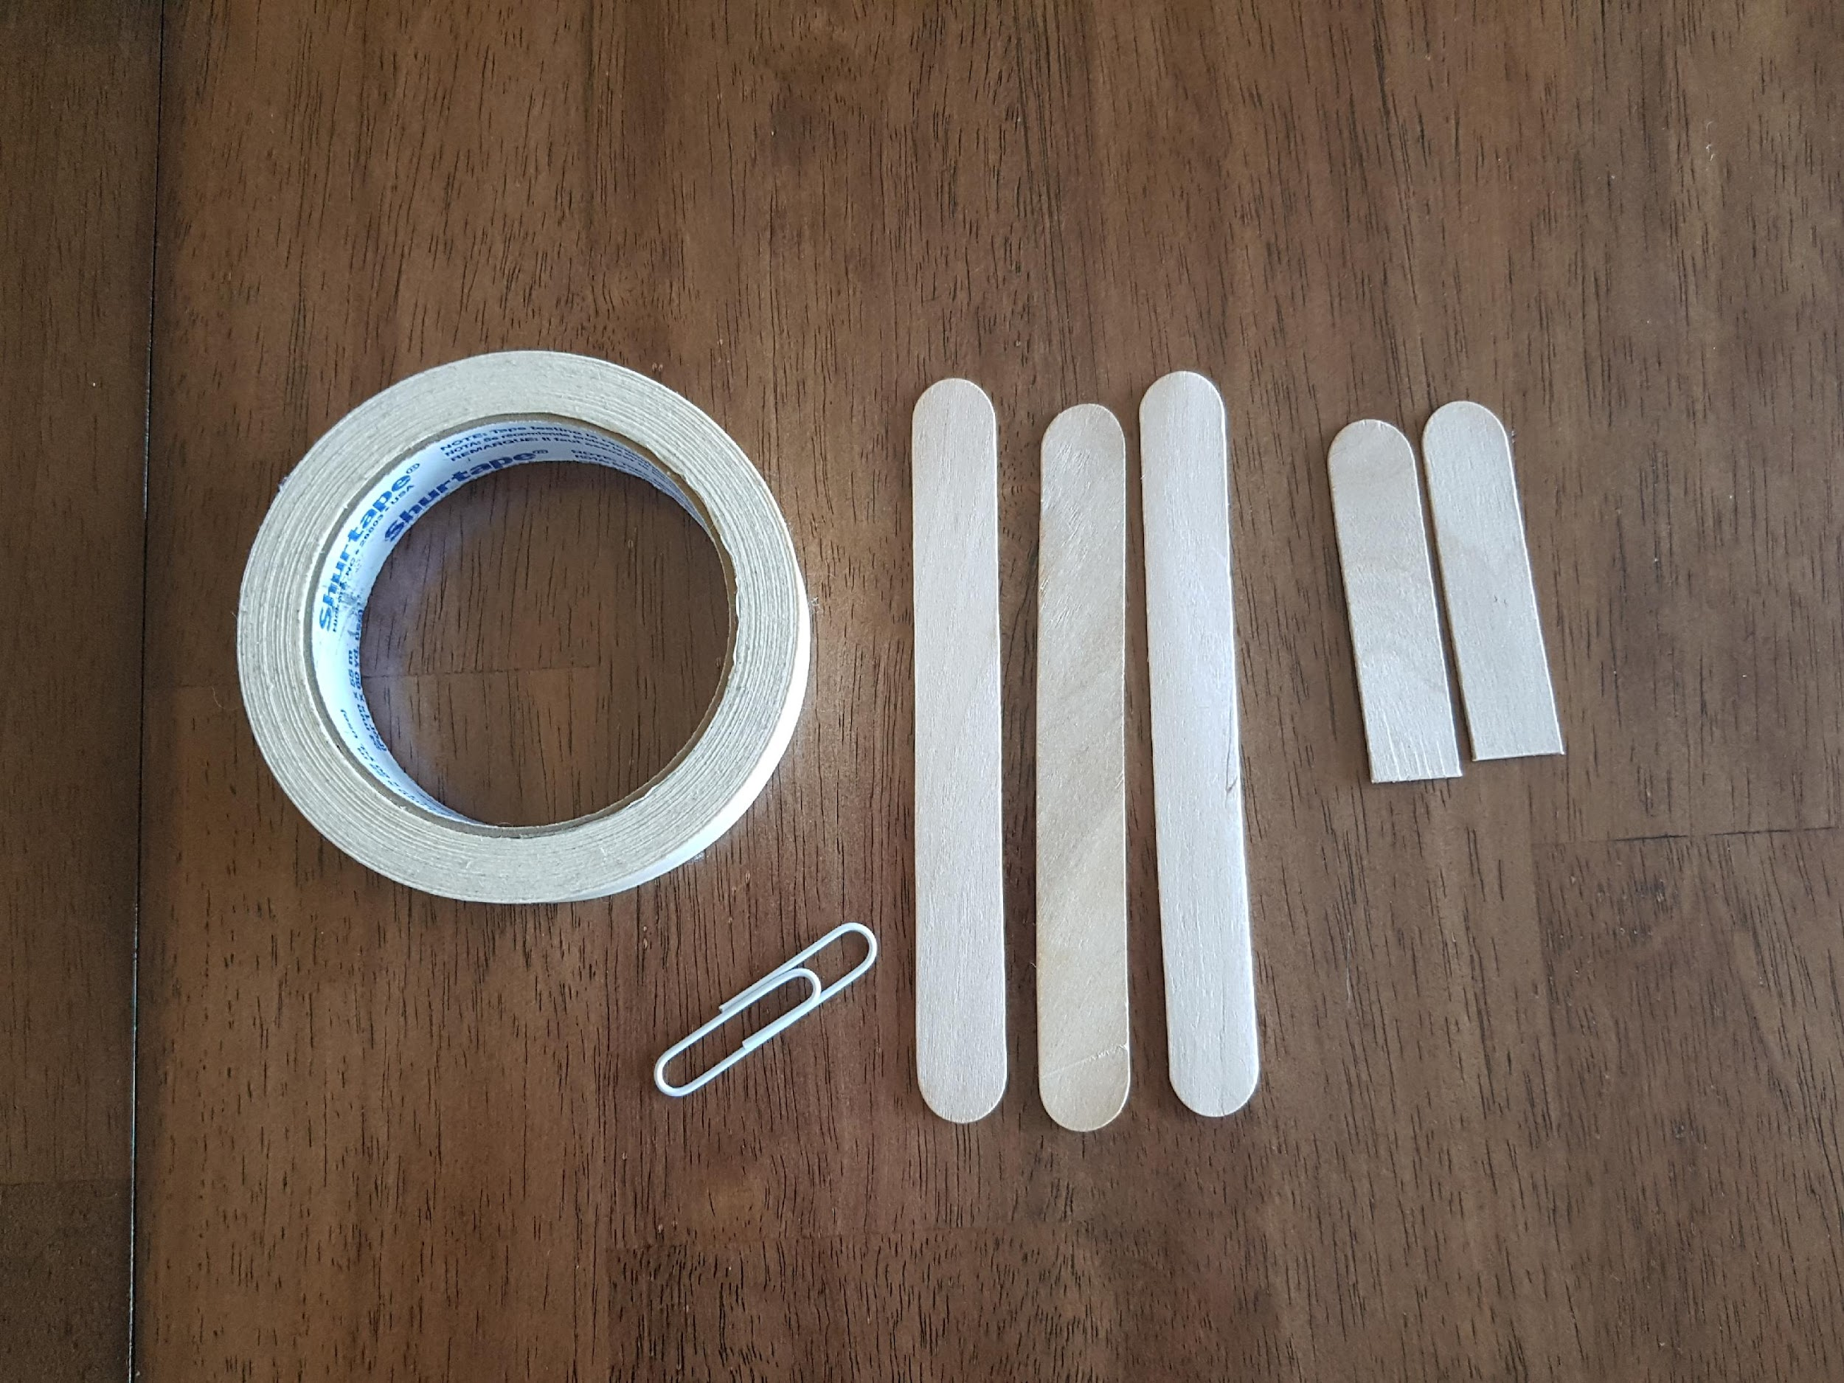
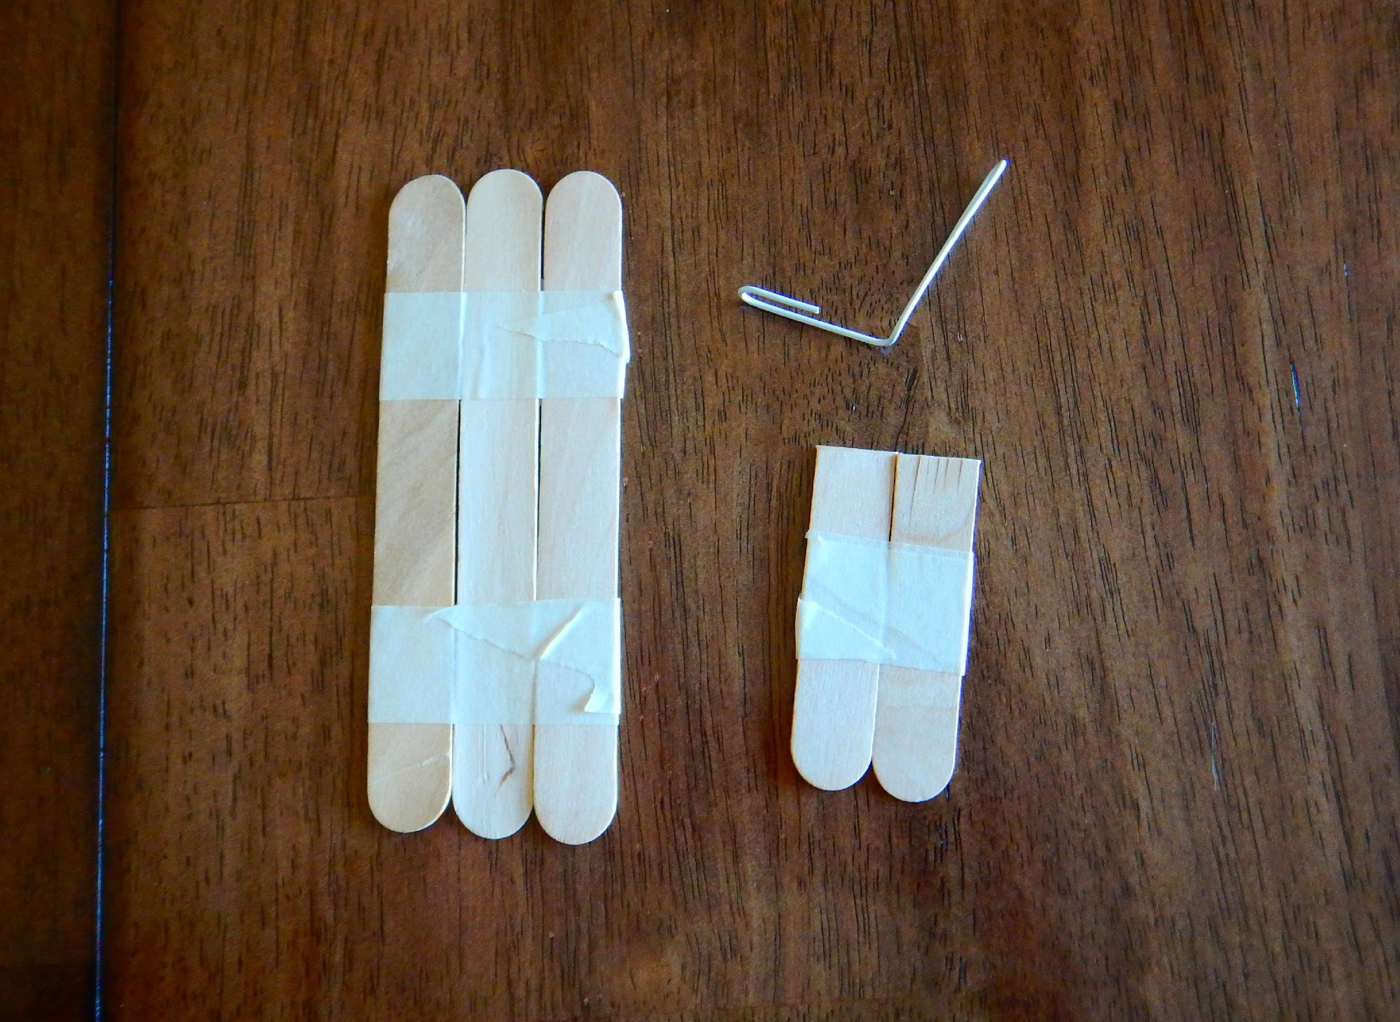
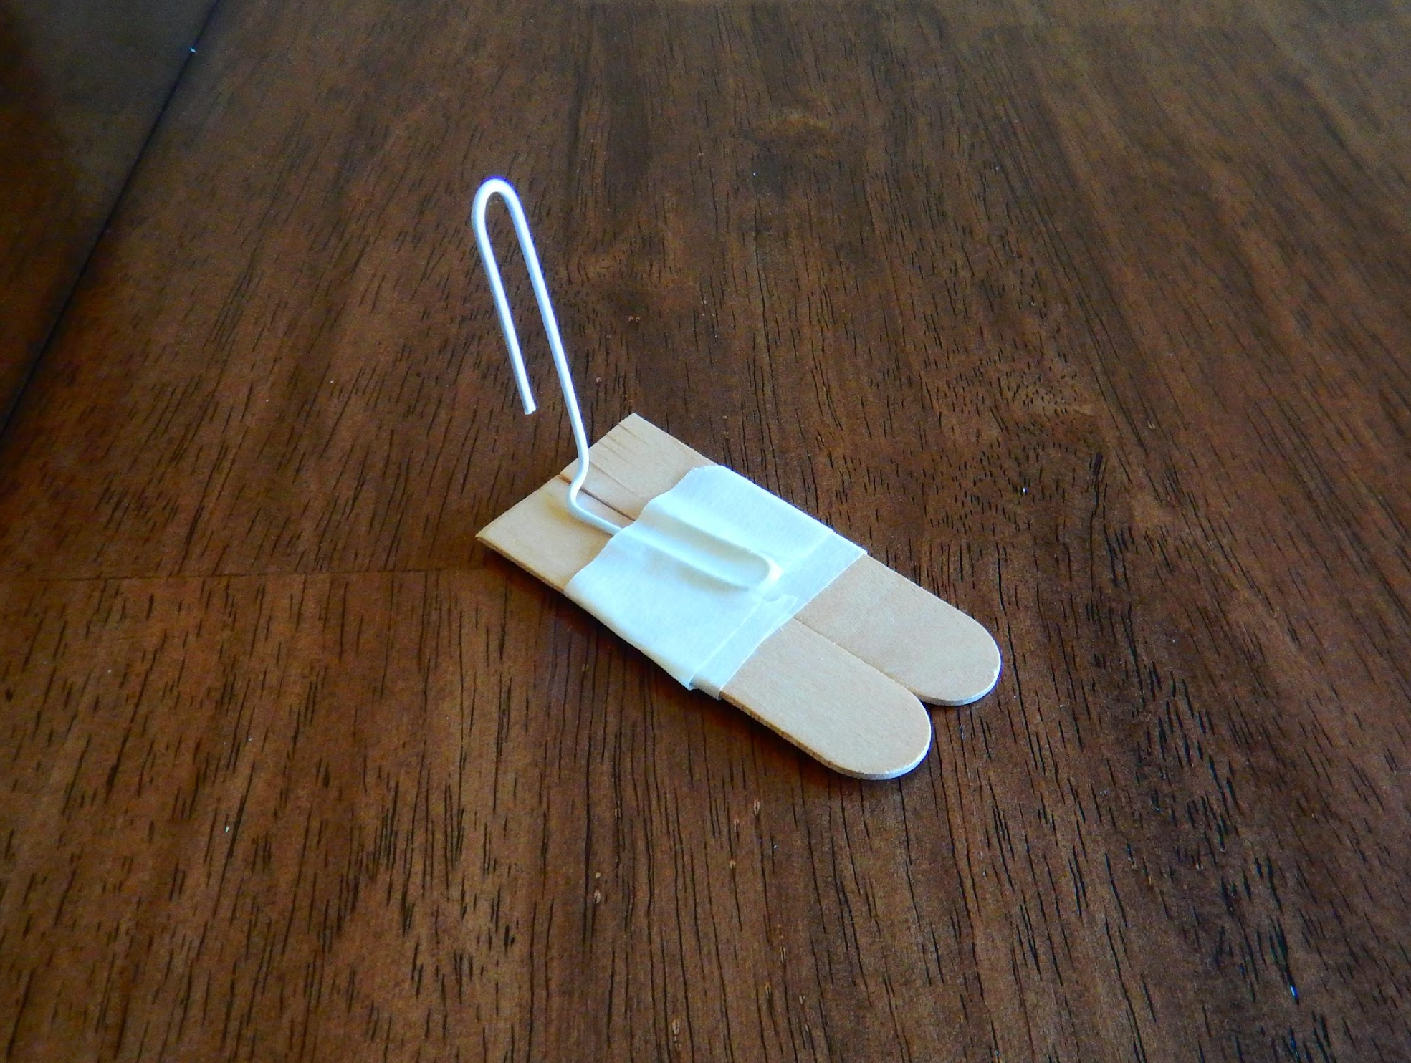
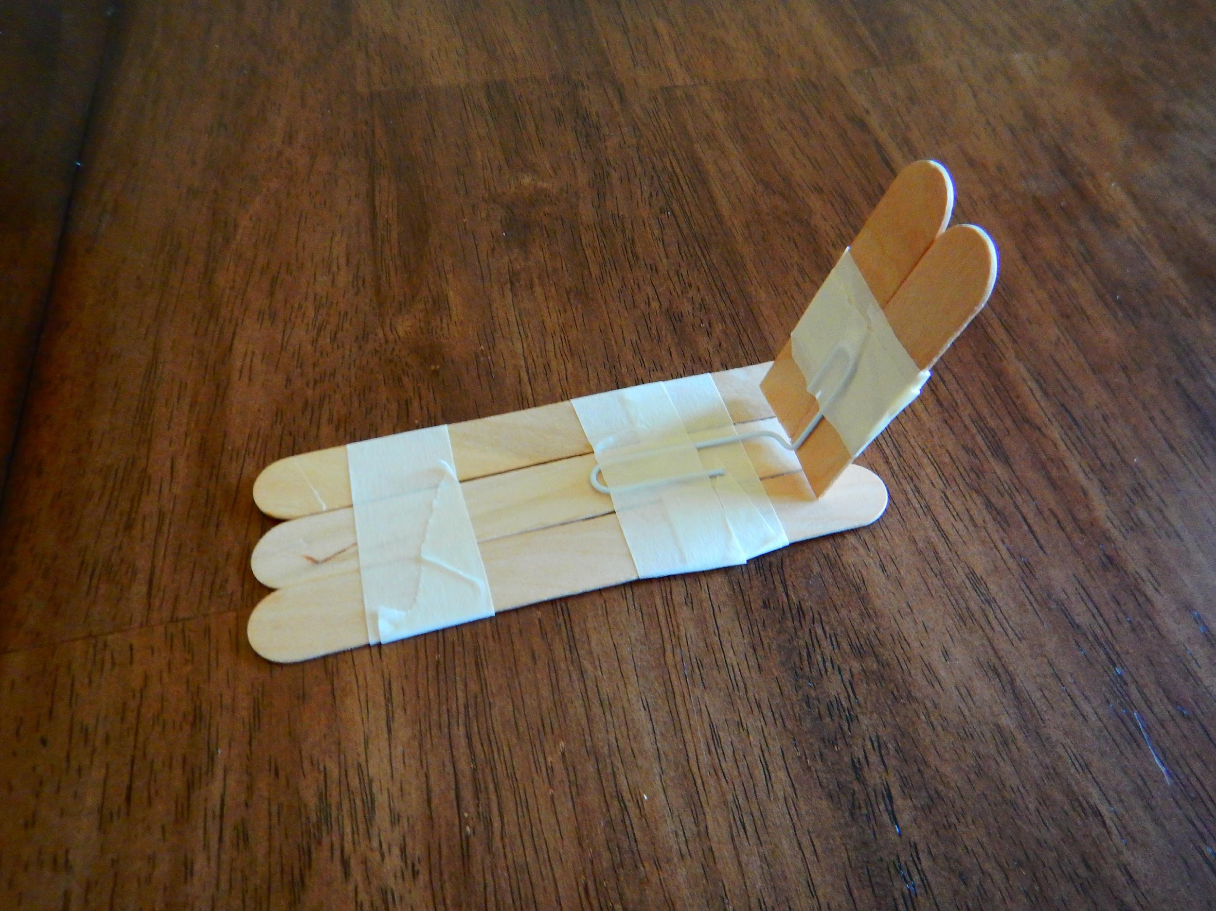
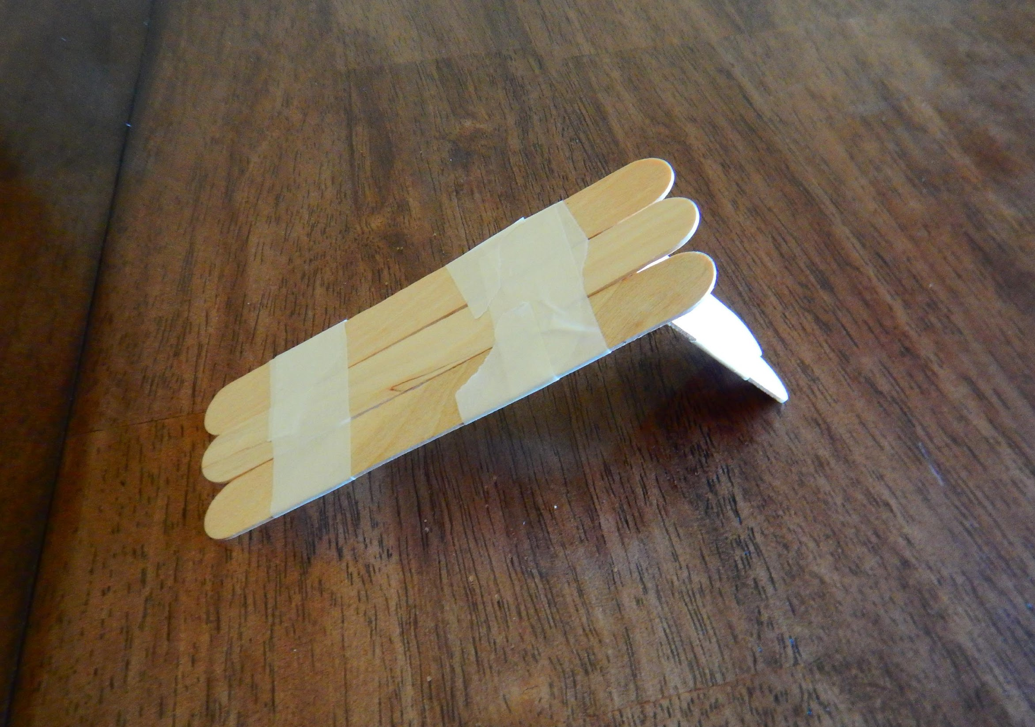
Example
Here is an example of one we built. We used the simple machine: inclined plane, to make a slide!
1
2
3
4
5
Finished product!

Slide 13
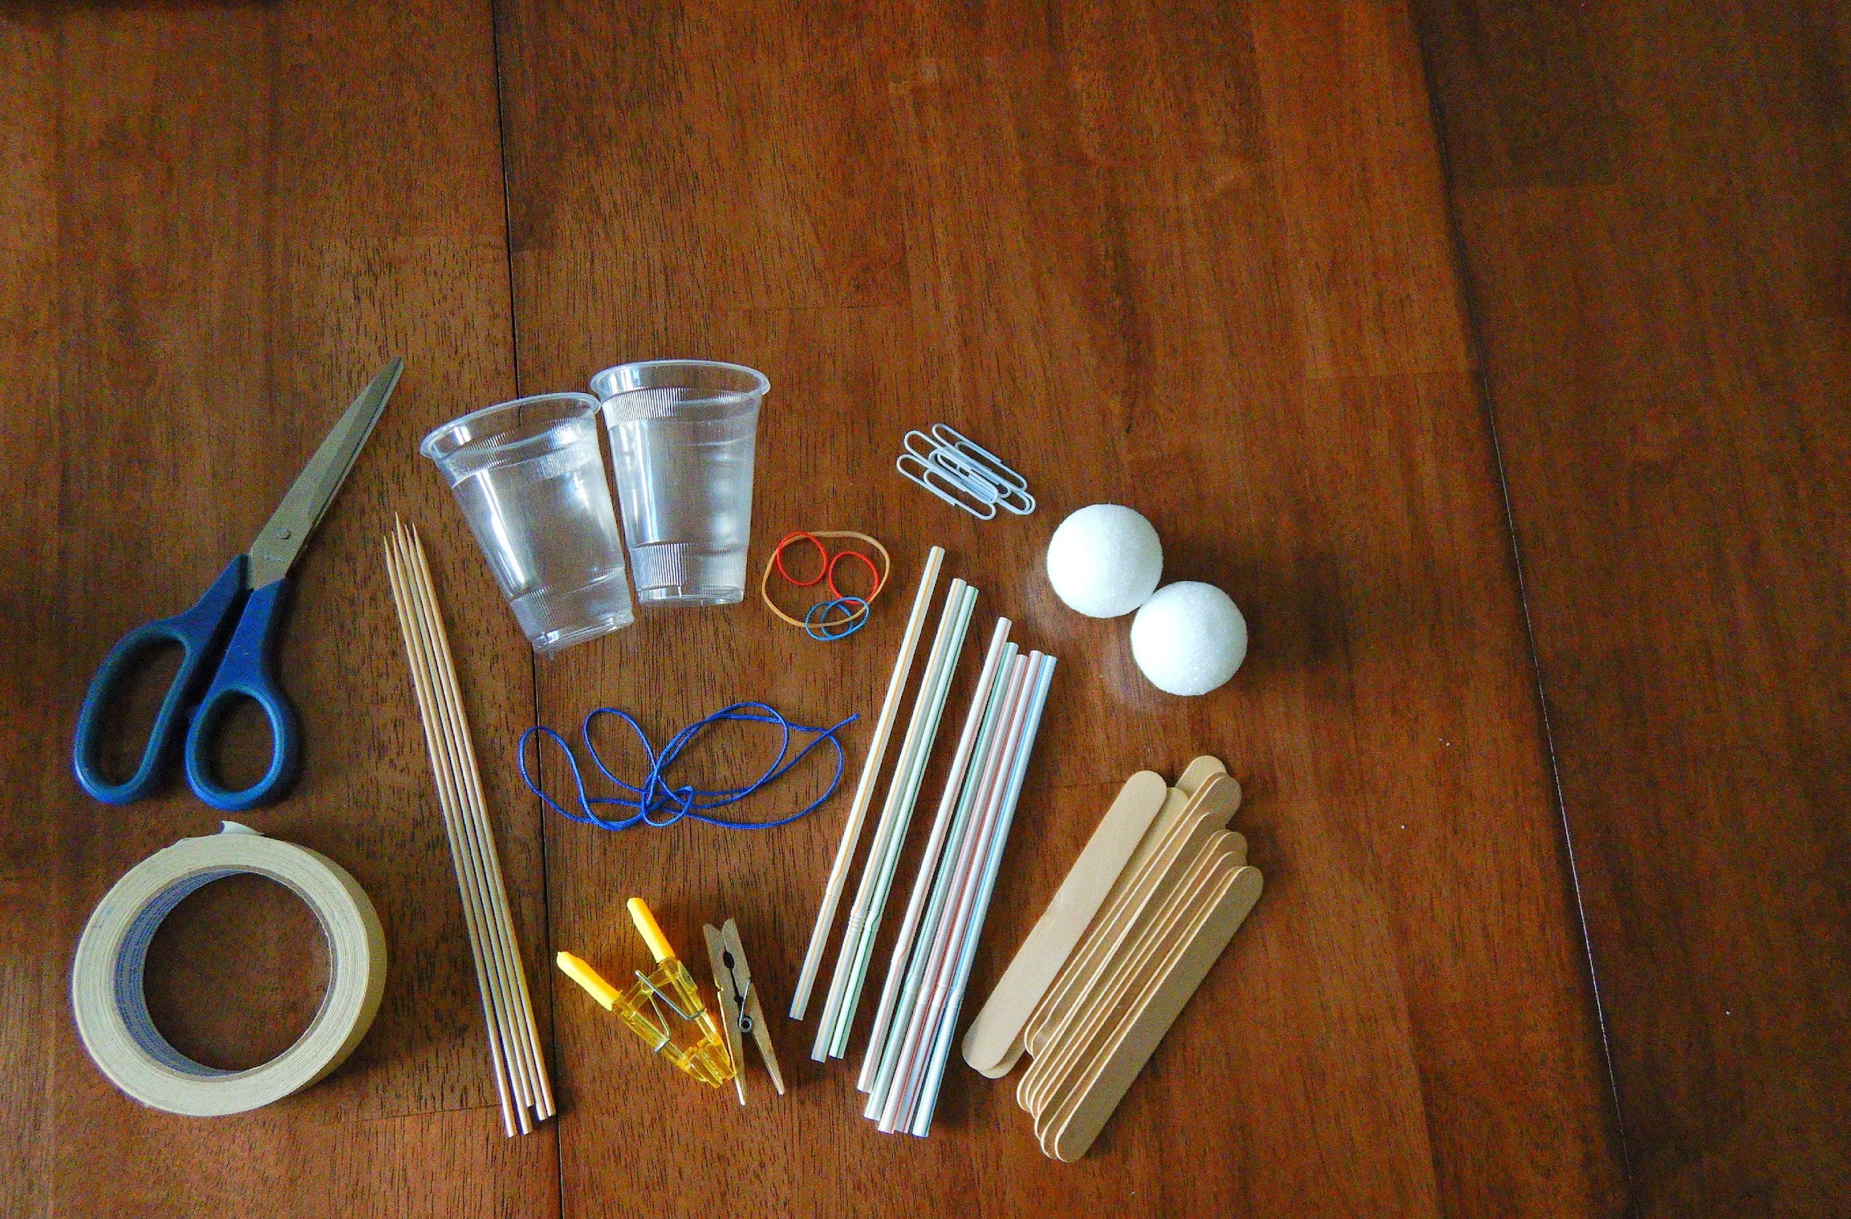
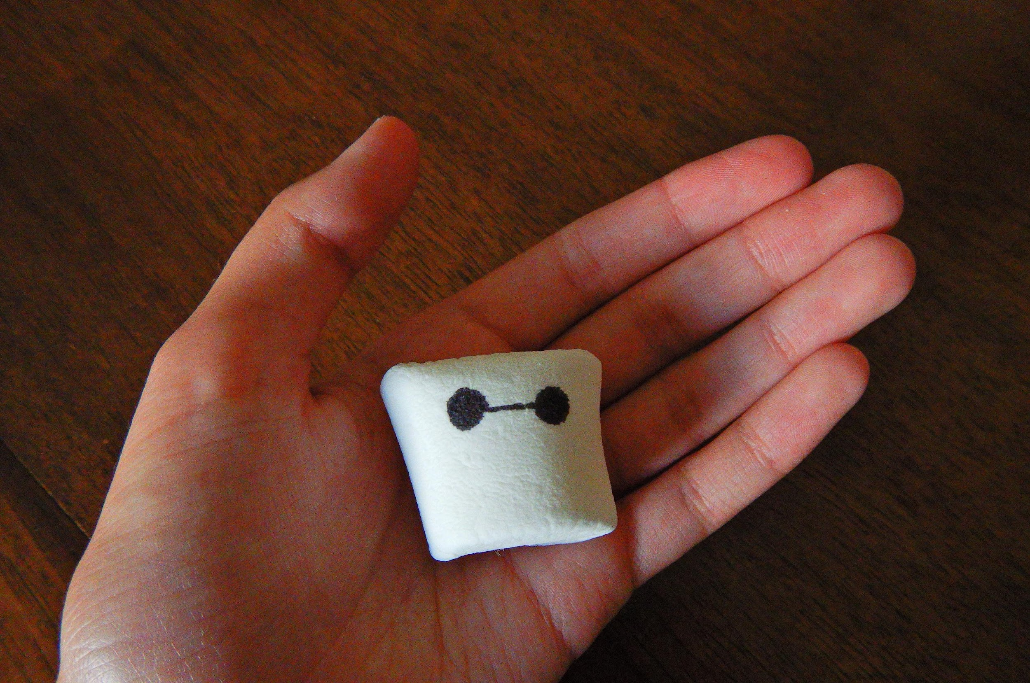
Materials
Popsicle sticks (20)
Elastic bands (10)
String (50 cm)
Tape (1 m)
Straws/
Pipe Cleaners (4)
Skewer sticks (4)
Paper clips (5)
Styrofoam cups (2)
Styrofoam balls (4)
Clothespins (2)
Marshmallow (1)

Slide 14
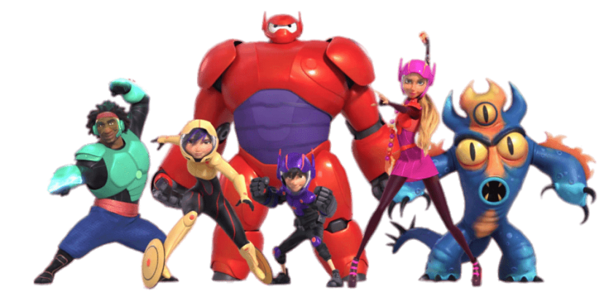
Rules
RULE 1: All three simple machines should be different.
RULE 2: Once materials are used, you cannot reuse them for the next checkpoint.
RULE 3: You may have only one human interaction at the start of every checkpoint. This means either a push, a tap, or one consistent pull.
RULE 4: You can reposition Baymax at every checkpoint.

Slide 15
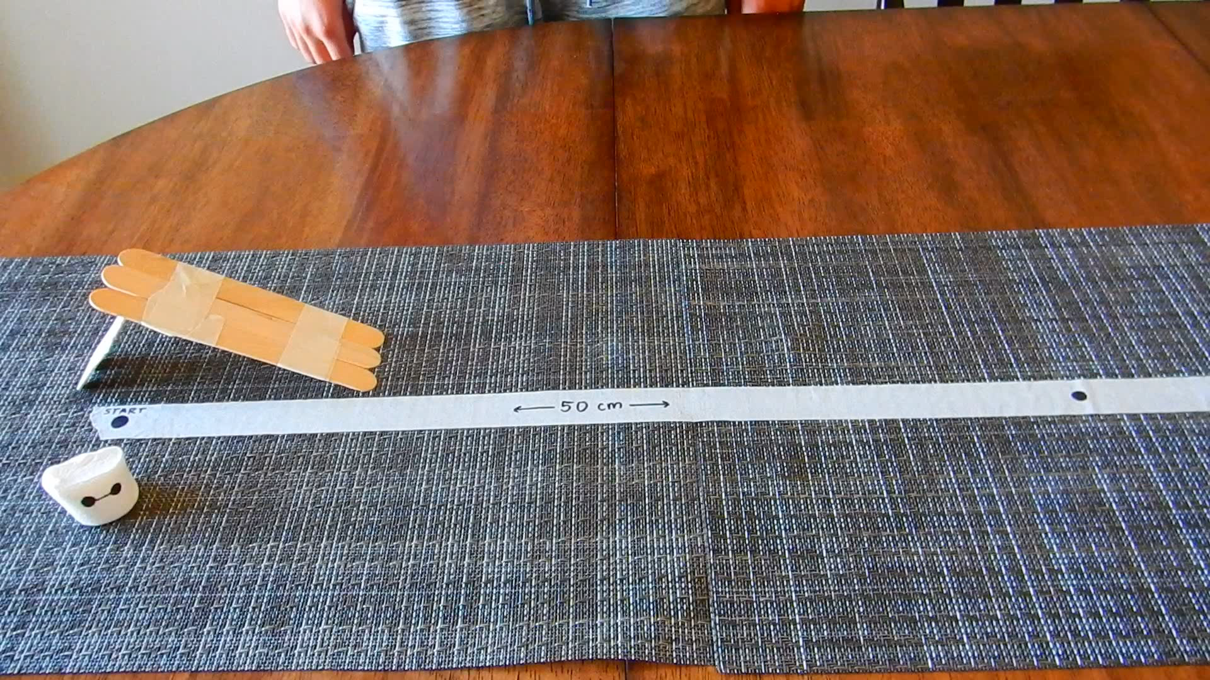
Example
Here is a video of the machine in action!

